Slide 1
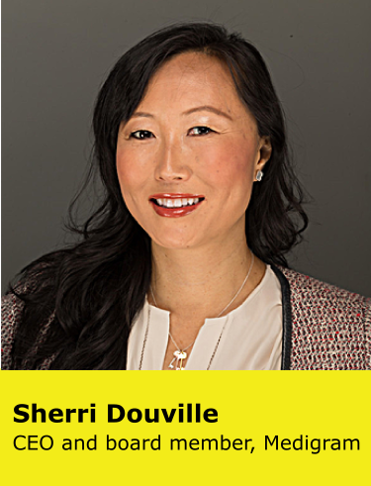
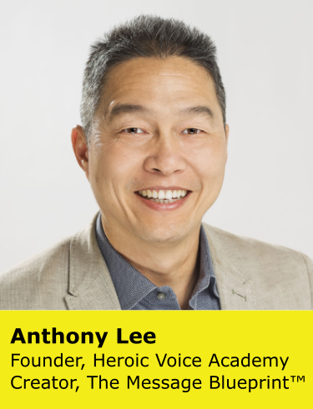
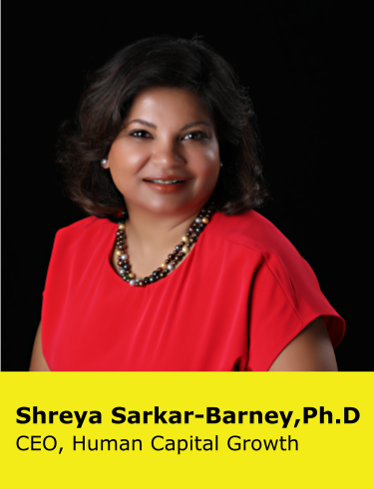


COMPLIMENTARY WORKSHOP
How to Deliver a Town Hall Presentation During Times of Uncertainty
April 28th | 8:30 am - 10 am PT
Brought to you by in partnership with the
Notes:
4/22

Slide 2



















We help organizations achieve better outcomes through talent using
science, analytics, and empathy.
Talent Management Excellence
Leadership Excellence
Drive business impact through timely talent actions
Deliver measurable and sustained improvements in leadership

Slide 3
Sources of Fear and Uncertainty
Stakeholders (4 Cs) | Concerns
Colleagues | Emotional and physical well-being Livelihood Work
Customers | Serviceability Supply chain Pricing
Company shareholder | Earnings call Earnings forecast Dividends
Community | Emergency supplies Economic well-being

Slide 4
Dashboard
Stakeholders | Concerns | Impacted | Not Impacted
Colleagues | Emotional and physical well-being Livelihood Work
Customers | Serviceability Supply chain Pricing
Company shareholder | Earnings call Earnings forecast Dividends | X
Community | Emergency supplies Economic well-being | X X

Slide 5
Plan
Stakeholders | Concerns | Immediate | Medium-term | Long-term
Colleagues | Emotional and physical well-being Livelihood Work
Customers | Serviceability Supply chain Pricing
Company shareholder | Earnings call Earnings forecast Dividends
Community | Emergency supplies Economic well-being

Slide 6
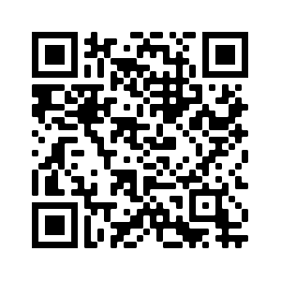
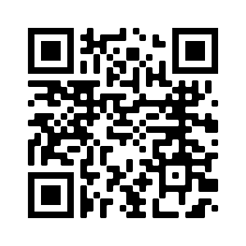
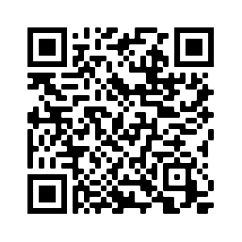
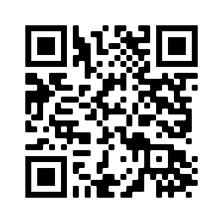
Our Thought Leadership
WEBINARS
BLOGS
PODCASTS
eBOOKS
Exponential Talent

Slide 7
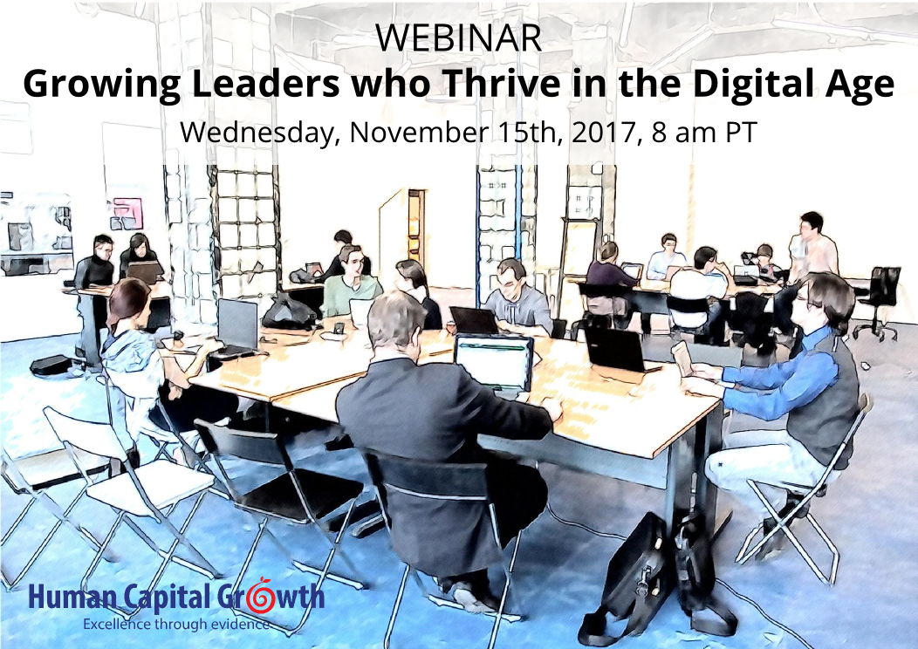
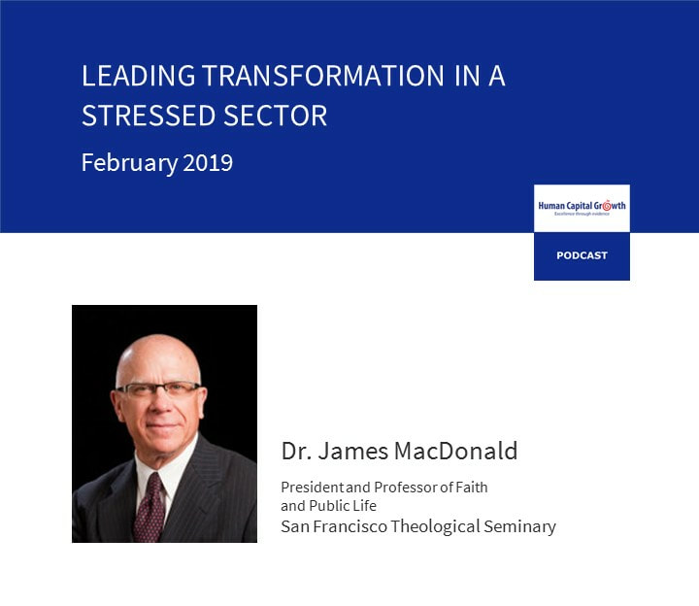

You May Also be interested in These Resources
The Unlikely Leader Behavior That Drives Team Performance
Corey Grantham
Webinar
Podcast
Blog

Slide 8
THANK YOU!
Stay Connected
HCG Talent Updates
SIGN-UP
Evidence-based insights on trending topics in talent management
WEBINARS, PODCASTS, BLOGS, EBOOKS
FOLLOW US
www.linkedin.com/company/human-capital-growth
@hcgtm
insights@humancapitalgrowth.com

