Slide 1
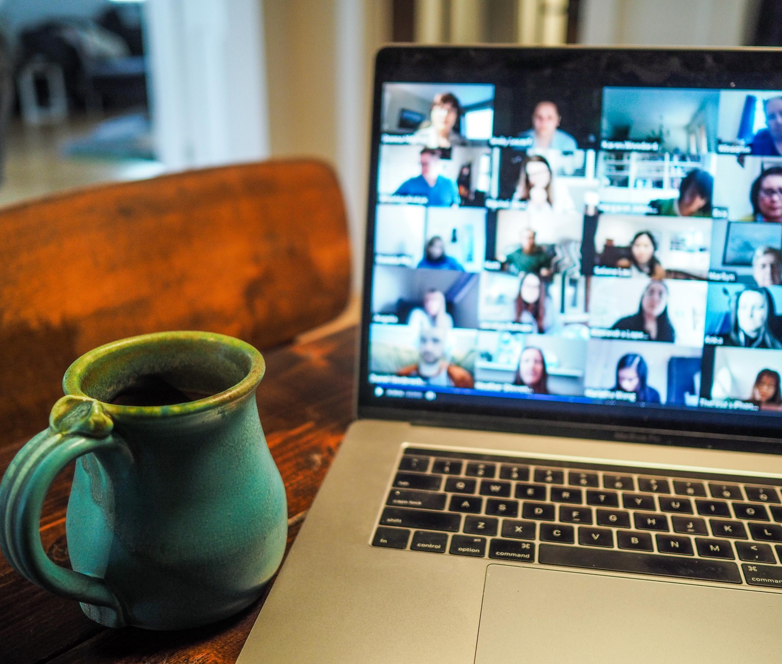
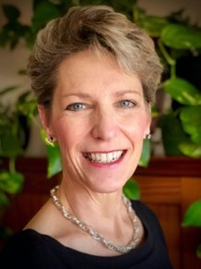


Public Webinar
The Business Case for Remote Work
After the Pandemic
September 23rd, 2020 | 9 AM Pacific Time
Guest Speaker
Kate Lister
President
Webinar Hosted by

Slide 2
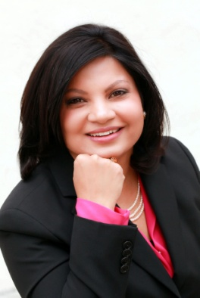

Host
Guest Speaker
© 2020. Copyright Human Capital Growth. All Rights Reserved.
Dr. Shreya Sarkar-Barney
Kate Lister
Founder and CEO
President
2

Slide 3


















We help organizations achieve better outcomes through talent using
science, analytics, and empathy.
Talent Management Excellence
Leadership Excellence
Drive business impact through timely talent actions
Deliver measurable and sustained improvements in leadership
© 2020. Copyright Human Capital Growth. All Rights Reserved.
3

Slide 4






Evidence-based Analyses
Webinars, Podcasts, Blogs, eBooks
Trending Practices
Systematic Reviews
Skills for the new world of HR
Design Thinking in HR
Digital Leadership
Developing Resilience
Internal Gig Economy
Talent Analytics
Talent Management in Times of Crisis
Performance Management
Employee Engagement
Talent Development
Executive Coaching
Moving the Needle on Inclusion
© 2020. Copyright Human Capital Growth. All Rights Reserved.
4

Slide 5
Certification Tracks in Strategic HR
Comprehensive certification for strategic HR Professionals in client partnering roles
New!
Earn a Certification in Data Science for HR I (CDS-HRi)
Certified Talent Management Practitioner (CTMP)
Certified Talent Management Specialist
(CTMS)
Specializations for designers and implementer of talent management systems
Certified in Data Science for HR i
(CDS-HRi)
© 2020. Copyright Human Capital Growth. All Rights Reserved.
Certified in Workforce
Staffing
(CWS)
Certified in Workforce
Development
(CWD)
Certified in Workforce
Management
(CWM)
Certified in Organizational Effectiveness
(COE)
Focused certifications on specific talent management practices
Certified in
Talent Acquisition
(CTA)
Certified in Leadership
Development
(CLD)
Certified in Workforce
Analytics
(CWA)
Certified in Workforce
Planning
(CWP)
Certified in Change Management
(CCM)
Certified in Employee Engagement
(CEE)
Curriculum design and certification informed by our expert panel
5

Slide 6










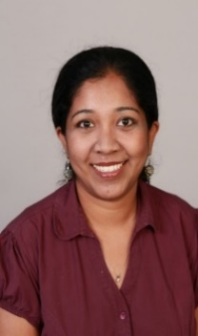
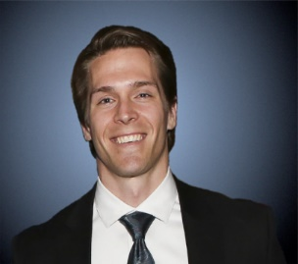

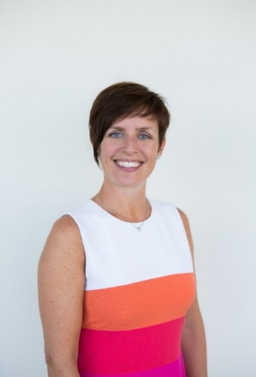

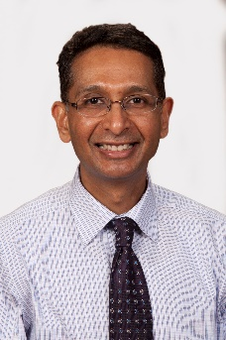






HCG Expert Panelists
Insights on needs and trending practices
Ramzi Baydoun, Ph.D.
​
Victoria A. Davis, Ph.D.
Fm
Liberty Munson, Ph.D.
Eric O’Rourke, Ph.D.
Neha Singla Ph.D.
Anu Ramesh, Ph.D.
© 2020. Copyright Human Capital Growth. All Rights Reserved.
Aarti Shyamsunder, Ph.D.
​
Psymantics Consulting &
Michael Tocci, Ph.D.
Frank Bosco, Ph.D.
metaBUS
Krista Uggerslev, Ph.D.
metaBUS
Comila Shahani-Denning, Ph.D.
Mahesh Subramony, Ph.D.
6

Slide 7

The Business Case for Remote Work After the Pandemic
Kate Lister, President
Global Workplace Analytics
© 2020 Global Workplace Analytics

Slide 8

Leading Global Thought Leader—15+ Years
Former Banker | Author of 5 Books | Research Nut | Remote Work Authority
As president of Global Workplace Analytics (GWA), Kate has been helping clients focus on shaping workplace and workforce strategies to improve people, planet, and profit outcomes for over 15 years.
GWA’s work is informed by a proprietary digital library of over 5,000 research reports, case studies, and other content related to the technologies, trends, and scientific understandings that are transforming workforce and workplace strategies around the globe.
Kate is a leading research-based authority on the future of work. She was one of only three witnesses invited to testify before Congress on the future of telework in government post-COVID. She is one of the most widely cited experts on the topic and is a sought-after source for publication including the New York Times, Wall Street Journal, Washington Post, and many others.
Some of the world’s industry’s most respected influencers partner with GWA to advance thought leadership on the future of work.
Kate Lister, President of Global Workplace Analytics
© 2020 Global Workplace Analytics
Notes:
I don’t’ consider myself a telework evangelist nor do I think it’s right for every person or every organization.
I champion for it with many of my clients because the research I’ve done and seen convinces me that it should and will be part of the future of work and the benefits are far greater for organizations that make it happen rather than letting it happen.
Started career… banker and through a circuitous route I won’t bore you with got involved in the world of workplace design and workplace strategy about 15 years ago.
At the time, remote work was largely being deployed as way to attract talent and reduce emp work-life conflict
.
But middle manager resistance was high and sr mgmt. was really involved.
But as a former banker and numbers nut, I realized no one had made biz case for change. So that’s what we set out to do and been doing ever since.
And while we work with clients on a wide range of workplace strategies and practices, since COVID19, we’ve been doing little else than helping organizations decide on their post-covid remote and return-to-work strategies
NEXT

Slide 9

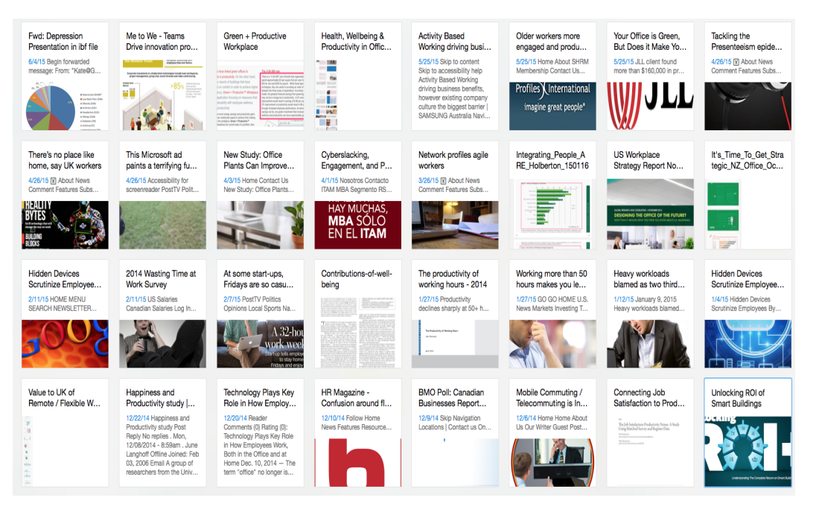
Tag: Telework, Tag: Productivity
Search
Proprietary
Research
Database
6,000+ data points
Fully tagged
Boolean searchable
Updated continually
Telework = 1,517 notes
Telework + Productivity = 902 notes
© 2020 Global Workplace Analytics
Notes:
Our work is informed by a proprietary library of …
Eyeballs
NEXT

Slide 10
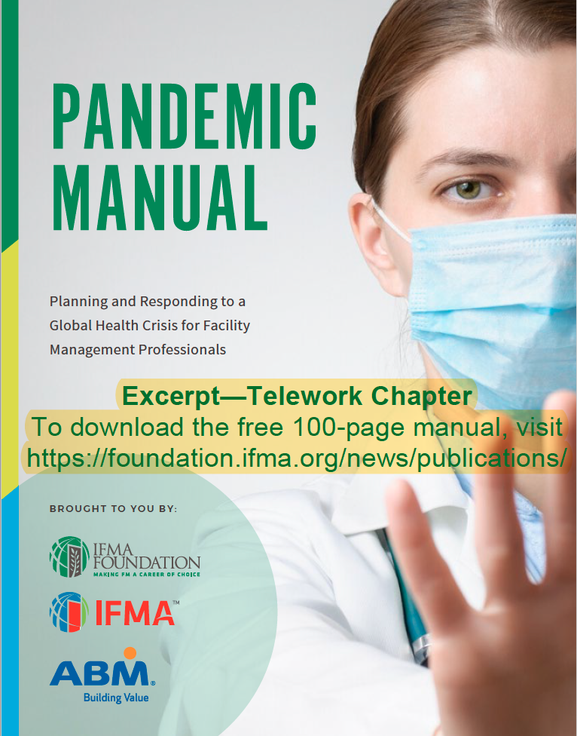
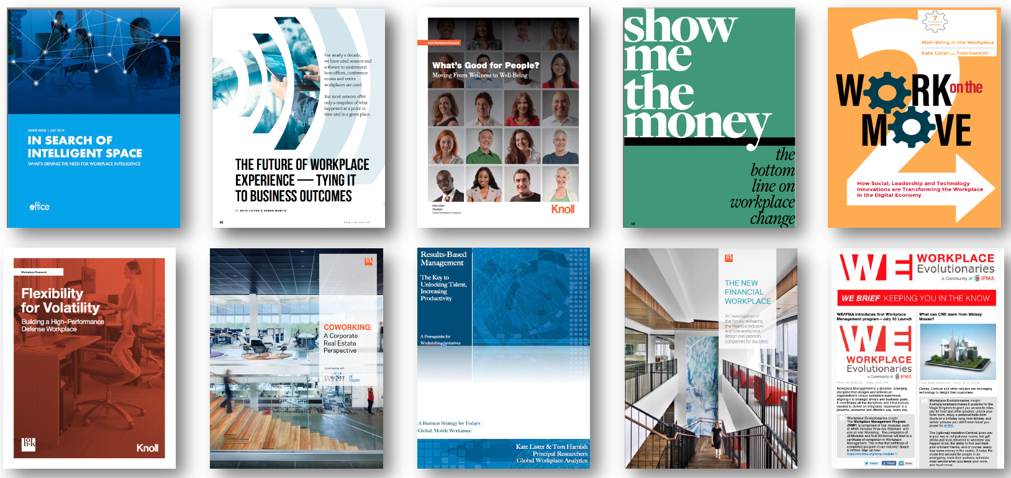

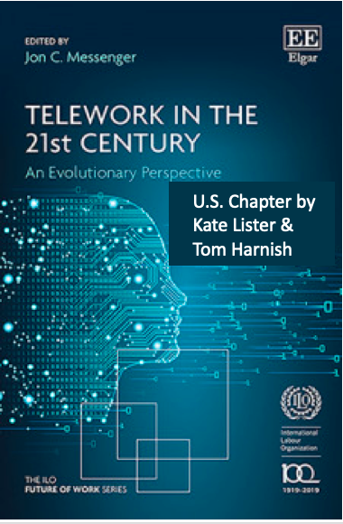
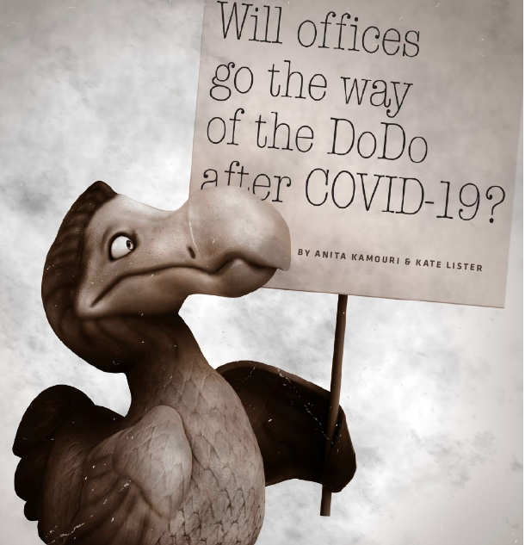
Recognized Thought Leader
Notes:
In addition to client work, we work with industry leaders to publish original and secondary research on a wide range of workplace and industry-specific topics
NEXT

Slide 11
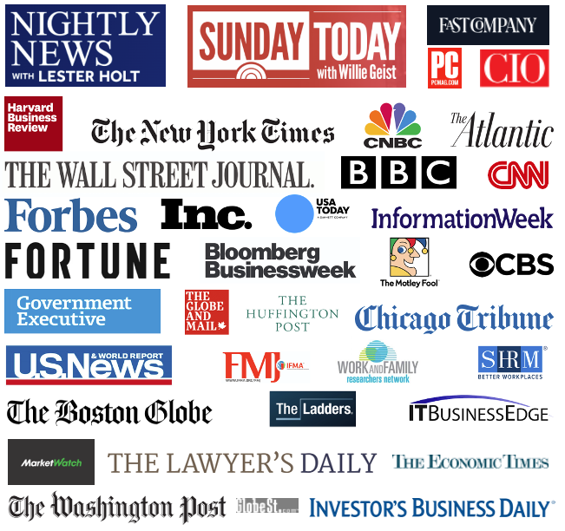
In the News
Notes:
Over the years, we have become a trusted source of insights for media outlets around the world.
I don’t’ say all this to brag, but to ensure you that we do our homework because some of the numbers I’ll be sharing about the ROI of remote work are almost unbelievable. So let’s get to it
NEXT

Slide 12

History/Trends
Who offers?
Who wants to?
Who can?
Who did?
Who will?
Why?
Business Case / ROI
People
Planet
Profit
Notes:
I’ve been the remote work rock uphill for over 15 years and now it feels like it chasing me down the other side.
Here’s a roadmap for what I’ll be covering in this session.
First, we’ll look at data on the who what when where and why of remote work before during and potentially after the pandemic.
Then we’ll dive into the ppp impact of an integrated remote work strategy.
By the end, you will be armed with a methodology for quantifying and even measuring the impact of not just remote work, but a variety of workplace strategies.
NEXT

Slide 13
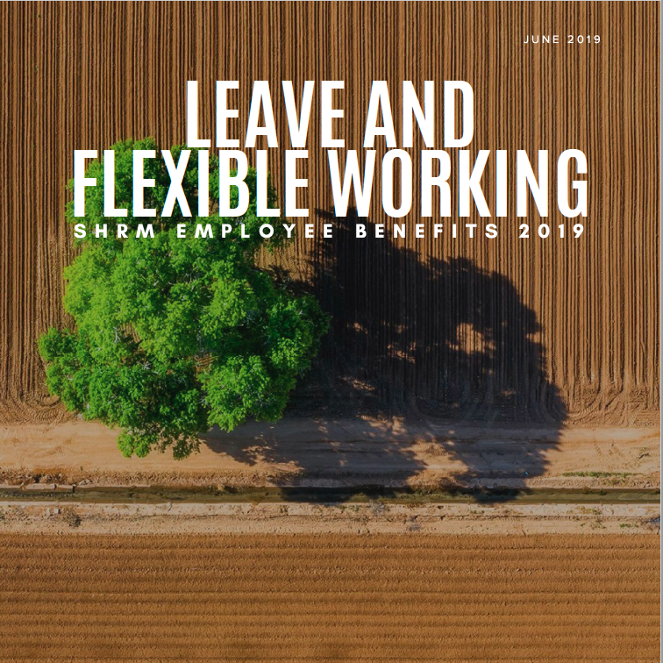
Who Offered?
Pre-COVID-19
Ad-Hoc 69%
Part-Time 42%
Full Time 27%
Flex Hours 57%
N=2,672 HR professionals
© 2020 Global Workplace Analytics
Notes:
SHRM…nearly 70%, at least ad hoc
I’d like to point out, flex-time, though we won’t be talking about it here, is just as important to employees as flex place. Important they go hand in hand.
NEXT

Slide 14
Who Offered?
Pre-COVID-19
7%
© 2020 Global Workplace Analytics
Notes:
But BLS, much stricter 7 %
Privilage – data shows…older, more tenured, higher salary
NEXT

Slide 15

Pre-COVID-19
Compatible = 56%
Wants to = 80%
Does occasionally = 43%
Does ½ time or more = 3.6%
Global Workplace Analytics 2017 State of Telecommuting in the U.S.
Federal Employee Viewpoint Survey 2018 / Citrix one poll 2019
Gallup 2020 State of American Workforce
American Community Survey / Global Workplace Analytics 2019
© 2018 Global Workplace Analytics
Copyright © 2020 Iometrics, Inc. and Global Workplace Analytics
Notes:
Our research shows that 56% of the population holds a job that’s at least partially compatible with telecommuting – More in Gov’t
Between 80% of employees say they would if they could Census…
Gallup show 43% wfh at least occasionally
Census shows less than 4% does so half time or more
Big gap between who wants to, can, and does
NEXT

Slide 16
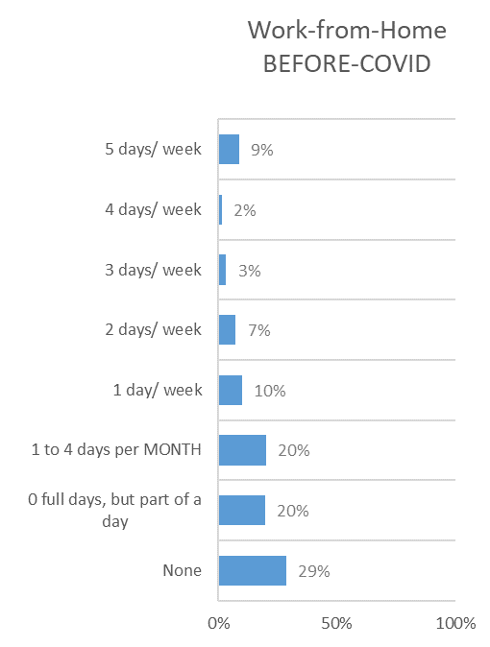
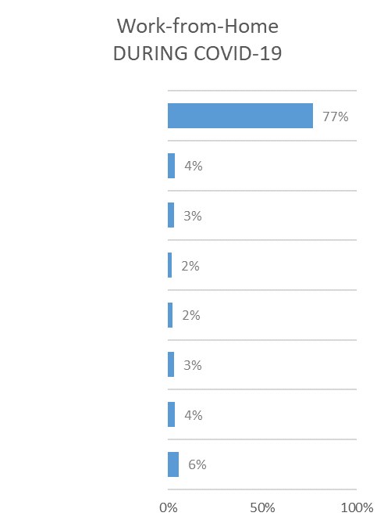


Who worked at home before/during COVID-19
Office Workers
Before COVID
Office Workers
During COVID
31%
88%
33%
97%
Source: Global Work-from-Home Experience Survey, 2020. © 2020 Iometrics and Global Workplace Analytics.
© 2020 Global Workplace Analytics
Notes:
In late March of this year (2020), we and a partner firm, Iometrics, conducted a global study to answer questions about who was working from home during the pandemic, what was working, what wasn’t, and how the experience would likely change the future of where people work.
31% of global office employees, said they worked from home at least one full day a week before the pandemic
That number mushroomed 88% during the month of April. Numbers in yellow represent US vs global
Importantly, nearly 60 of the people working remotely during the pandemic had never done it before.
Note also small % who did it 5x/week b4. Hybrid model is most common.
NEXT

Slide 17
Who wants to?
76% (82%)
Post-COVID-19
Federal Employee Viewpoint Survey 2018 (n=28k) / Citrix one poll 2019 (n=5k)
© 2020 Global Workplace Analytics
Notes:
Prior to Covid – surveys showed globally 65-80% wanted to wfh at least some of the time.
When asked during the peak of sheltering in place, 76% want to at least once a week (82% in US). Only 6% don’t want to at all (3% in US)
NEXT

Slide 18


Millennials Who Would Change Jobs for:
Flextime 63%
Insurance Other than Health 60%
Flexible Location Part-Time 50%
Flexible Location Full Time 47%
Student Loan Reimbursement 45%
Tuition Reimbursement 45%
Paid Maternity Leave 44%
Gallup State of the American Workforce 2017
© 2020 Global Workplace Analytics
Notes:
And actually, they don’t just want to, they really want to.
According to Gallup, Flexibility is one of the highest ranked benefits by Millennials ….even higher than student loan or tuition reimbursement
63% would change jobs for flex time and about half for full or part time telework. (30% would actually take a paycut for the privilege)
Boomers rank these similarly, thought the percentages are 15 to 20 points lower.
Note too the importance of flex time too – it takes both
NEXT
Flextime (47%), Insur (43%), telework pt (33%), telework ft (31%)

Slide 19
Frequency of WFH Pre-COVID-19 vs Desired Post-COVID-19
Source: Global Work-from-Home Experience Survey, 2020. © 2020 Iometrics and Global Workplace Analytics.
© 2020 Global Workplace Analytics & Iometrics, Inc.
Notes:
In terms of frequency, the blue bars show frequency pre-COVID, the orange ones show desired frequency post-COVID
Legend at bottom from most freq on left to least freq on right – so you can see the shift looking from right to left of the orange bars getting bigger
- reflects people wanting to wfh more than they did before
Sweet spot 2 days a week globally, half time in US
While 9% did it full time before, 16% want to now
NEXT

Slide 20

© 2020 Global Workplace Analytics
Notes:
So often the media and naysayers like to make this conversation polar.
It’s not either all remote or all in the office.
That’s just not the reality.
Survey showed people felt more successful wfh for their individual work and equally successful in group work during covid. But they preferred the office for the latter.
Nothing new…Entire workplaces are being designed as places of collab, with home the preferred place for getting things done.
NEXT

Slide 21

The Business Case
© 2020 Global Workplace Analytics
Notes:
Let’s shift gears and look at the business case.

Slide 22


© 2020 Global Workplace Analytics
Notes:
Orgs are finally realizing their survivability depends on doing the right thing for people, planet, and profit….

Slide 23
Profit
Notes:
We’ll look at the business case for all three starting with profit.

Slide 24

Employer Why?
  Productivity 64%
  Cost Savings 63%
  Attraction/Retention 61%
  Collaboration 58%
  Work-Life Balance 53%
  Continuity 20%
  Sustainability 2%
The Once Alternative Workplace Strategies: Fifth Biennial Global Benchmarking Study, Lister/Hood/Nagy 2018
© 2020 Global Workplace Analytics
Notes:
The drivers of workplace change change over the years, but the top five here have dominated the list of driver for the past decade.
Before last recession, talent
During, saving $ - primarily by slashing real estate costs
Last 5 years back to attracting and retaining talent.
Unfortunately, at least in US, sustainability at bottom of the list.
Continuity of operations, being able to continuing working in the event of a disaster, wasn’t in the top before Covid-19 but I’m pretty sure we can expect to see that catapult to the top of the list in the future.
NEXT

Slide 25

Show me the money
© 2020 Global Workplace Analytics
Notes:
Now not to be crass, but whether you call it increasing productivity, attracting/retaining talent, improving work-life balance, coop…the reason they’re important to the C suite is because of the connection to the bottom line. So if we want to get their attention and support for remote work, that’s what we need to show them. Bottom line impacts.
NEXT

Slide 26
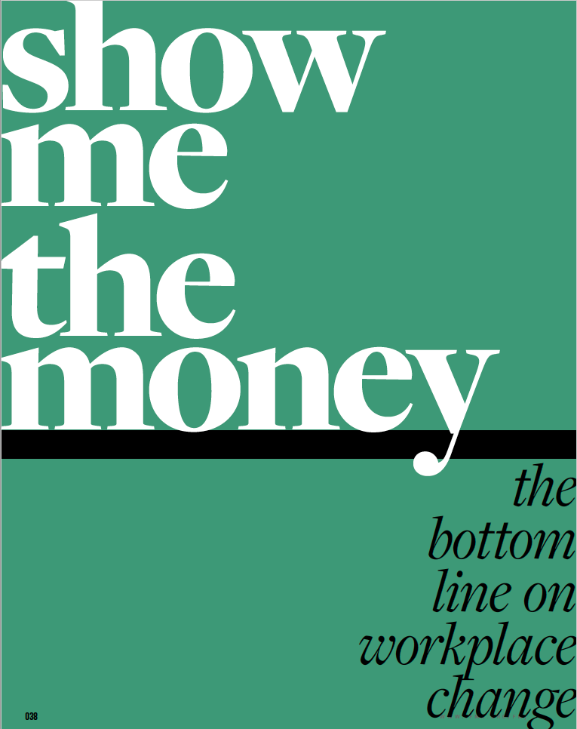
Employer Savings
$11,000 / Half-Time
Telecommuter / Year
© 2020 Global Workplace Analytics
Notes:
Our estimate is that a typical US employers can save an average of $11k per half-time remote worker/year.
Those savings come from a combination of increased productivity, and reduced turnover, and absenteeism, and real estate costs
I’m going to explain how we came up that $11k next, but in case you get lost or want to read more I’ll have an article about it and other resources at the end of this session.
NEXT

Slide 27
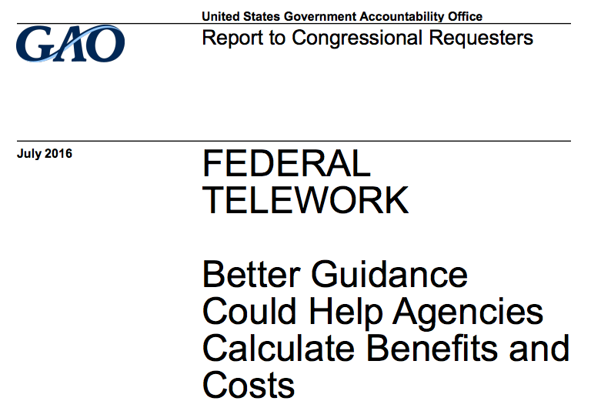
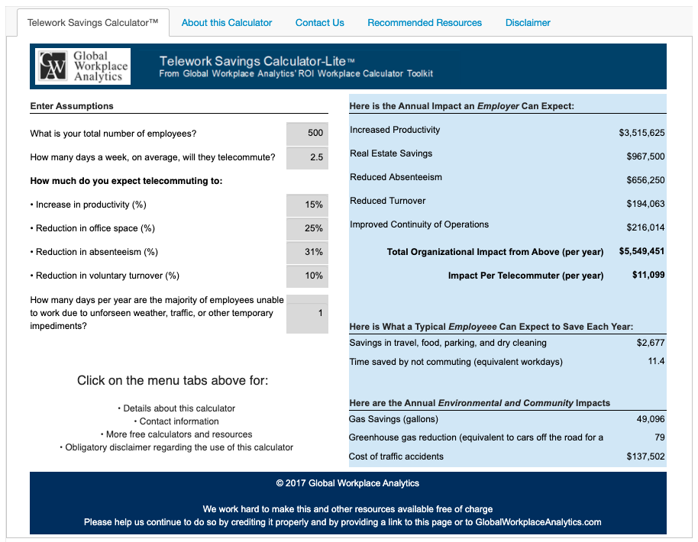
125 Variables | 600 Calculations | Backed by Research
Global Workplace Analytics Telework Savings Calculator™
“Global Workplace Analytics’ telework calculator is comprehensive and based on solid research.”
http://GlobalWorkplaceAnalytics.com/roi
© 2020 Global Workplace Analytics
Notes:
In 2016, the GAO was asked by members of Congress, to investigate tools that would help agencies quantify the impact of their telework programs.
We gave them a peek behind the curtain at the 125 variables, 600 calculations, and research that powers our Telework Savings Calculator, something we created over a decade ago to quantify the employer, employee, and environmental impact of remote work. I free to anyone who wants to use it.
GAO’s report to Congress stated it was “comprehensive and based on solid research.”
Though others were evaluated, no other tools were mentioned in the report.
I tell you all this to ensure you we didn’t just pull these numbers out of the sky. They are based on a great deal of research.
NEXT

Slide 28

WARNING
Math Ahead
REMAIN CALM
© 2020 Global Workplace Analytics
Notes:
Now it’s kinda hard to talk about quantifying impacts without a bit of math. But I promise, I’m not going to get geek out on the math here.
What I want to do, is give you a framework for making your own business case for not just remote work, but other investments too.
NEXT

Slide 29

You can’t measure productivity.
Notes:
People are fond of saying you can’t measure productivity in the information age. They are wrong.
I call that horsepuckey! Of course you can and I’m going to show you how.

Slide 30

Productivity: The Math
    Salary = $65,000/year
    Cost = $81,500/year
    = $325/day
    = $40/hour
    = 70¢/minute
© 2020 Global Workplace Analytics
Notes:
We’re paid a wage to work right? So if miss a day here or there, the employer isn’t getting the full value of that salary.
But it’s not just sick days that rob employees and employers of productivity, minutes count too.
If you do the math, you’ll find that works out to about = 70 cents/minute
That may not sound like a lot but it quickly adds up.
NEXT

Slide 31

Employer Savings:
The Math
Productivity +15%
Absenteeism -30%
Continuity 1 day
Office space -25%
Turnover -15%
1)
2)
3)
© 2020 Global Workplace Analytics
Notes:
Here’ are the assumption we use to come up with the $11k/half-time remote worker per year I mentioned earlier….the same ones GAO said were based on comprehensive and solid research, which represent a synthesis of the case studies we’ve collected and clients we worked with, half-time telework results in:
Top 3 relate o productivity
Read %’s
So let’s look at examples of the impact of remote work on productivity.
NEXT

Slide 32

Productivity Increase #1:
Fewer Interruptions
Home = 43 mins/day
Office = 78 mins/day
© 2020 Global Workplace Analytics /Iometrics Global Work from Home Experience Survey
Notes:
Our survey showed people who wfh save an average of 35 mins/day due to unwanted interruptions
They’re interrupted 78 mins a day in office, 43 at home
This, remember is during covid when wfh conditions are less than ideal for many.
But the problem isn’t just the interruption.
A study by Microsoft showed employees are interrupted every 3 minutes (often they are interrupting themselves).
Once they’re distracted, by even as little as 60 seconds, it can take them 15 to 25 minutes to recover
And if that’s not a bad enough hit to productivity, consider that it also leads to stress, frustration, physical health problems
NEXT

Slide 33
Productivity Increase #1:
Fewer Interruptions
35 mins x $.70 per minute
= $24.50/day
x 125 workdays
= $3,066
per ½ time remote worker/year
© 2020 Global Workplace Analytics
Notes:
Here’s the math on what that 35 mins/day costs (or saves for a half-time remote worker…the example I’ll use throughout this session.
NEXT

Slide 34
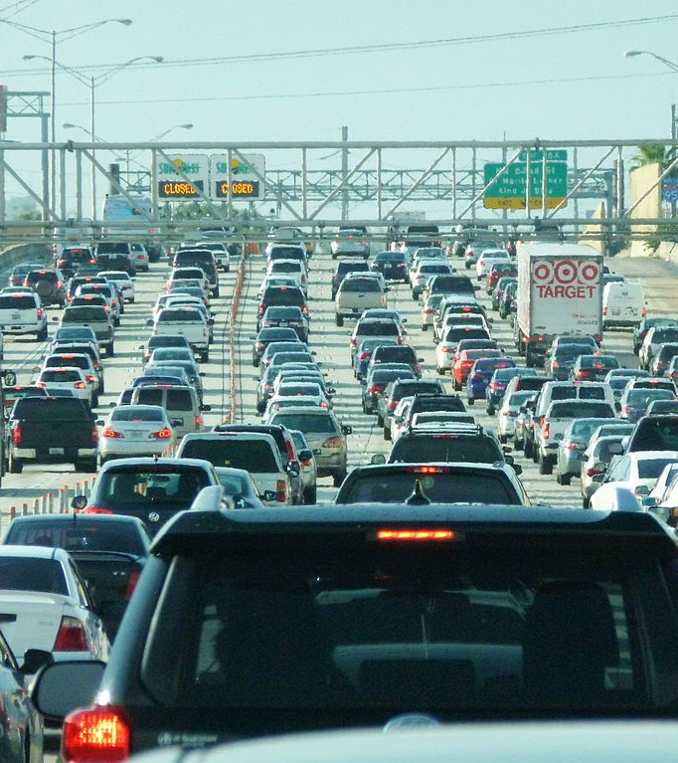
Productivity Increase #2
Commute Time
Average Commute = 60 Minutes
x 50% = 30 minutes
x 70¢ per minute
= $21 day
x 125 days
= 2,625
Per ½ time remote worker/year
© 2020 Global Workplace Analytics
Notes:
Data showed emps save 1 hour/day not commuting and give back about half that time.
NEXT

Slide 35

Productivity Increase
15% Assumption
$81,500
x 15%
= $12,225
x half-time
= 6,112
per ½ time remote worker/year
= $611,200
per 100 half-time remote workers/year
© 2020 Global Workplace Analytics
Notes:
In our calc, we used 15% increase in productivity, same math shows savings of over $600k for every 100 remote workers.
NEXT

Slide 36

Productivity Increase #3
Absenteeism
Absenteeism = 10 days/year
Reduction = 30%
= 3 days/year
x $325/day
= $975/person
© 2020 Global Workplace Analytics
Notes:
Of course, the utltimate reduction in productiivy is not coming to work at all.
Our compilation of studies shows remote work reduces absenteeism by about 30%
Variety of factors:
Largest cause of short term absenteeism isn’t sickness per se, being sick and tired of work. WFH reduces stress and allows people to avoid the politics of work
Also, sometimes you’re not really so sick you need to stay in bed, just not well enough to get dressed up and go
Culture of dragging yourself to work when sick is bad for everyone
Stay at home and work in jammies – still at least partially productivity
Also when recovering from surgery, meeting refrigerator repair person, childcare issues, etc.
If average absenteeism is 10 days a year (which it is in most sectors), we’d expect remote workers to take 3 less sick days a year.
That totals up to about $100k per 100 employees.
NEXT

Slide 37
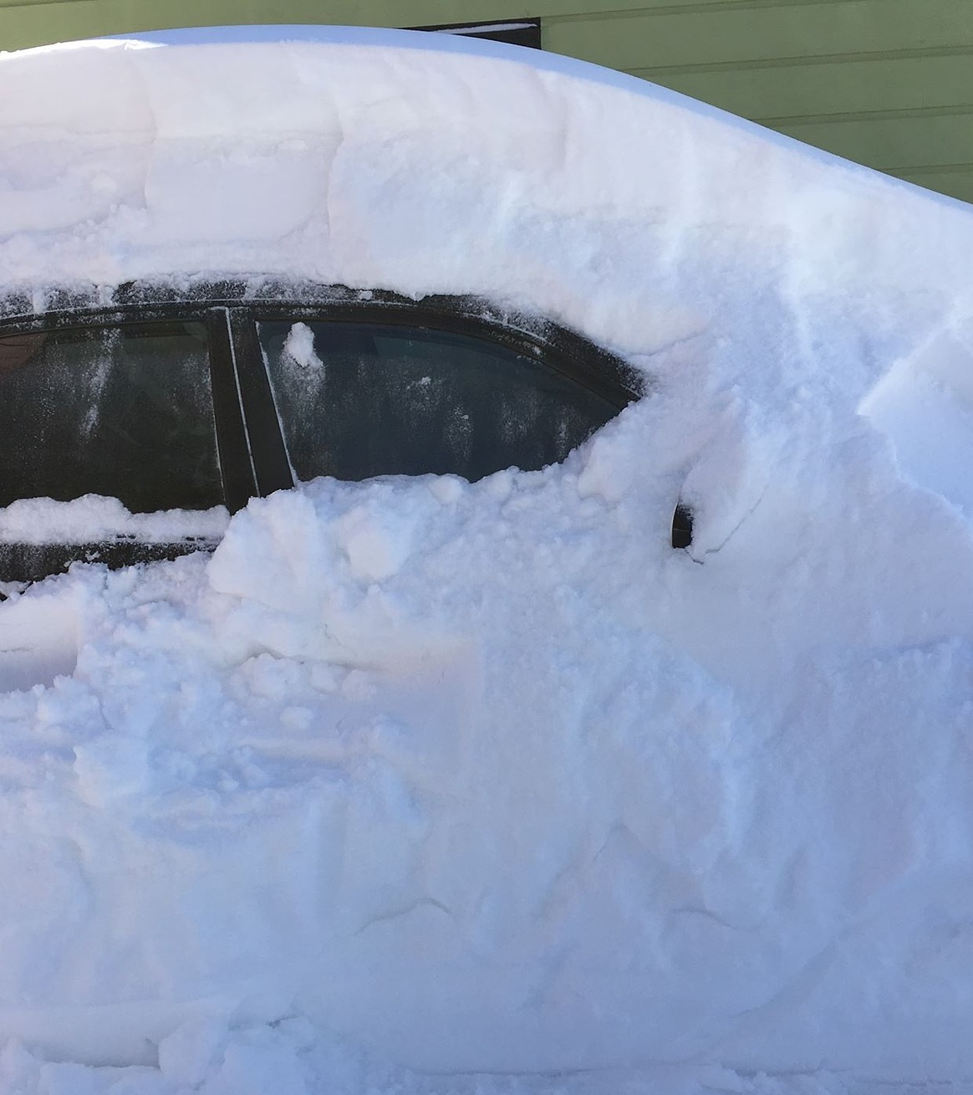
Productivity Increase #3
Disaster Preparedness
$325 pp/day
© 2020 Global Workplace Analytics
Notes:
We used to talk about the disaster preparedness implications of remote work.
Being able to wfh in the event of bad weather, or a highway closure.
Based on our salary assumptions, it costs a company $325/day for every day an employee can’t get to work
NEXT

Slide 38
Productivity Impact
x 6
© 2020 Global Workplace Analytics
Notes:
Now those numbers alone are pretty staggering, but consider this.
We are not hired…
So every one of those impact are x 2 or 3 or 6…depending on the revenue/person ratio at your org.
I don’t’ use that multiple in the calc, because the numbers are compelling enough without it.
NEXT

Slide 39
Employer Savings:
Real Estate
Productivity
Absenteeism
Continuity
Office space
Turnover
1)
2)
3)
© 2020 Global Workplace Analytics
Notes:
So let’s leave productivity and look at the impact of wfh on office space
NEXT

Slide 40
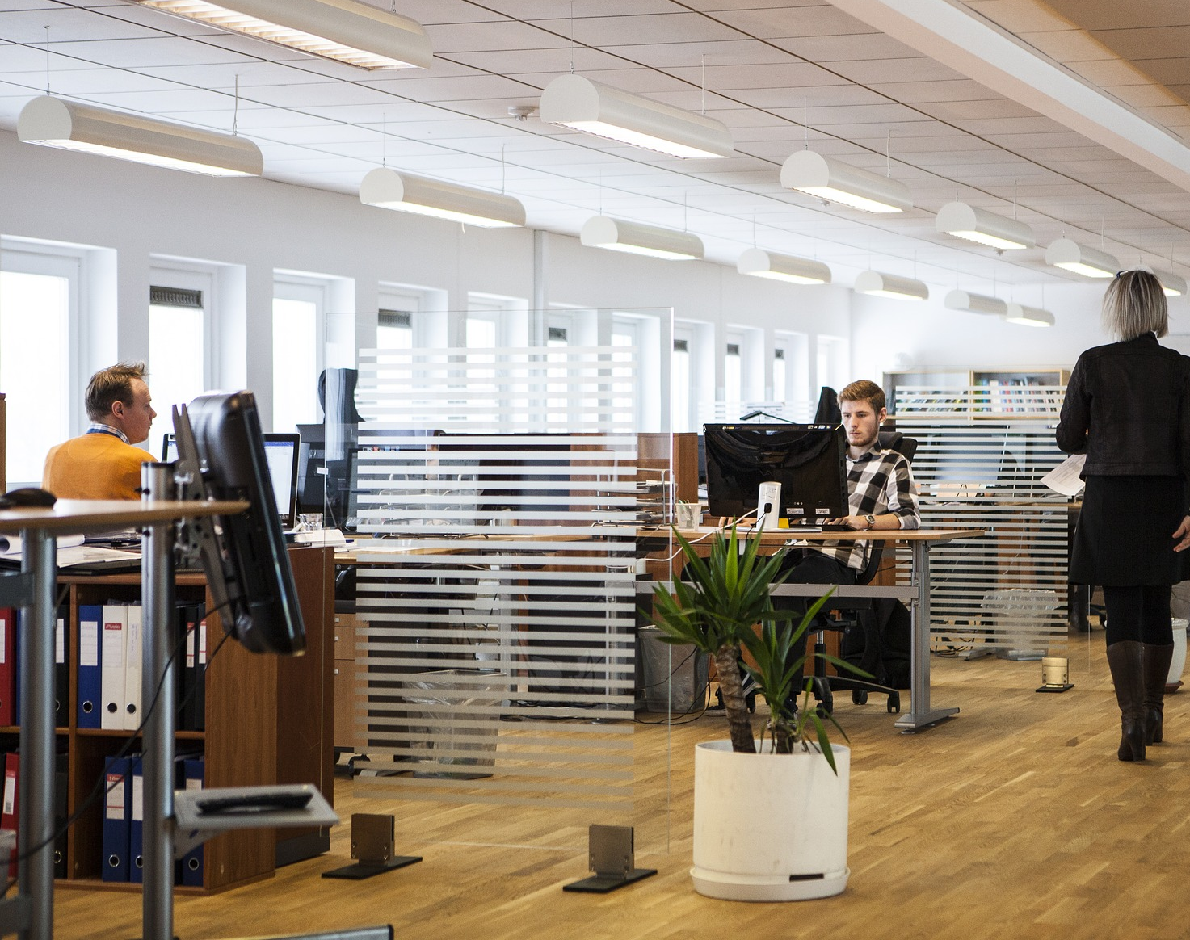
Real Estate Savings
Assume:
25% Reduction in Space
with 50% Remote Work
Office cost = $10k/person/year
x 25%
= $2,500
© 2020 Global Workplace Analytics
Notes:
We conservatively assume a company can reduce office space by about half the frequency of remote work.
So if we’re talking about half-time remote work, we assume a 25% reduction in RE.
Assuming a cost of office space at $10k pp/year, that savings adds up to $250k a year.
NEXT

Slide 41
Employer Savings:
Turnover
Productivity
Absenteeism
Continuity
Office space
Turnover
1)
2)
3)
© 2020 Global Workplace Analytics
Notes:
Finally, let’s look at turnover.
NEXT

Slide 42

Voluntary Turnover
Per 100 Half-Time Teleworkers
Average Quits Rate = 7%
Cost of Turnover as % of Salary = 75%
Reduction with Remote Work = 15%
$81,500 x 100
= $8.2 million/year payroll
x 7%
= $570,500
x 75%
= 427,875 cost of turnover/year
x 15% reduction
= $64,181/year
© 2020 Global Workplace Analytics
Notes:
In a typical year, about 7% of employees typically choose to leave their employer (doesn’t count the ones you let go – we want them to leave)
SHRM ad others estimate the cost of turnover at 35 – 200% of salary.
We show cost of 75% here.
Research and case studies show the ability to work remotely can dramatically reduce turnover. It’s a good gig, they don’t want to give up.
For the sake of the sanity of the people on this call who aren’t number nuts like I am, I’m going to skip the math in the middle here but, but the bottom line is that a 15% reduction in turnover can save a company $64k a year for every 100 employees.
NEXT

Slide 43

Annual Employer Savings
Half-Time Remote Work
Per 100 Employees
Global Workplace Analytics
Remote Work Savings Calculator™
Productivity $611,000
Real Estate $250,000
Absenteeism $98,000
Retention $65,000
Continuity of Operations $33,000
Total $1,057,000
Calculate your own company savings:
https://globalworkplaceanalytics.com/roi
© 2020 Global Workplace Analytics
Notes:
Putting all that together, here’s the bottom line.
A typ employer can save over 1 million per one hundred half time remote workers; about $11k per half-time remote worker
NEXT

Slide 44

Use this methodology for making a wide range of investment decisions
Employee engagement
Training
Health and well-being
Technology
New processes and practices
Space design
And more
© 2020 Global Workplace Analytics
This Photo by Unknown Author is licensed under CC BY-ND
Notes:
Use this methodology for a wide range of investment decisions

Slide 45
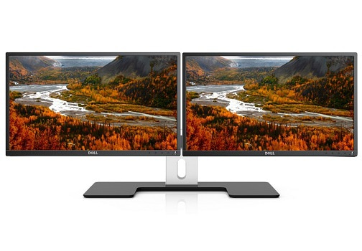
No Brainer ROI / Breakeven
Benefit x Useful Life ÷ Cost
© 2020 Global Workplace Analytics
Notes:
I said at the beginning you can use this framework in a number of ways that can help make decisions about how you spend money a no brainer
NEXT

Slide 46
Research: Up to 50% increase in productivity
Breakeven Analysis
Dual Monitors
Assumptions:
Second Monitor = $200
Productivity / Minute = 70¢
Useful Life = 3 years
$200 / 3 = $67
÷ 70¢ = 95 minutes/year
÷ 250 days/year
Breakeven = 23 seconds/day
Up to 50% increase in productivity
© 2020 Global Workplace Analytics
Notes:
Instead of ROI, I use a BE to show what a no-brainer it is to decide on whether you should spring for an extra monitor for your people
Research shows one can increase productivity as much as 50% in some functions.
At a cost of $200/monitor, and emp cost of $70 cents a minute as we showed earlier
All we need to do is divide the cost of the monitor by 3 years ($67/year) … that’s conservatively how long before you’ll have to replace it … and divide that by the cost per minute.
So if the monitor saves someone 90 minutes a year, or 23 seconds a day, its worth the investment.
So often we make decisions like this that are false economy.
Tell story about showing this in a small team meeting
NEXT

Slide 47
Breakeven Analysis
Ergonomic Chair
Assumptions:
Chair = $1,000
Workers Comp Average Claim = $28k
Useful Life = 5 years
$1,000 ÷ 5 = $200
$28,000 ÷ $1,000
= 28 x 5
= 140 chairs
© 2020 Global Workplace Analytics
Notes:
Similar analyses can be made about ergo chair.
Instead of productivity, we use the cost of a WC claim data.
Do the math and you find that you could buy 140 chairs for the cost of one WC claim.

Slide 48
People
Notes:
I could go on and on and on on the quant and qual benefits of remote work on employers, but I said we’d look at the people, planet, and profit impacts so let’s move on to how remote work benefits employees.

Slide 49



Employee Impact
Notes:
Simply put, it saves them 3 most precious commodities
10+ days,
$2-$4k
Their health – ….

Slide 50
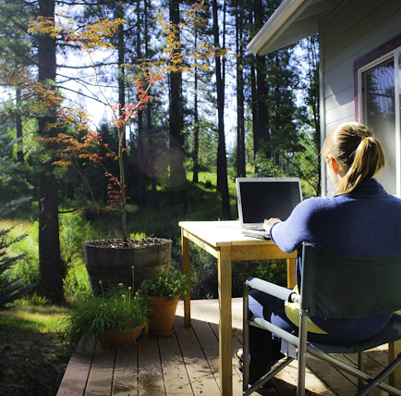
Employee Benefits
Flexibility 77%
Well-Being 69%
Food 54%
Exercise 48%
Life/Work Conflict vs.
Work/Life Conflict
This Photo by Unknown Author is licensed under CC BY-NC-ND
Source: Iometrics/Global Workplace Analytics Global Work-from-Home Experience Survey (2020)
Notes:
Repeated studies show people who work from home are better able to manage stress, they get more sleep, and some even eat better and exercise more.
In the study we did in April showed majority of people felt they had greater flexibility, that wfh improved their well-being, that they ate healthier at home, and slightly less than half said it gave them more time for exercise.
While life may interfere with work more when they’re wfh, the reduction in work-life conflict tips the scales in favor of wfh.

Slide 51
Profit
Notes:
Finally, there’s the impact of remote work on the planet.
The pandemic has given us the oppor to actually see the difference we can make by reducing commuter travel. In just a few short weeks, cities were reporting dramatically better air quality.
We estimate that if those with remote-work compatible jobs (56% as I mentioned earlier), and a desire to wfh at least some of the time (about 80% of the workforce) did so half the time, it would have the ghg equiv of taking the entire NY state workforce off the road.
There’s simply no cheaper, quicker, or more popular way to reduce our carbon footprint than by working remotely

Slide 52
© 2020 Global Workplace Analytics
Notes:
So there’s the emp, employ, environ business case for remote work. But those kinds of results don’t just happen, they have to to made to happen.

Slide 53

Notes:
Most orgs’ were forced to do overnight …usually take 6 mos.
Did it amazingly well
But the cracks are starting to show
If emps want to continue wfh after the pandemic, and it’s looking like most do, the need to develop a plan that will allow them to maximize outcomes

Slide 54
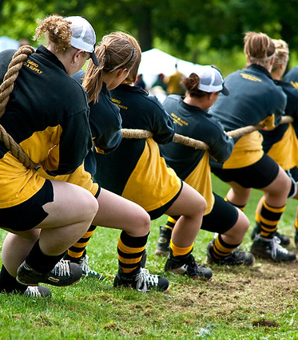
Maximizing Outcomes
Sr. Exec Support
Cross-functional collaboration
Change management
Being true to your own org DNA
© 2020 Global Workplace Analytics. All rights reserved.
© 2020 Global Workplace Analytics
This Photo by Unknown Author is licensed under CC BY-SA-NC
Notes:
That mean starting at the very top
Having Sr. Exec Support, but also the support of middle management who have been the primary obstacle to remote work for over 40 years.
I means looking at every function in the org and working cross-functionally to adapt policies and practices
HR, IT, RE are top three but also Communications, Risk Management, Sustainability, and other functional areas
Investing in Change management, - the office your people left isn’t the one they’ll return to – Change management is a must if you want to get everyone pulling in the same direction
Being true to your own org DNA – You’re not Google

Slide 55

This Photo by Unknown Author is licensed under CC BY-SA-NC
© 2020 Global Workplace Analytics. All rights reserved.
Notes:
Finally, let’s look at some case studies on some early adopters of remote work

Slide 56
© 2020 Global Workplace Analytics
Notes:
Here are some companies who didn’t get it right. I’m sure you’ve read about their wfh reversals in the news.
They are the first line of defense for the remote work naysayers.
Of course, the media doesn’t write about the thousands of companies that got it right.
Nor do they talk about the fact that all three of these were deeply troubled companies at the time of their reversal.
I don’t know who said it first, but it’s true, Remote work doesn’t create management problems, it reveals them.
If it took looking at the VPN activity to alert Yahoo managers to the fact that their people weren’t working, that’s a management problem, not a remote work problem.

Slide 57
U.S. GSA
Results
2:1 desk ratio
$30+ million/year
Energy 50%
Paper reduction
Source: 2017 Telework Report to Congress
© 2020 Global Workplace Analytics
Notes:
GSA was able to put 4400 emps in a building designed for 2200 .. The difference was the integration of remote work
Following the renovation, nobody had an assigned desk, not even the administrator
Instead of 1:1 desk ratio, they went to 2:1
Saved $30M/year and reduce energy usage by 50%

Slide 58
U.S. GSA
Results
2:1 desk ratio
$30+ million/year
Energy 50%
Paper reduction
Source: 2017 Telework Report to Congress
© 2020 Global Workplace Analytics
Notes:
GSA was able to put 4400 emps in a building designed for 2200 .. The difference was the integration of remote work
Following the renovation, nobody had an assigned desk, not even the administrator
Instead of 1:1 desk ratio, they went to 2:1
Saved $30M/year and reduce energy usage by 50%

Slide 59
Sharp Healthcare
Results
Commuter Travel
Office space
Morale
- 20% reduction
- 26,000 s.f.
+++
© 2020 Global Workplace Analytics
Notes:
Sharp Healthcare (a client of mine) has about 700 teleworkers who collectively reduced their commuter travel by 20^ and eliminated the need for 26k of office space. Plus the emps love it.

Slide 60
Apollo
Results
Courtesy of Iometrics
Productivity + 34%
Turnover - 56%
Absenteeism - 88%
Distractions - 49 mins/day
Impact = $17.5M/year
© 2020 Global Workplace Analytics
Notes:
Apollo who owns Univ of Phoenix measured

Slide 61
Dell
Results
Frequency 2-3 days/week
Commute - 136M miles
GHG - 35 mmt
Real Estate - $12M/yr
© 2020 Global Workplace Analytics
Notes:
100K emps in 180 countries
2020 Goal – 50% of staff working 2-3 days a week
37% already did last year

Slide 62
We make
remote work …
work better
Free Resources:
White Papers:
http://GlobalWorkplaceAnalytics.com/Whitepapers
Remote Work Savings Calculator™
http://GlobalWorkplaceAnalytics.com/ROI
Contact: Kate Lister
Kate@GlobalWorkplaceAnalytics.com
Notes:
Here are links to the resources I mentioned.
It’s time we make the information highway, the way to work

Slide 63

25-30%
Multiple Days/Week
Notes:
Our estimate, based on research of who can and wants to, is we’ll see 25-30% of US office workers working remotely multiple days a week when this all settles out.

Slide 64

1) Employees
Notes:
The genie is out of the bottle, it’s not going back in.
The longer this continues the more used to it people will become and it looks like it may at least through the end of the year and much longer before workplaces will even be able to think about bringing every one back.
Three most precious commodities: Time, money, sanity
SF area: 13+ days a year (half time)
Money: average $2,500 - $4k – more in SF …even more if move to less expense area
Sanity & Health – lower stress, w/l conflict, commute

Slide 65
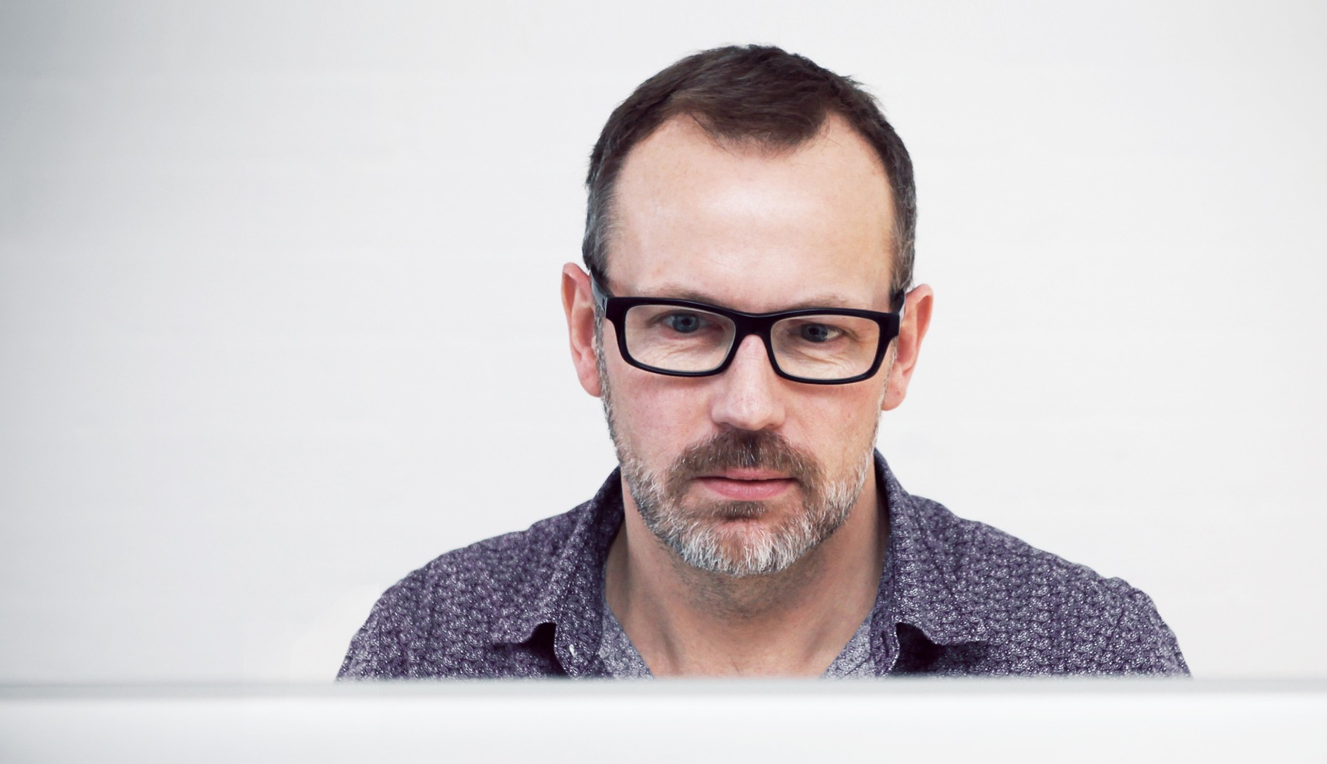
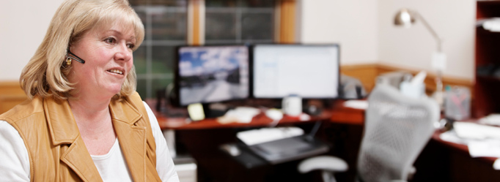
2)Managers
Notes:
The second factor that will contribute to the increase in wfh, is manager acceptance. Biggest holdback for decades has been middle managers who don’t trust their employees to work untethered.
Research show the biggest diff between managers that support it and those that don’t is experience. Once they’ve done it themselves, they realize their people are still be working and that they can manage them remotely.

Slide 66

3) C-Suite
Notes:
Third factor is economic. During the last recession, many companies launched remote work programs to reduce real estate costs. Since then, it’s been about using workplace flexibility to help attract and retain talent. In the economic downturn that will inevitably follow the Covid-19 crisis, the potential for work-from-home to reduce real estate costs, increase productivity, and enhance scalability will once again come into focus.

Slide 67
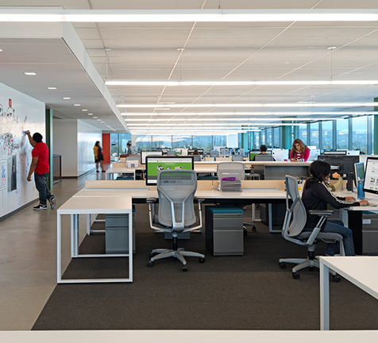
74% of CFOs say their company will reduce office space because employees have adapted to working from home, according to a survey of over 300 CFOs by Gartner, a Connecticut-based research and advisory firm.
This Photo by Unknown Author is licensed under CC BY-SA-NC
Notes:
When we started this study, we said: we’re in the midst of a massive WFH experiment
What if it works? How do you prepare CRE for WFH success?
Several announcements from org’s saying they will be shedding space

Slide 68

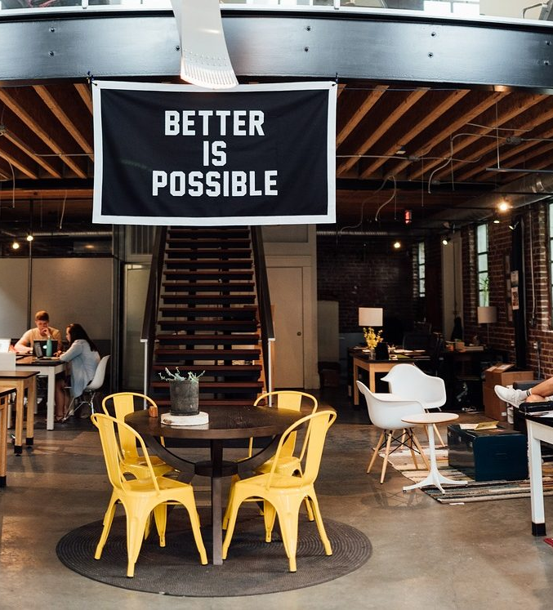
Productivity, Attraction/Retention, Real Estate, Absenteeism, Disaster Preparedness
Notes:
SF area - $17k per half-time
Company with 100 people loses

Slide 69

4) Investors
Notes:
A survey conducted by PWC at the end of March found that 60 percent of U.S. CFOs felt their lack of preparedness for remote work would hurt organizational productivity. The bottom-line impact will be enormous.
It’s not a question of if another natural or man-made event will force people to work from home, it’s a matter of when.
Risk managers and institutional investors will demand better disaster preparedness and organizational agility.

Slide 70
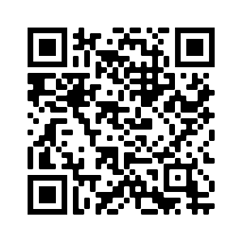
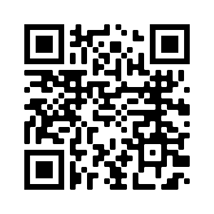
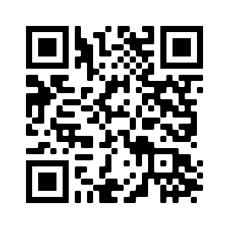
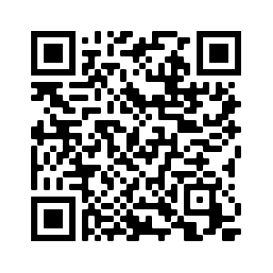
Our Thought Leadership on Evidence-based HR
WEBINARS
BLOGS
PODCASTS
eBOOKS
© 2020. Copyright Human Capital Growth. All Rights Reserved.
Exponential Talent
70

Slide 71
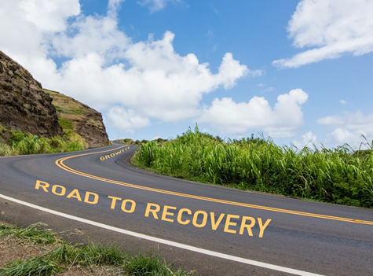
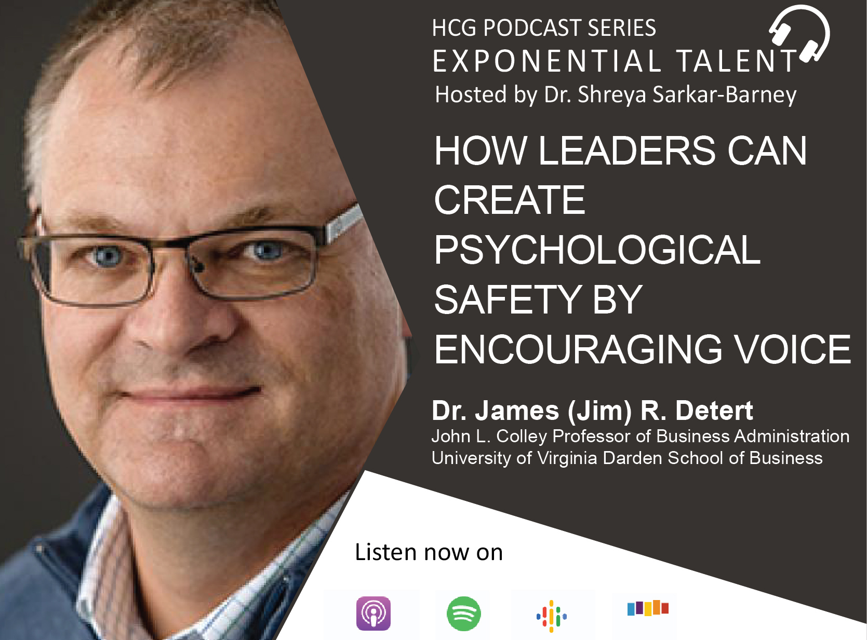
You May Also Be interested in These Resources
© 2020. Copyright Human Capital Growth. All Rights Reserved.
Blog
Podcast

Slide 72
HCG Talent Updates
THANK YOU!
SIGN-UP
FOLLOW US
Evidence-based insights on trending topics in talent management
WEBINARS, PODCASTS, BLOGS, EBOOKS
www.linkedin.com/company/human-capital-growth
@hcgtm
insights@humancapitalgrowth.com
72

