Slide 1



Take your Performance Management from Hate to Love
Webinar Series
April 29th, 2015

Slide 2

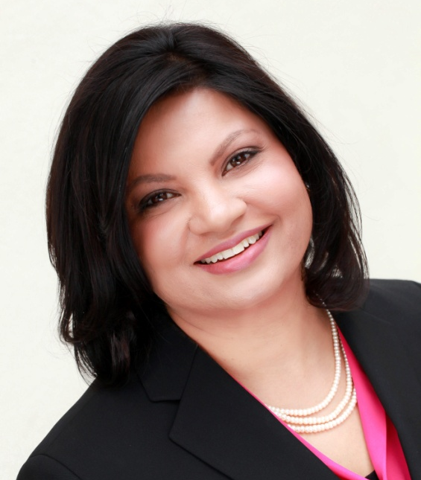
Presenters
Izabela Widlak, M.S.
Research Consultant
Dr. Shreya Sarkar-Barney
HCG President & Founder

Slide 3









About us
Introduction | Boutique, evidence-based talent management firm, founded in 2001
Mission | Promote the use of objective methods to drive fairness and profitability
Focus | Talent management consulting Predictive Analytics Talent management education for HR
Locations Select Clients | US and India

Slide 4
Agenda
Why the universal hate for PM?
Broad categories of practice
What is missing?
Elements of an uplifting PM system
Should companies stop doing performance reviews?

Slide 5
Global Perspective
Respondents’ plans for updating performance management system

Slide 6
Why the Universal Hate?
Rating | Process | Outcomes
Lack of objectivity Lack of differentiation | Poor ongoing feedback & communication 91% - mgt. unable to hold difficult conversations 90% - poor use of time | Performance - reward linkage missing 70% - see no link between review and performance improvement 92% of HR professional see no link between PM and business value
Copyright Human Capital Growth. All Rights Reserved.

Slide 7
Variations in Practice
 | Ratings | Process | Outcomes
Traditional | Annual review & ratings | Annual cascading of goals Rating & calibration | Pay, promotion, rewards administration
Contemporary | No ratings | Goals set between manager and employees Frequent check-in, feedback and coaching | Manager free to assign pay, promotion, and rewards
Copyright Human Capital Growth. All Rights Reserved.

Slide 8
Contemporary Models
 | Ratings | Process | Outcomes
Adobe Systems | Abolished annual reviews, ratings, rankings and forms | Managers set & clarify performance expectations Regular check-ins with feedback and coaching | ?
Juniper Networks | No forced distribution/labeling Assessment against scenarios Assignment into categories | Goals set between manager and employees Frequent check-in, feedback and coaching | Manager free to assign pay, promotion, and rewards
Copyright Human Capital Growth. All Rights Reserved.

Slide 9
Glassdoor.com Reviews
 | Ratings | Process | Outcomes
Adobe Systems | The no review/check-in process fosters no clear goals, no career development Boss[es] give your review with no knowledge of your actual performance | Politics drive promotions Lack of check-ins for personal growth Favoritism by leadership ---------------------- Establish clear goals Hold people accountable | Loyalty/friendship rewarded over experience and performance -------------------- Reward those who go above and beyond Need new measures of success for new initiatives
Copyright Human Capital Growth. All Rights Reserved.

Slide 10
Glassdoor.com Reviews
 | Ratings | Process | Outcomes
Juniper Networks | Too many average/below average employees No consistent calibration across teams | Too much politics If you and your boss are from the same Indian village, then you will advance quickly ---------------------- Keep skilled people employed, lose unskilled people Cull low performers | Pay industry average to retain talent Bonus usually split up equally Upper management is not supportive of career growth unless you are favored
Copyright Human Capital Growth. All Rights Reserved.

Slide 11
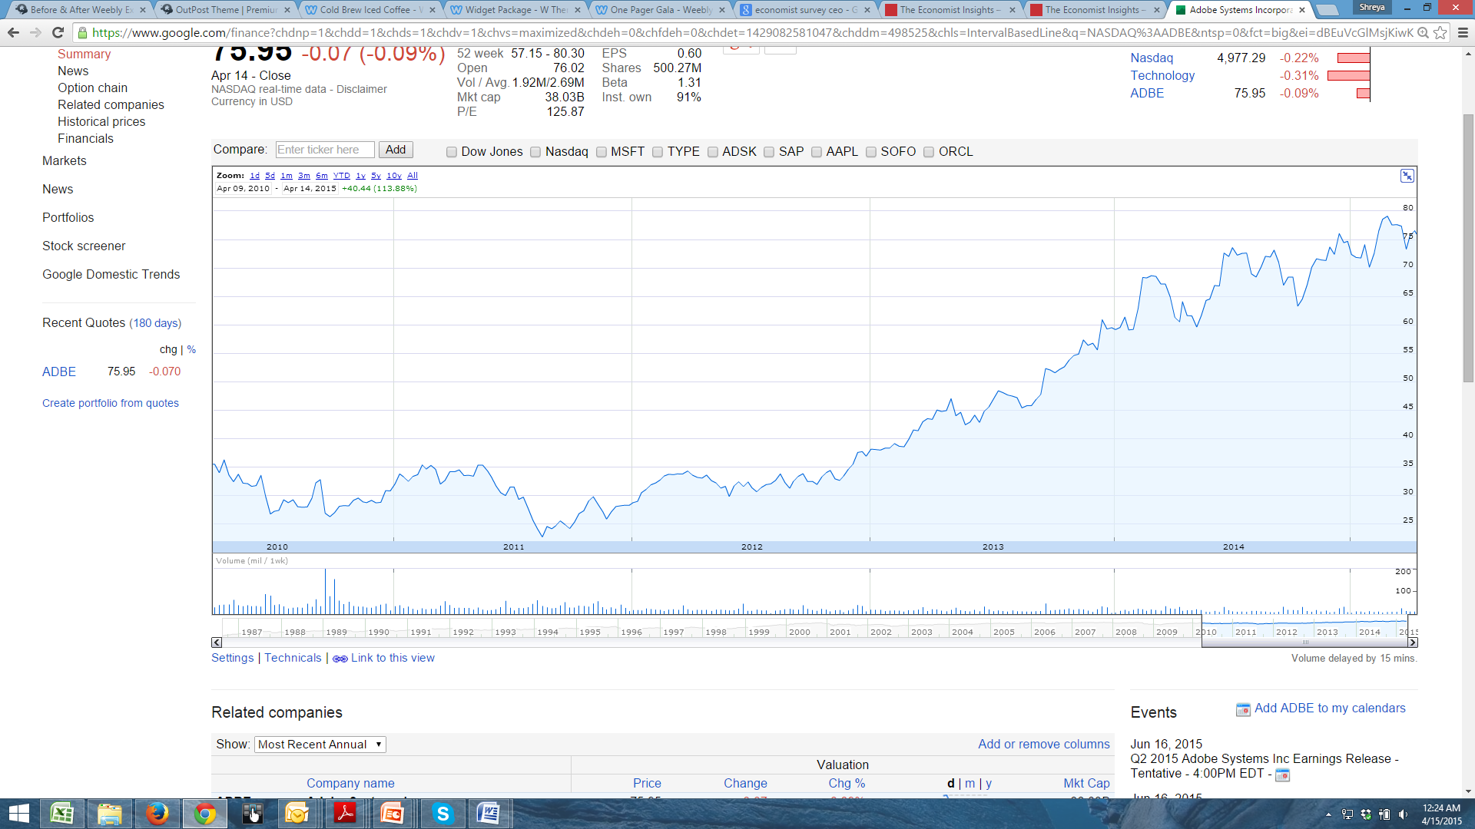
Financial Performance
Adobe Systems

Slide 12
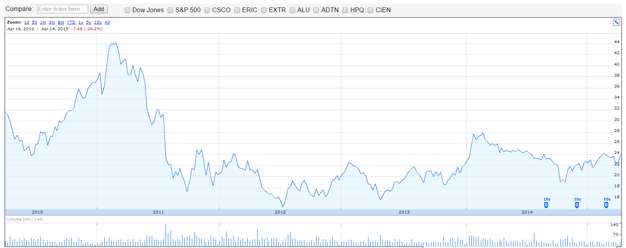
Financial Performance
Juniper Networks

Slide 13


Summary
Organizations
Employees
Less focus on rating/labeling/
distribution
Ongoing conversations
Backward and forward looking
Care about relative standing
How decisions are made
Focus on pay, bonus, and career development
Copyright Human Capital Growth. All Rights Reserved.

Slide 14
What’s missing?
Misalignment between
  what organizations want and what employees want
  what organizations want and what they evoke through their PM systems
Copyright Human Capital Growth. All Rights Reserved.

Slide 15
Misalignment
 | Organizations | Employees
Ratings | Did you do what you were told? | Tell me how I did, where I stand, and what I need to do to get better?
Process | How much and how well did you do it? | I want to do meaningful work and make a difference.
Outcomes | How much of the reward did your efforts earn? | I want to be recognized for making a difference.
Transactional
Transformational
Copyright Human Capital Growth. All Rights Reserved.

Slide 16
Style of Leading
Transactional
Transformational
Focus on an
exchange
relationship
Focus on
emotionally uplifting communication & engagement
Copyright Human Capital Growth. All Rights Reserved.

Slide 17
Three Key Elements to Creating Uplifting PM Systems
Motivation
(equity)
Experience
(respect &
fairness)
Feedback
(growth &
meaning)
Copyright Human Capital Growth. All Rights Reserved.

Slide 18
1
As much as organizations want to move away from a rating system, employees really care about their relative standing and linkage between effort and performance.
Equity Drives Motivation
Copyright Human Capital Growth. All Rights Reserved.

Slide 19



Motivation
What Motivates?
PERFORMANCE ⇨ = OUTCOMES
EFFORT ⇨ = PERFORMANCE
1
[ ]
2
REWARDS & RECOGNITION
Self
Others
Market
Comparison made relative to a basket of needs = $, benefits, work life balance
Copyright Human Capital Growth. All Rights Reserved.

Slide 20
2
Absence of bureaucracy does not constitute a positive experience.
Accuracy and Fairness matter
Copyright Human Capital Growth. All Rights Reserved.

Slide 21
Experience
Processes
Relationships
Accuracy of information collected
Consistency in decision making procedures
Employees allowed to voice their concerns
Appeal or challenge any decisions
Including employees’ views
Minimizing personal biases
Treating employees with kindness, consideration and truthfulness
Copyright Human Capital Growth. All Rights Reserved.

Slide 22
3
Frequent Check-ins alone are insufficient to drive performance change.
Effective feedback produces extraordinary outcomes
Copyright Human Capital Growth. All Rights Reserved.

Slide 23
Feedback
 | Transactional | Transformational
Content | Task focused Outcome focused Evaluative | Mission and meaning focused Effort and outcome focused Progressive
Context | Guarded Conflict avoidant | Authenticity Trust & Transparency
Collaboration | Downward communication Performance goal-oriented | Insightful for both parties Learning goal-oriented
Copyright Human Capital Growth. All Rights Reserved.

Slide 24
Should companies abolish performance reviews?
No
Yes
X
Copyright Human Capital Growth. All Rights Reserved.

Slide 25
Summary
Hate
Love
Ratings
Inaccuracy
+
Process
Politics
+
Outcomes
Futility
Motivation
Rewards
+
Experience
Treatment
+
Feedback
Growth
Copyright Human Capital Growth. All Rights Reserved.

Slide 26
Questions?

Slide 27

“I’ve talked to nearly 30,000 people on this show, and all 30,000 had one thing in common: They all wanted validation.
… every single person you will ever meet shares that common desire. They want to know: ‘Do you see me? Do you hear me? Does what I say mean anything to you?’
Oprah Winfrey
May 25, 2011

Slide 28
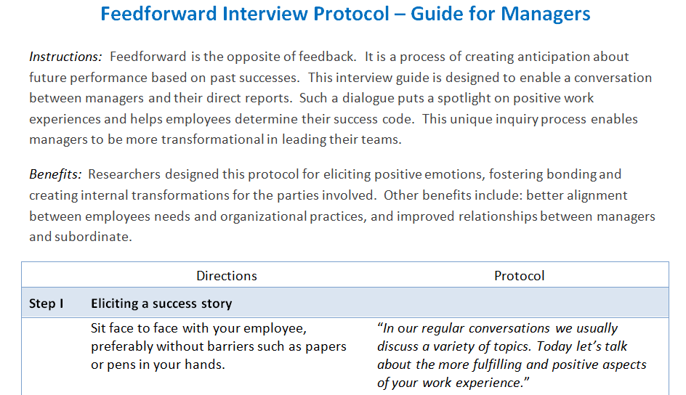
Tool
Copyright Human Capital Growth. All Rights Reserved.

Slide 29
Want more!
Contact us for
In-house Sessions
Keynote Speakers
Talent Strategy & Consulting
Courseware on Performance Management
and 16 other Talent Management Practices
info@humancapitalgrowth.com
www.humancapitalgrowth.com
Notes:
If you are

Slide 30
Next Webinar- June 2015
Reskilling HR:
The Missed Opportunities

Slide 31
Thank You

