Slide 1


HCG Webinar
Resilience
The Key to an Engaged Workforce
By
Dr. Linda Hoopes

Slide 2
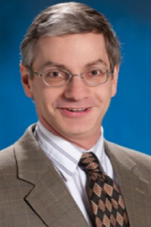

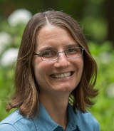
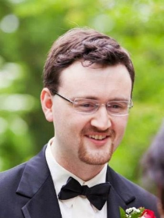
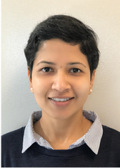
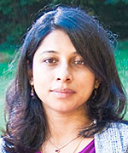





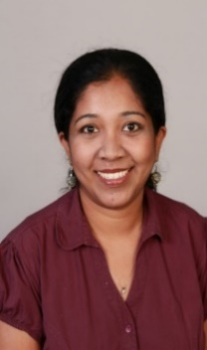
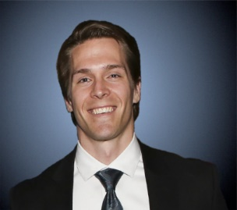

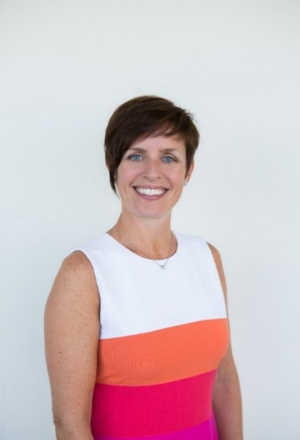
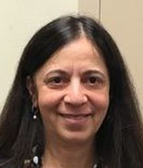
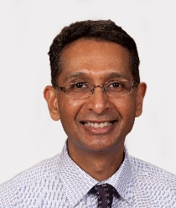






HCG Expert Panelists
Insights on needs and trending practices
Ramzi Baydoun
​
Victoria A. Davis
Fm
Liberty Munson
Eric O’Rourke
Neha Singla
Anu Ramesh
Aarti Shyamsunder
​
Psymantics Consulting &
Michael Tocci
Frank Bosco
metaBUS
Krista Uggerslev
metaBUS
Comila Shahani-Denning
Mahesh Subramony

Slide 3
















We help organizations achieve better outcomes through talent using
science, analytics, and empathy.
Talent Management Excellence
Leadership Excellence
Drive business impact through timely talent actions
Deliver measurable and sustained improvements in leadership

Slide 4
Evidence-based Analyses
Webinars, Podcasts, Blogs, eBooks
Systematic reviews
Trending Practices
Performance Management
Employee Engagement
Talent Development
Executive Coaching
Skills for the new world of HR
Design Thinking in HR
Digital Learning
Digital Leadership
Certifications for skill development
Leadership Development
Talent Analytics
Employee Selection

Slide 5










Certification Tracks for HR
The New HR Skillset
Business-focused, science-informed, analytics driven
Comprehensive certification for strategic HR Professionals in client partnering roles
Certified Talent Management Practitioner (CTMP)
Certified Talent Management Specialist
(CTMS)
Specializations for designers and implementer of talent management systems
Certified in Workforce
Staffing
(CWS)
Certified in Workforce
Development
(CWD)
Certified in Workforce
Management
(CWM)
Certified in Organizational Effectiveness
(COE)
Focused certifications on specific talent management practices
Certified in Talent Acquisition
(CTA)
Certified in Leadership
Development
(CLD)
Certified in Workforce
Analytics
(CWA)
Certified in Workforce
Planning
(CWP)
Certified in Change Management
(CCM)
Certified in Employee Engagement
(CEE)
Curriculum and certification exams are set by expert panelists from these organizations

Slide 6

WORKSHOP
DATA SCIENCE IN HR: THINKING IN NUMBERS
Faculty : Alyssa Perez, ABD and ​Shreya Sarkar-Barney, Ph.D.
REGISTER TODAY
Hands-on data science workshop is designed for both, those with and without a background in statistics. You will come to understand the critical basics of data as is relates to HR through what we call the “language of numbers.”

Slide 7

HCG webinar
Talent Practices that Move the needle on Diversity and Inclusion
Wednesday, March 18th
9-10 am PT

Slide 8

About Me
Ph.D. I/O Psychology
25+ years in organizational change with ODR (now Conner Partners)
Faculty in OD/Leadership, Statistics, HR, Org Behavior
Founder, Resilience Alliance and Realization Institute
Author, Prosilience: Building Your Resilience for a Turbulent World
Licensed Psychologist
Sailboat Racing, Photography, Travel, Massage Therapy

Slide 9

Agenda
Resilience: What and Why?
Connections to Engagement
Building Your Own Resilience
Growing Resilience in Organizations

Slide 10
Human Energy is a Strategic Resource
Physical
Mental
Emotional
Spiritual
It takes effort to accomplish results, master challenges, and adjust to new situations
We use energy to do this
We have a finite supply of energy
We can replenish our energy
The various forms of energy are interconnected

Slide 11
Resilience: What and Why?

Slide 12
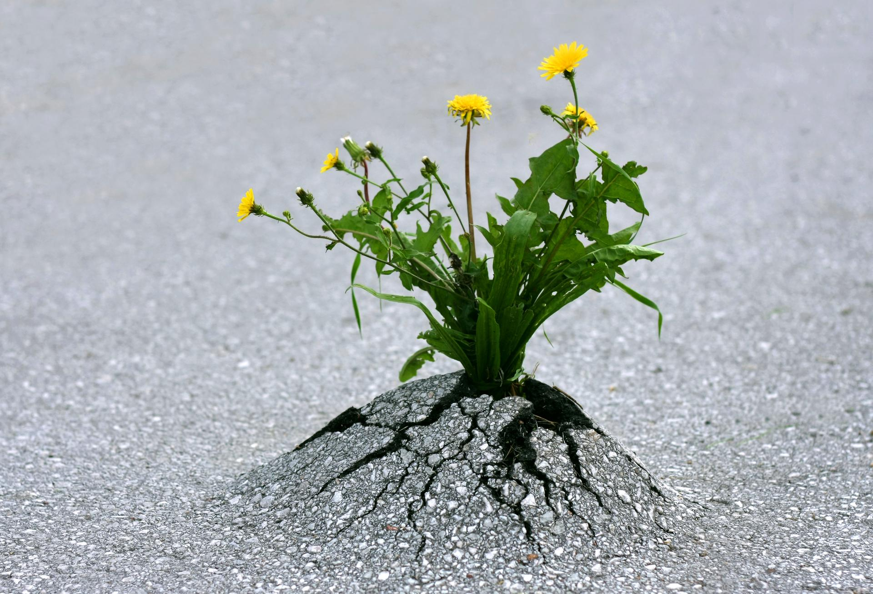
What is Resilience?
The ability to deal with high levels of challenge and disruption while maintaining high levels of effectiveness and well-being.
© 2020 Resilience Alliance, all rights reserved.

Slide 13

Challenge
Gap between current state and desired state
Physical, mental, emotional, and/or spiritual effort
Problem- or opportunity-based
© 2020 Resilience Alliance, all rights reserved.

Slide 14
Challenges Use Energy
Physical
Using the body to get things done
Mental
Thinking clearly and quickly
Emotional
Working with difficult feelings
Spiritual
Connecting with meaning and purpose

Slide 15

Adversity
Danger, threat, or loss
Affects our brains
Makes challenges harder

Slide 16
Four Building Blocks of Resilience
Calming
Choosing Strategies
Solving Problems
Building Energy

Slide 17

Calming
Different from relaxing
A positive, alert emotional state

Slide 18

Reframing
Choosing Strategies
Accepting
Altering
Reframing
Consciously shifting perspective
From adversity to opportunity
Reinterpreting the situation
iStockphoto.com
© 2020 Resilience Alliance, all rights reserved.

Slide 19

Solving Problems
Applying a core set of tools and capabilities to effectively address challenges:
  Positivity
  Confidence
  Priorities
  Creativity
  Connection
  Structure
  Experimenting
© 2020 Resilience Alliance, all rights reserved.

Slide 20

Managing Energy
Energy fuels our resilience. When it runs low, we have nothing to draw on.
We can protect, build, and replenish our energy.
© 2020 Resilience Alliance, all rights reserved.

Slide 21
Connections to Engagement

Slide 22
The Opposite of Engagement
Burnout
Engagement/Thriving
Exhaustion
Cynicism
Vigor
Ineffectiveness
Involvement
Efficacy
Bakker & Demerouti, Journal of Occupational Health Psychology, 2016
Maslach, Schaufeli, & Leiter, Annual Review of Psychology, 2001

Slide 23
Job Demands/Resources Model
Demands
Resources
Energy drains
Aspects of the job that require sustained effort and are associated with physiological and/or psychological costs
  Work pressure
  Emotional labor
  Work/home conflict
  Etc.
Energy boosters
Aspects of the job that help achieve work goals, address job demands, and/or stimulate personal development
  Supervisor support
  Team cohesion
  Autonomy
  Learning opportunities
  Etc.
Demerouti et al, Journal of Applied Psychology, 2001

Slide 24
Each Leads to Different Outcomes
High Job Demands
Exhaustion
↑ Burnout
↓ Engagement
Low Job Resources
Cynicism

Slide 25
Resilience Enables Engagement
Reducing Demands
  Wasting less energy
  Reframing, avoiding, or minimizing problems
  Dealing with challenges more effectively
  Recovering from disruption more quickly
Increasing Resources
  “Job crafting”—proactively redefining and customizing job tasks and interactions
  Seeking opportunities for growth
  Building and sustaining personal energy

Slide 26

Leader Resilience
Increased leader well-being
Modeling effective responses
Increasing engagement:
  Reducing unnecessary demands
  Increasing job resources

Slide 27
Building Your Own Resilience

Slide 28
Resilience: The Big Picture
Solving Problems
Out-comes
Calming
Strategies
Energy
Challenges

Slide 29
Resilient Outcomes
Minimizing Harm
Staying/ Getting Back on Track
Growth

Slide 30
Resilience Characteristics
Characteristic | Helps you…
Positivity | See possibilities and hope in challenging situations
Confidence | Engage your energy in approaching challenges
Priorities | Direct your energy toward your most important goals
Creativity | Generate a wide range of possibilities and ideas
Connection | Draw on others for resources and support
Structure | Apply organization and discipline to use energy efficiently
Experimenting | Take action in the face of uncertainty and learn by doing

Slide 31
Growing Resilience in Organizations
Practical Applications and Examples

Slide 32
Three Levels of Application
Individual
Understand/ manage own energy and responses to challenge
Team
Leverage individual energy and resilience strengths for team performance
Organizational
Systemic readiness for challenge
Leadership and culture that support resilient responses
Prepare and support individuals in dealing with challenges
Human energy sustainability
Development activities at team level

Slide 33
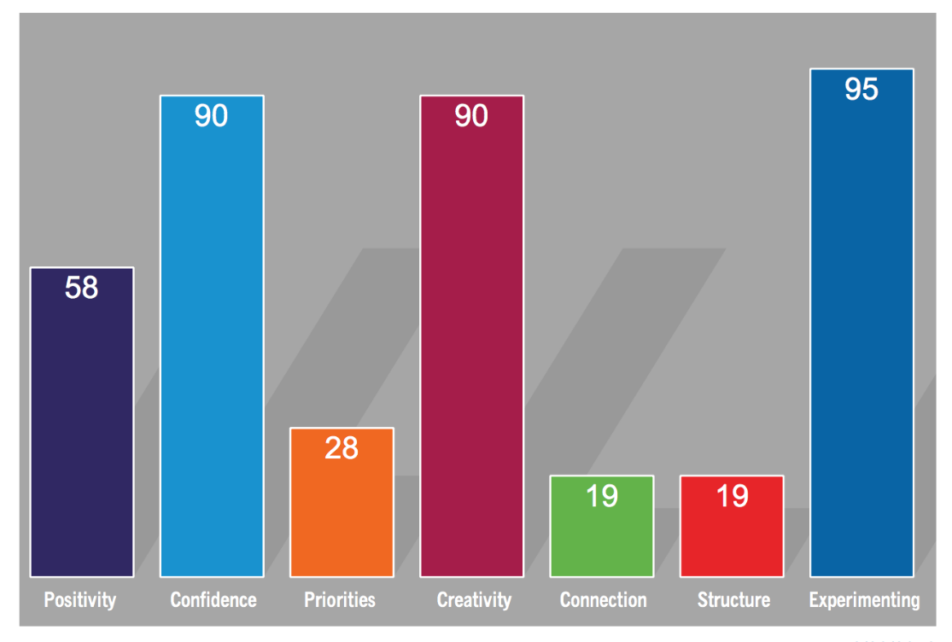
Leader Coaching
Leader was strong individual contributor.
Difficulty in planning and implementing a compensation change for his team.
Helped him articulate his vision, engage others, and design a solid structure.
Personal Resilience Profile used to identify predispositions in dealing with challenge.

Slide 34
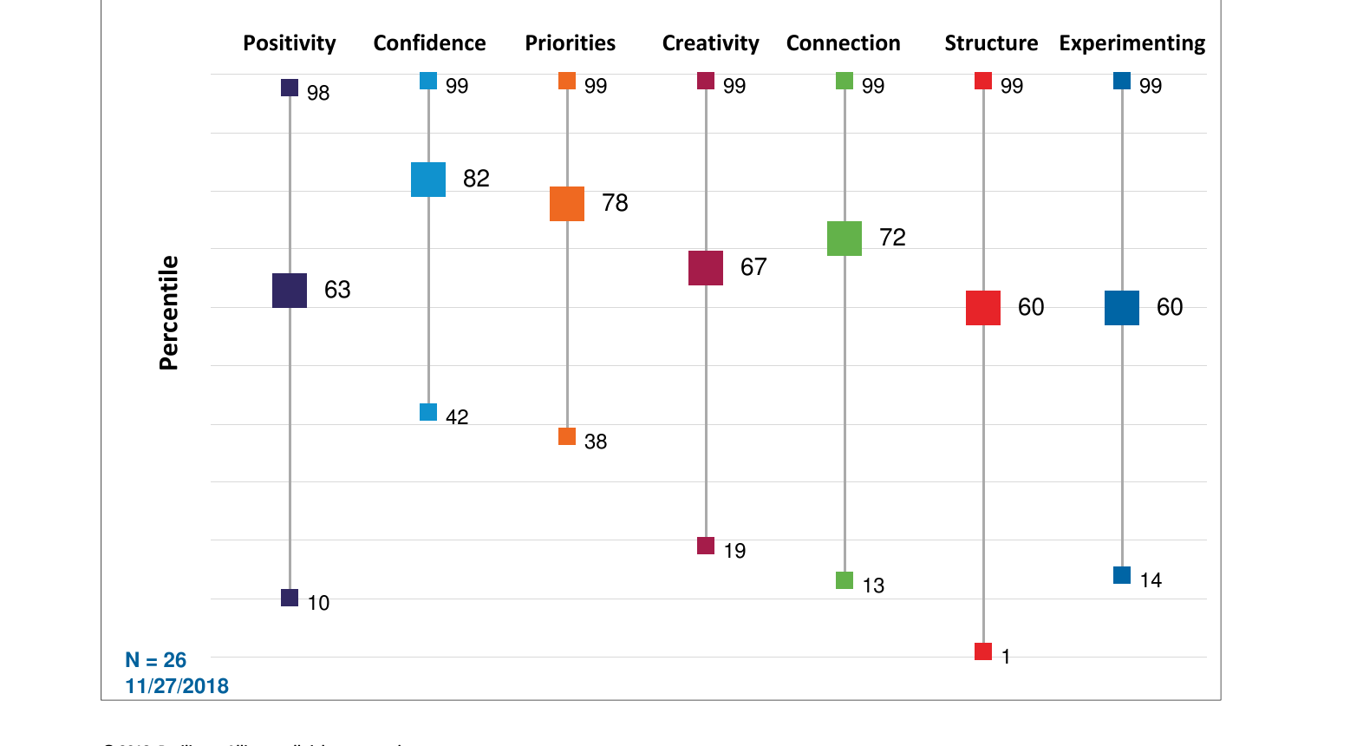
Team Development
Leadership team engagement high; rest of organization low.
Created insight around implications of high confidence and strong resilience muscles.
Developed action plan for employee discussions.
Group Resilience Summary used to create an aggregate picture of resilience for the senior team of a health-care system.

Slide 35
System-Level Support for Resilience
Characteristic
Positivity
Confidence
Priorities
Creativity
Connection
Structure
Experimenting
Leadership
Context
Culture
X

Slide 36
Summary
Resilience is the ability to deal with high levels of challenge and disruption while maintaining high levels of effectiveness and well-being.
The workplace presents many challenges—demands for physical, mental, emotional and spiritual energy.
The four building blocks of resilience—calming, strategies, problem-solving, and energy, help individuals deal with challenges more effectively.
Resilience increases engagement by equipping people to reduce job demands and increase job resources.
Resilience “muscles” can be developed through practice.
Within organizations, resilience can be developed at individual, team, and organizational levels.

Slide 37
Three Invitations
Fueling Resilience ebook
Complimentary Personal Resilience Profile and debrief session
Newsletters
linda@resiliencealliance.com
Linda Hoopes
Resilience Alliance
315 W. Ponce de Leon Ave, Suite 750
Decatur, GA 30030
404-371-1011

Slide 38


Additional Information
Webinar-based Certification

Slide 39
Upcoming Events
FEBRUARY 12th, 14th, 19th, 21st
Workshop series on Data Science for HR
MARCH 18th
HCG webinar: Talent Practices that Move the Needle on Diversity and Inclusion
HCG Talent Updates
SIGN-UP
Evidence-based insights on trending topics in talent management
WEBINARS, PODCASTS, BLOGS, EBOOKS
FOLLOW US
www.linkedin.com/company/human-capital-growth
@hcgtm
insights@humancapitalgrowth.com

Slide 40

Thank You!

