Slide 1



Webinar
PAY AND PERFORMANCE MANAGEMENT: ARE THEY TWO SIDES OF THE SAME DYSFUNCTIONAL COIN?

Slide 2



















We help organizations achieve better outcomes through talent using
science, analytics, and empathy.
Talent Management Excellence
Leadership Excellence
Drive business impact through timely talent actions
Deliver measurable and sustained improvements in leadership

Slide 3
Evidence-based Analyses
Webinars, Podcasts, Blogs, eBooks
Systematic reviews
Trending Practices
Performance Management
Employee Engagement
Talent Development
Executive Coaching
Skills for the new world of HR
Design Thinking in HR
Digital Learning
Digital Leadership
Certifications for skill development
Leadership Development
Talent Analytics
Employee Selection

Slide 4


Host and Guest Presenter
Shreya Sarkar-Barney, Ph.D.
CEO & Founder
Human Capital Growth
Alan L. Colquitt, Ph.D.
Managing Partner
Alan L. Colquitt, LLC

Slide 5
Agenda
Problems
Trending solutions
Trending solutions ineffective
Iterate (again) or transform?
PM 2.0 and Rewards 2.0

Slide 6

Complaints about PM 1.0
Takes too much time, too little value
Doesn’t help improve performance
Provides little feedback, feedback not helpful
Reviews/ratings aren’t accurate reflection of performance
Managers aren’t invested, don’t differentiate
Rewards not linked to performance
Process isn’t fair
Science doesn’t support it
Only 2% of companies believe their existing PM systems deliver exceptional value (Mercer 2018)

Slide 7
Trending solutions
Feedback. More of it, feedback culture, continuous PM, crowdsource
Ratingless PM
Management behavior and skills
Separate Evaluation & Development
Simplify, reduce the burden
Goals. Fewer, larger, higher quality, audits/calibration, skills, OKRs
Technology

Slide 8
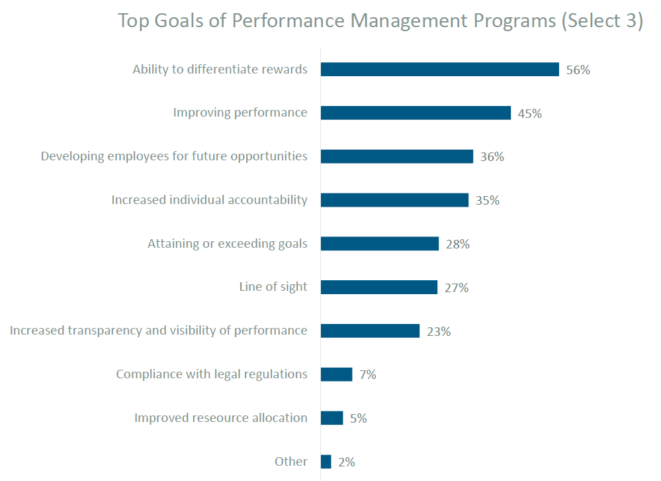
Trending solutions won’t work
Real purpose of PM: Evaluate performance to differentiate rewards
Trending solutions focus on secondary objectives
Compensation drives the PM bus
Solutions don’t address core problems with PM
WorldAtWork, 2017

Slide 9
Reward programs require PM 1.0
These tools and programs require performance ratings and differentiation of performance
Tools used to differentiate rewards based on performance
WorldAtWork, 2017

Slide 10
These programs aren’t effective
m
Companies say:
Cost too much
No differentiation
Differentiation not meaningful
Small budgets, underfunded
Poor execution
Managers weak, lack skills
Annual cycle—rewards not timed well
“US employers allocate roughly $345 billion annually to motivate employees for superior performance…” (Shaw & Gerhart, 2017
Employees say:
Lack of fairness
Zero-sum game, competition
Limited value
Lack of transparency
And yet they say they want them
Science says:
Money isn’t a strong motivator
P4P has limited effectiveness
P4P creates other problems
More pay differentiation isn’t effective
Tools used to differentiate rewards based on performance
WorldAtWork, 2017

Slide 11
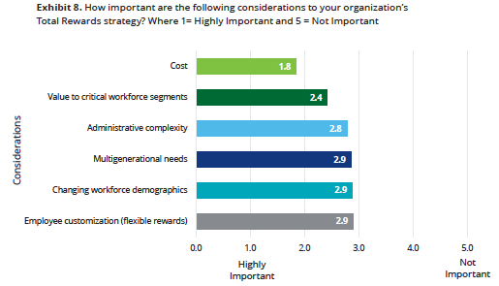
Reward fixes? Manage costs
Shift money from merit to variable pay
Spot bonuses
Non-cash rewards, recognition
Give key talent more
“Total rewards”
Strategic rewards…“pay for ??”
More transparency, better communication
Deloitte, 2017
Deloitte, 2017

Slide 12
What to do? Iterate or transform?
Separate Motivation from Managing Compensation
Motivate without money
Manage compensation without differentiation
How far are you willing to go?
Value
Different thinking
Reduce the pain
Make it kinder and gentler
Manage optics
Focus on managers
Same thinking
Iterate
Transform
Magnitude of Change

Slide 13

Transform: Paradigm shift
Motivate without Money
Manage Compensation Without Differentiation
Purpose and meaning
Progress and Positivity
Belonging
Autonomy
Mastery/Competence
Pay employees well
Grow their pay over time
Share the wealth
Other non-financial “rewards”

Slide 14
The Future
PM 2.0
Rewards 2.0
Management process, translates strategic priorities, provides direction and alignment
Goals are central, provide purpose and meaning, use the work to motivate
Continuous, everyday process, driven by the needs of the work, employees
Enable and support progress toward performance goals
Focus on positivity
Built around teams to reinforce belonging
Pay above market for critical skills, roles
Market-based pay increases
Cost-of-living adjustments
Robust internal labor market, more promotions
Pay the person instead of the job
“Shared capitalism.” Profit sharing, gain sharing, stock ownership
Non-monetized recognition
Investment in training, learning, development

Slide 15

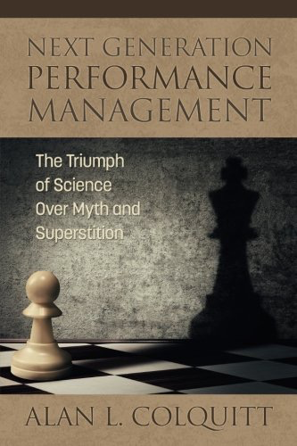





For more information…
alancolquitt@alancolquitt.com
https://www.linkedin.com/in/alan-colquitt-ph-d-45810b6/
https://twitter.com/acolquitt
www.alancolquitt.com
https://www.alancolquitt.com/blog-1
Video Infographic In partnership with 15Five and CognitiveMedia
April 5, 2019
© 2019 Alan L. Colquitt, Ph.D.
15

Slide 16
Thank You!
HCG Talent Updates
SIGN-UP
Evidence-based insights on trending topics in talent management
WEBINARS, PODCASTS, BLOGS, EBOOKS
insights@humancapitalgrowth.com
Follow us
www.linkedin.com/company/human-capital-growth
@hcgtm

