Slide 1

A New Approach to People Analytics Leading with Intelligence

Slide 2

Presenter
Dr. Shreya Sarkar-Barney
President & Founder
Human Capital Growth

Slide 3














We help organizations achieve talent management excellence and leadership excellence using science, analytics, and empathy.
Talent Management Excellence
Leadership Excellence
US
India
Notes:
We help organizations achieve TM excellence and leadership excellence.

Slide 4
What we do
Talent Management Excellence
STRATEGY
Leading with intelligence
AUDIT
Pinpointing opportunities
ANALYTICS
Fine tuning intelligence
EDUCATION
Shaping minds
Leadership Excellence
ASSESSMENT
Accurate insight on candidates
DEVELOPMENT
Inspiring growth & excellence
TEAM ALIGNMENT
Help leadership teams win
Notes:
Here are the range of services we offer. Human Capital Growth is excited to share that we now offer a full portfolio of solutions for optimizing your Talent Management function. If you’d like more information, Please reach out to us. We will share our contact information at the end of this session.

Slide 5
Agenda
Common approaches to people analytics
Challenges with traditional analytics efforts
New approach: Leading with intelligence
Case studies showcasing the new approach
Skills for leading intelligence-based people analytics

Slide 6
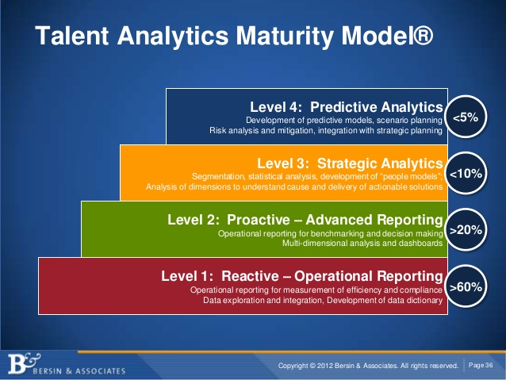
Talent Analytics Framework

Slide 7
Talent Analytics Methods
High
Value
Predictive modeling
Predictive analyses
Correlational
Low
Reporting
Dashboard
Benchmark
Hindsight
Insight
Foresight
Low
Complexity
High

Slide 8
Traditional Talent Analytics
80%
High
Value
Predictive modeling
Predictive analyses
Correlational
Low
Reporting
Dashboard
Benchmark
Hindsight
Insight
Foresight
Low
Complexity
High

Slide 9
The Talent Analytics Dashboard
Don’t Trust
of business leaders don’t trust talent data
Don’t Believe
of business leaders don’t believe talent analytics are focused on the right issues
Don’t Use
of HR leaders have not used information gleaned from data analytics to change a business decision in the past year
Source: CEB 2013
Notes:
http://raconteur.net/business/from-information-to-insight
Only 6 percent of worldwide HR teams feel they are “experts” on the use of analytics in talent management, according to a report from human resources research firm Bersin & Associates.
In fact, only 20 percent believe that the data they capture now is highly credible and reliable for decision-making in their own organization. - See more at: http://data-informed.com/the-potential-and-challenges-of-workforce-analytics/#sthash.6AKUg4ZK.dpuf

Slide 10
Traditional Talent Analytics Approach
Hindsight
Reacting to past challenges
1
2
3
4
Data
Analytics
Insights
Reactive
Actions
Phase 1
3 -12 months
Phase 2
12-18 month lag
May not be relevant
5
Outcomes
Phase 3
3-12 month lag
18-42 months
A little too late
Project Phases
1. Design
2. Implement
3. Improve

Slide 11
Can we Overcome these Challenges?
Trust in the data
Focus on the right business issues
Timeliness
Move from hindsight/insight to foresight

Slide 12
Alternative Approach
Talent Analytics: Leading With Intelligence
Timelines
Business Focus
1
Expected Outcomes
7-19 months
Phase 1
2-6 weeks
Foresight
2
3
Evidence
Planned Actions
Phase 2
3-6 months
Data quality
4
5
6
Measures
Analytics
Insights & Foresights
Project Phases
1. Design
Phase 3
3-12 months
2. Implementation
3. Improvement
Notes:
In step 3 establish the ground workforce analytics, including data structures

Slide 13
Traditional vs. Intelligent Analytics
Traditional analytics
Intelligent analytics
Past focused
HR Analytics isolated from business operation
Utilizes data
Justifying costs/ ROI
Future focused
HR Analytics integrated with business Operations
Utilizes data, metrics, and measures
Outcome focused
Good for steady state business
Keep pace with changes in the business

Slide 14
Data, Metrics, and Measures
Data
Raw information, can be numeric or non numeric
Metric
Using data to compute a single score or a set of scores to represent a phenomenon
Measures
Developing a metric that is a reliable and valid representation of an abstract concept

Slide 15
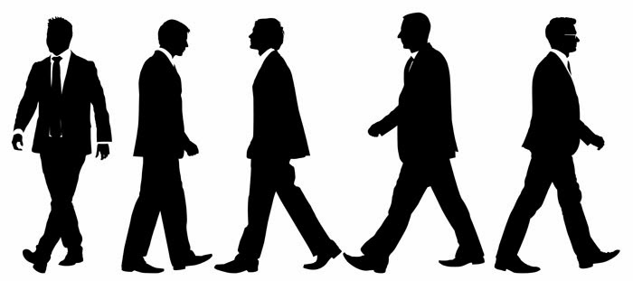

“Put more feet on the street to close the revenue gap”
Client: Midsize Software Firm
CASE STUDY

Slide 16




“Put more feet on the street to close the revenue gap”
BUSINESS CHALLENGE
CASE STUDY
Publicly traded: Meet analyst expectation
Expand sales team
Increase revenue and profitability
Meet revenue target in Less than 12 months

Slide 17
Solution
Outcome
Deploy more sales executives to grow revenue
Reduce time to productivity from 18 months to 6 months
Evidence
Onboarding
Assessment
Goal Setting
CASE STUDY
Design & Implementation
6 Months
Actions
Two week Sales Boot camp
60-90-120 day plan with mentoring and feedback
Measures
Individual performance data during the boot camp
Goal achievement
Analytics
Chart with rank ordering of new hires by scores

Slide 18
Using Evidence to Gain Foresight
Outcome
Shorten onboard time
New hire socialization
Source: Bauer, T. N., Bodner, T., Erdogan, B., Truxillo, D. M., & Tucker, J. S. (2007). Newcomer adjustment during organizational socialization: a meta-analytic review of antecedents, outcomes, and methods. Journal of applied psychology, 92(3), 707.
Outcome
Predicting skill transfer
Knowledge and attitude change
Source: Kraiger, K., Ford, J. K., & Salas, E. (1993). Application of cognitive, skill-based, and affective theories of learning outcomes to new methods of training evaluation. Journal of applied psychology, 78(2), 311.
Outcome
Manage performance
Goal setting and feedback
Source: Mento, A. J., Steel, R. P., & Karren, R. J. (1987). A meta-analytic study of the effects of goal setting on task performance: 1966–1984. Organizational behavior and human decision processes, 39(1), 52-83.
CASE STUDY

Slide 19
Sales Director Score Card
 | Knowledge Test |  |  | Business Case Analysis |  |  |  |  | Overall Score
Name | Product group A | Product Group B | Product Group C | Identification of correct solution | Presentation | Pitch | Customer Engagement | Comments
A
B
C
D
E
F
G
H
I
J
K
L
M
CASE STUDY
Top Quartile
Bottom Quartile

Slide 20
Results
After 6 months
X
CASE STUDY
Bottom Quartile
Top Quartile

Slide 21
Lessons Learned
Alignment around key outcomes
Culture of data-based decision making
Evidence on key drivers
Forward looking insights
CASE STUDY

Slide 22
Traditional Talent Analytics
Use of evidence-based practices provided foresight with simple analytics
High
Value
Predictive modeling
Predictive analyses
Correlational
Low
Reporting
Dashboard
Benchmark
Hindsight
Insight
Foresight
Low
Complexity
High

Slide 23

“ Justify the Training Expenditure”
Client: Large Technology Firm
CASE STUDY

Slide 24





“ Justify the Training Expenditure”
BUSINESS CHALLENGE
CASE STUDY
Ivy league business school providing marketing education
Over a million dollars annual budget
“Quantify the value or else deploy budget elsewhere”
Some data/metrics/measures available
Need results in six weeks

Slide 25
ANALYTICS STRATEGY
Review of archival data
  Training participation data
  Marketing competency scores
  Performance ratings
Generation of predictions
  Competency scores will be higher for trainees than non-trainees
  Post training competency scores will be higher than pre-training scores
  Performance rating scores will be higher for trainees than non-trainees
Statistical approach
  Logistic linear regression
  Discriminant analysis
CASE STUDY

Slide 26
INSIGHTS
Market Competency 1
CASE STUDY
In Time 1, trainees and non-trainees had similar competency scores.
In Time 2 (a year apart), the competency ratings of trainees was on average 2 points higher than non-trainees (statistically significant difference)

Slide 27
INSIGHTS
Comparison by Review Rating
CASE STUDY
Trainees had higher (statistically significant) review ratings than non-trainees.

Slide 28
EXPLORATORY ANALYSES
Does more training result in higher performance ratings?
CASE STUDY

Slide 29
EXPLORATORY ANALYSES
Who gets to attend the training?
Managers were nominating high performers for the training. Those with low performance ratings, arguably those who needed it the most, did not get access to the training.
CASE STUDY

Slide 30





Summary
Leadership focus on data-based decision making
Focused on a critical business question
Use of measures not just data
Timely and relevant analyses
Forward looking view to de-risk the future
CASE STUDY

Slide 31
Talent Analytic skills to Lead with Intelligence
Awareness of how the organization operates, competes and wins in the marketplace
Business Acumen
What predicts workplace behaviors and human performance?
Evidence-based talent management
Measurement of Human Attributes
Expertise in measuring attributes such as leadership, satisfaction, motivation
Expertise in data types, descriptive and inferential statistics, qualitative analysis, levels of analysis
Statistics

Slide 32
Roadmap: Leading with Intelligence
Strategic challenge
Understand what outcomes are important to the business
Evidence-based practice
Use prior evidence to select “initiatives” required to deliver outcomes
Data and measurement model
Plan to measure all aspects of the initiative
Analytics and data visualization
Analyze data and report to stakeholders
Improve and advance
Assess implication of the findings, make recommendation for improvement, develop plans for improvement

Slide 33
Questions?

Slide 34
Questions?
Next HCG Webinar
Employee Selection Practices for Low Literacy Candidates
Dr. Victoria Davis
Thursday, September 22nd, 2016
8am PT
Notes:
IW:
We have few minutes left to take Questions
All lines are unmuted now,
Feel free to speak your question or type in the chat box

Slide 35
For a free one hour consultation email us at info@humancapitalgrowth.com
Talent Management Excellence
STRATEGY
Leading with intelligence
AUDIT
Pinpointing opportunities
ANALYTICS
Fine tuning intelligence
EDUCATION
Shaping minds
Leadership Excellence
ASSESSMENT
Accurate insight on candidates
DEVELOPMENT
Inspiring growth & excellence
TEAM ALIGNMENT
Help leadership teams win
Notes:
If you’re company is interested in a free hour consultation on how to use Design thinking and evidence based talent management, please email us at info@humancapitalgrowth.com

Slide 36
Next Webinar

Slide 37
Thank you!
Shreya Sarkar-Barney, Ph.D.
Shreya@humancapitalgrowth.com
+1.707.317.7644

