Slide 1


Five Science-based Answers to the Most Pressing HR Problems of 2017
#5sciencebasedanswers
Notes:
Hello, everyone, and thank you for joining us today. My name is Corey Grantham, and I am a consultant at Human Capital Growth.
We at Human Capital Growth undertook an exhaustive review of the research done in 2016 in the field of talent management. Our goal was to uncover the year’s most influential studies that address some of the most pressing problems in the world of work. Today’s webinar will present the findings from five of those important studies.

Slide 2



Presenters
Alyssa Perez
Human Capital Growth
Shreya Sarkar-Barney, Ph.D.
President & Founder
Human Capital Growth
Corey Grantham
Human Capital Growth
Notes:
I will be co-hosting today’s webinar along with two of my colleagues. First, we have fellow consultant, Alyssa Perez [Alyssa’s greetings]. Next, we have President and founder of Human Capital Growth, Dr. Shreya Sarkar-Barney. [Shreya’s greetings.]
We are really excited to be leading this webinar. There is a lot of exciting research coming out on talent management practices which we are happy to share with you. Thank you again for joining us today.

Slide 3
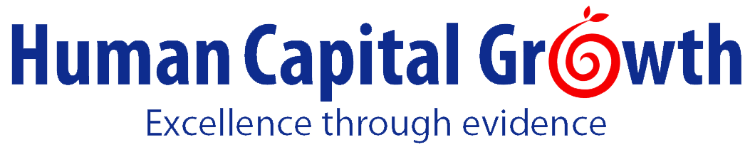










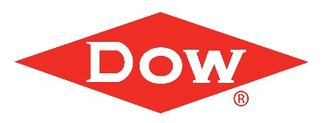


We help organizations achieve talent management excellence and leadership excellence using science, analytics, and empathy.
Talent Management Excellence
Leadership Excellence
US
India
Notes:
If you are not familiar with Human Capital Growth:
We are a boutique Talent Management firm. Our mission is to help organizations and employees thrive together. We help organizations achieve Talent management excellence, and Leadership excellence. We do this by putting a spotlight on the truth, as well as using empathy and insights from science and analytics . We have bases in the US and in India. We work with clients ranging from non-for-profit entities to fortune 500 companies around the world. (You can see some of the clients we work with. )
Here is the range of services we offer.

Slide 4
What We Do
Talent Management Excellence
Leadership Excellence
STRATEGY
AUDIT
DESIGN
ANALYTICS
EDUCATION
DEVELOP
ALIGN
ASSESS
Notes:
Human Capital Growth is excited to share that we now offer a full portfolio of solutions for optimizing your Talent Management function. If you’d like more information, please reach out to us. We will share our contact information at the end of this session.

Slide 5
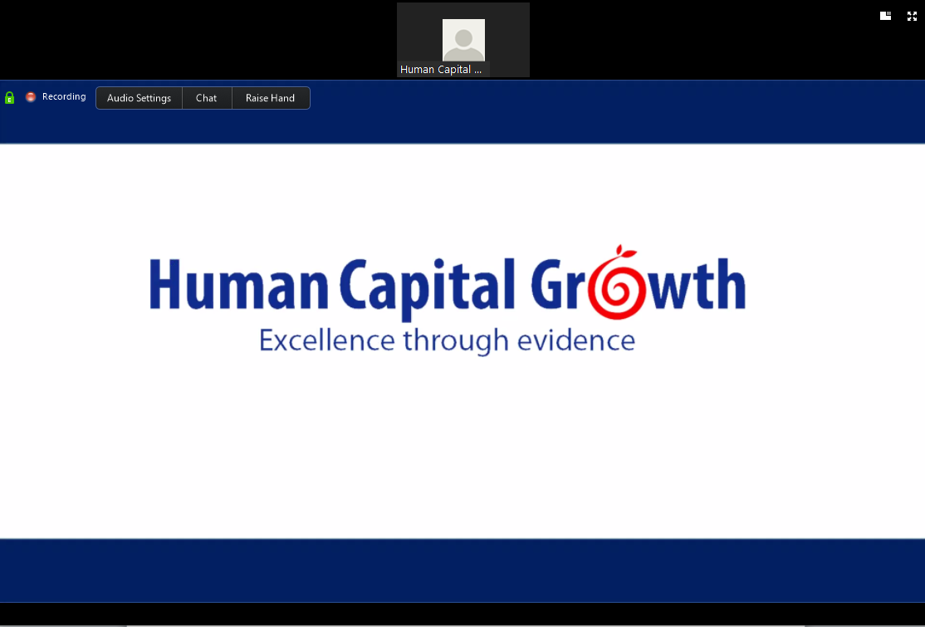
The Zoom Web Conferencing Platform
To test/adjust computer audio
Chat for Tech support or to comment
Raise Hand to comment by voice
If you require HCG or HRCI recertification credits for your participation, please be sure to join with your full name.
Notes:
Before we begin, here’s a quick overview of the conferencing platform we use, zoom. If you need to test or adjust your computer’s audio, you can do that by clicking in the Audio Settings button on the top left of the zoom tool bar. You will notice that your audio was placed on mute when you entered the webinar session. You will be able to communicate with us through the use of the Chat feature (which you can access from the Chat button at the top of the zoom tool bar). This Chat feature allows you to connect with tech support for this webinar or to comment on the material being presented. Next to the Chat button is the Raise Hand button, which allows you to comment or ask questions by voice. If you require HCG or HRCI recertification credits for your participation in today’s webinar, please be sure that you have joined this session with your full name. Now, let’s begin our webinar. I’ll turn it over to Shreya, who will present an overview of the topics we’ll be discussing today.

Slide 6
Most Pressing HR Problems of 2017
Diversity
Leadership
Technology and work-life
Social media and recruiting
Employee engagement
Notes:
Today, we will be discussing five of the most pressing HR problems of 2017. These challenges were identified by leaders and HR professionals as critical issues in organizations. The five problems are in the areas of diversity, leadership, technology and work-life balance, recruiting with social media, and managing employee engagement.

Slide 7
2017 Deloitte Human Capital Trends
Notes:
Deloitte’s most recent survey of Human Capital Trends support the need for programs and interventions to be developed around these five issues.

Slide 8
Questions
What are some surefire ways to achieve gender diversity in the workplace?
Should you use social media to decide who you hire?
Should you or should you not be tethered to technology after work hours?
Which leader behaviors are best at driving team performance?
What works in improving employee engagement?
Notes:
Today’s webinar, then, will answer the following questions:
What are some surefire ways to achieve gender diversity in the workplace?
Should you use social media to decide who you hire?
Should you or should you not be tethered to technology after work hours?
Which leader behaviors are best at driving team performance?
What works in improving employee engagement?
First, we’ll examine ways in which gender diversity can be improved in organizations. For this, we’ll turn to Alyssa.

Slide 9

Gender Diversity
What are some surefire ways to achieve gender diversity in the workplace?
Kalysh, K., Kulik, C. T., & Perera, S. (2016). Help or hindrance? Work–life practices and women in management. The Leadership Quarterly, 27(3), 504-518. http://dx.doi.org/10.1016/j.leaqua.2015.12.009
Notes:
Thank you, Corey, and thank you again everyone for being with us. My name is Alyssa and I will be talking to you about our first research question; “What are some surefire ways to achieve gender diversity in the workplace (What types of investments does it take to achieve gender parity in the workplace?)”

Slide 10
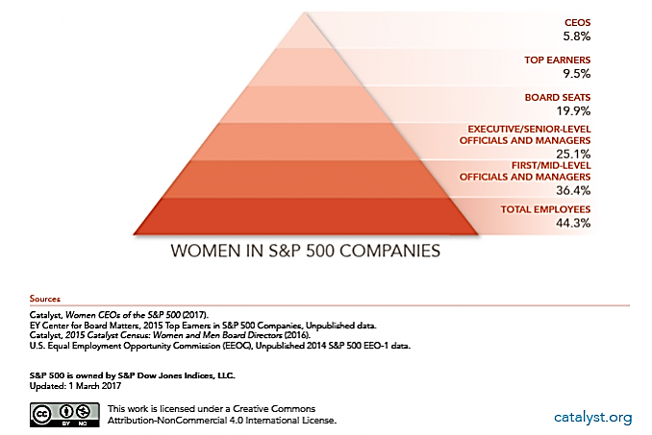
Representation of Women in Management
Notes:
In 2015, women held slightly more than half (51.5%) of management and professional occupations overall, and in 2014 women earned more than half of educational degrees at every educational level [bachelor's degrees (57.1%), master’s degrees (59.9%), and doctorate degrees (51.8%)]. In spite of that, most of female managers stay at entry-level or lower-level management positions.
As demonstrated in particular by these S&P companies, as we go higher up the ladder of management, the proportion of women represented shrinks. Women make up only fractions of top earners, higher level managers, and CEOs.
This past year, there was an IMPACTFUL study that shed some insights on the likely causes and what organizations CAN DO to improve gender diversity.

Slide 11
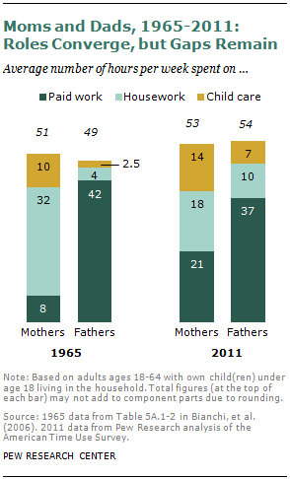

Societal Practices on Child Rearing Contribute to the Gender Gap
70% of mothers work
Approximately 1/3 of working women are mothers
Notes:
70% of mothers work. Approximately 1/3 (34.2%) of working women are mothers. Further, mothers are typically expected to do far more child care and household chores than fathers, and thus women with children carry the burden of house work more than their male counterparts. This discrepancy likely explains why working mothers tend to prefer part time work to full time work (with 47% compared to 32%). Working women (especially mothers) have a need for greater work-family balance in order to enable them to excel and advance in the workplace.
If firms want to increase their gender diversity, they must take additional steps to ensure work-family balance is possible for their employees.
Because of this, Kalysh, Kulik, and Perera studied work life practices as a predictor of women in management

Slide 12

The Study:
Archival Data from Australia’s WGEA
2002-2014
Women in management
Workplace programs for gender diversity
675 Organizations
Average of 64 years and 1130 employees
Notes:
The study conducted was done in Australia and focused on Archival data. Data were collected from Australia’s Workplace Gender Equality Agency (WGEA) which requires that organizations REPORT their gender composition in management and non-management roles, as well as workplace programs for improving gender equality and removing barriers to women entereing and advancing within the organization.
The study looked over these reports from 2002 until 2014 and analyzed them to determine if the reported work-life balance programs in place had any relationship with the proportion of women in management.
Our starting sample was a random sample of 675 organizations that had submitted reports to the WGEA in 2006. The organizations
had been in operation for an average of 64 years and employed on average 1130 people.

Slide 13

Poll: Which of these work-family programs does your organization offer?
Notes:
Our first question for you is this: which of the following programs does your organization offer in the way of work-family options?
You can fill out all that apply.
1) leave arrangements: parental leave, leave to take care of a sick
child, short break (Poelmans, Chinchilla, & Cardona, 2003), flexible annual leave, family leave, carer's leave, and special leave;
2) Flexible work schedules: part-time, staggered hours, job share, flexitime, compressedworkweek, reduced hours (Callan, 2007), casual hours, and
flexible start/finish time;
3) direct provision of services: childcare, eldercare (Wright & Sheridan, 1998), employee assistance programs (Bourhis, Mekkaoui, & Déom, 2010), and breastfeeding facilities; and
4) virtual office facilities: work at home, telecommuting, telework and video conferencing (Poelmans et al., 2003), remote access technology, and provision of laptop/phone.
If you have another option, please feel free to write it to us in the chat

Slide 14


Study Findings
1. What organizations invest in matters: overall, work-life practices effect the proportion of women in management.
2. What conditions exist prior to investments matters as well: investment commitments must be stronger in male-dominated organizations.
Notes:
There organizations invest their resources MATTERS; and for gender diversity, work life programs DO MAKE a difference. The biggest return was found to come from work-life programs.
HOWEVER: It is important that the RIGHT CONDITIONS EXIST for these investments to pay-off. That is, investments are less likely to produce results in male-dominated organizations

Slide 15

Poll: For how many years has your organization offered work-family programs?
Notes:
Here is another question for you all. Some of you answered the previous poll that your organization has work-family programs in place. So, now the question is, how long has your organization employed work-family programs?

Slide 16

Study Findings
3. How long investments last relates to gender parity: the positive effect of work-life practices on women in management was only found after an 8-year time lag.
Notes:
If you answered longer than eight years, then your organization is on the right track. Another important finding by this study showed that how long companies commit to investment is incredibly important: The important effect of work-life programs on women in management only showed results after 8 years. Therefore, organizations must be prepared to make long-term investments in their work-life programs in order to reap the full benefits of these programs.
Shreya, what does this finding mean for organizations?

Slide 17
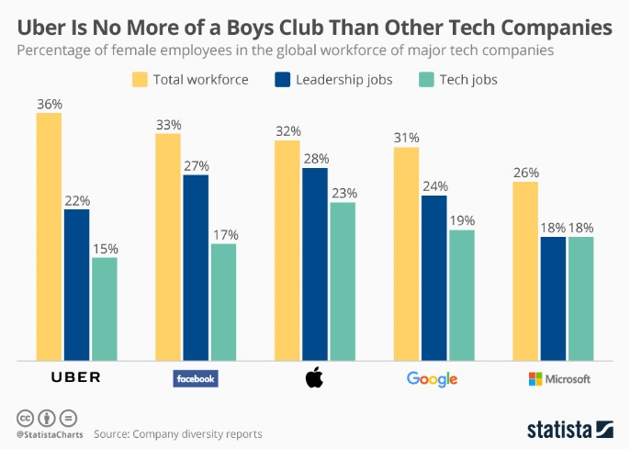
Practical Implications
Support
MANAGE THE EMPLOYEE LIFE CYCLE
Hire
Manage
Develop
Design options to retain women in the workforce across life stages.
Organizations need to make long-term investment commitments in work-life programs (4-8 years)
The early years may not reveal any ROI

Slide 18

Social Media & Hiring Decisions
Should you use social media to decide who you hire?
Van Iddekinge, C. H., Lanivich, S. E., Roth, P. L., & Junco, E. (2016). Social media for selection? Validity and adverse impact potential of a Facebook-based assessment. Journal of Management, 42(7), 1811-1835. doi:10.1177/0149206313515524
Notes:
Thank you, Alyssa. That was an insightful look at how to increase gender diversity in organizations. Next, we’ll examine how firms use technology in the employee selection process.
Many of you have probably considered ways of using popular technology to aid your search for quality talent. You want tools that provide a lot of information about job candidates at minimal cost. One popular trend that I’ve noticed during my career as an HR manager is for hiring managers and recruiters to use social media sites, such as LinkedIn, Facebook, and Twitter as tools for attracting and researching potential candidates.

Slide 19



77%
of organizations use social media sites for recruiting.
75%
of recruiters report being required by their employers to use social media for employee selection.
70%
of recruiters have rejected job candidates based on material found on social media websites.
Notes:
In 2008, 34% of organizations used social media sites as a recruiting tool. By 2013 that number had shot up significantly, and the Society of Human Resource Management (SHRM) reported that 77% of organizations use social media sites in some way for employee selection purposes. A senior manager for the Equal Employment Opportunity Commission (EEOC) in the United States reported that approximately 3 out of 4 recruiters across multiple industries are required by their firms to conduct online research of job candidates. What’s more, 70% of recruiters state that they have rejected candidates based on the material found on social media websites. Frequent updates to user privacy settings on social media platforms (especially on Facebook) have made gaining access to candidates’ personal information much easier for prospective employers. But does the information featured in candidates’ social media profiles predict their job performance?

Slide 20









Illegal
Notes:
Besides posing potential problems for job applicants, searching a candidate’s social media profile presents organizations with potentially damaging consequences. First, much of the information uncovered by recruiters from looking at social media profiles is not job-related. For example, one’s age, hobbies, religious views, political leanings, and marital/relationship status all appear on one’s Facebook profile, but have very little to do with a person’s ability to perform most jobs. Using much of this type of information for employee selection is considered illegal in most states in the U.S. and in many countries around the world.

Slide 21

Study: Social Media For Hiring?
1.) Recruiters viewed Facebook profiles of job candidates.
Source: Brown & Vaughn, 2011; Davison, Maraist, Hamilton, & Bing, 2012; Grasz, 2012
Notes:
Despite the trend of using social media sites in the employee selection process, research has shown that viewing candidates’ social media profiles to predict a candidate's success in the role doesn’t work. Last year, Van Iddekinge, Lanivich, Roth, and Junco conducted a study in which they had staffing specialists and hiring managers from multiple organizations view and rate Facebook profiles of job applicants. These applicants were recent college graduates, and their Facebook profiles were used by the recruiters and hiring managers to rate them on 10 skills that are required for most jobs across any industry.

Slide 22

Study: Social Media For Hiring?
2.) Recruiters rated candidates on 10 skills.
3.) Supervisors’ ratings of the employee were completed and compared to the recruiters’ ratings.
10 Skills
Adaptability
Creativity
Dependability
Integrity
Intelligence
Interpersonal Skills
Leadership
Maturity/Professionalism
Work Ethic
Written Communication Skills
Notes:
After the applicant had been employed on the job an average of 13.7 months, the ratings made earlier by the recruitment professionals were compared to performance evaluations completed by each employee’s supervisor. These two sets of ratings were then used to determine whether there was any correlation between the employee’s predicted and actual job performance.

Slide 23

Study Findings
1. Ratings of applicants did not predict applicant job performance.
Source: Van Iddekinge, Lanivich, Roth, & Junco, 2016
Notes:
If you recall, 70% of recruiters had reported rejecting candidates based on the information contained in the candidate’s social media profile. This study found, however, that candidates’ social media profiles did not predict job performance. That is, recruiters’ ratings of applicants were not related to supervisors’ ratings of the employee after the employee had been on the job for longer than a year. I would like to emphasize that this study was not performed in a lab setting and involved real job candidates that went on to be employees in actual organizations. The recruiters that participated in this study were also real recruiters that had an average of 6.40 years of experience recruiting and selecting employees.
[Additional notes from the study not to be read during the webinar]:
A total of 86 recruiters agreed to participate in the study. Participants were HR staffing specialists (n = 40), hiring managers (n = 29), or employees in the job who were assigned to do recruiting (n = 17). These participants possessed an average of 6.40 years of experience recruiting and selecting employees (SD = 5.46). This set of participants was 55.8% female and 82.4% White (other participants were Black, Hispanic, or Asian), and their average age was 33.11 years (SD = 9.12).

Slide 24
Study Findings
2. Recruiters’ overwhelmingly preferred White females above all other sub-groups.
Source: Van Iddekinge, Lanivich, Roth, & Junco, 2016
Notes:
Another critical finding of this study was that recruiters tended to prefer White females above all other subgroups, posing serious legal and ethical problems for organizations. For companies looking to achieve meritocracy and prevent adverse impact, the findings of this study are extremely problematic.
Shreya, should organizations be using social media sites at all for employee selection? If so, how should firms use these sites?

Slide 25
Practical Implications
Support
MANAGE THE EMPLOYEE LIFE CYCLE
Adopt practices that do not screen out qualified candidates
The information a candidate reveals in their social media profiles may not be indicative of their fit with the role.
Social media better suited to generate a large candidate pool but not fit for screening candidates.
Using social media for screening may result in reverse discrimination opening up the possibility for legal scrutiny.
Hire
Manage
Develop
Notes:
[NOTES]: Using social media sites to screen job candidates opens up the potential for the organization to incur legal action. Furthermore, organizations using social media for selection could be screening out qualified candidates based on information that does very little to predict employee job performance.
Social media is best used to advertise job openings and to engage in employer branding (such as sharing “Best Placed to Work” awards). So, until additional research can be conducted on ways to effectively use social media in the selection process, organizations should discontinue using sites such as Facebook to search for information on job candidates and should only use social media as a means of growing an organization’s applicant pool.
[SCRIPT]: Thank you for sharing your insight about this topic, Shreya. Next, Alyssa will talk about another topic related to the use of technology in the workplace.

Slide 26

Tethered to Technology
Should you or should you not be tethered to technology after work hours?
Ferguson, M., Carlson, D., Boswell, W., Whitten, D., Butts, M. M., & Kacmar, K. (2016). Tethered to work: A family systems approach linking mobile device use to turnover intentions. Journal of Applied Psychology, 101(4), 520-534. doi:10.1037/apl0000075
Notes:
Thank you, Corey. From social media, we will now switch to another technology related topic, which is to what extent should organizations expect employees to be connected after hours.

Slide 27


Work-Family Balance
45% of employees in tech-enabled firms report working during family time
Involuntarily working from home can lead to:
burnout
lower organizational commitment
increased work-family conflict
turnover intentions
Source: Pew Research Foundation
Notes:
Many employees are working more and more after hours due to a constant technological connection to work. 45% of employees report working in the family domain through their mobile devices. Working from home with a mobile device has been referred to as mWork.
However, often times this mWork is necessary but involuntary on the part of employees. Involuntarily working from home through mWork has many negative effects on employees, such as burnout, less commitment to the organizations, conflict with their families and ultimately, these things can lead to turnover.
A unique and important study conducted by Ferguson and colleagues looked at the family (particularly the spouse)’s role in these negative work outcomes.

Slide 28

Work-Family Balance Policies
Does your organization have policies on mobile work during off times?
Notes:
Here is my question to all of you:
Does YOUR organization have policies on mWork?
If so, in the chat, please share and discuss what is in those policies.
For example; some governments and organizations have proposed steps to limit the amount of working from home employees can do
France’s law: “Right to Disconnect”
Volkswagen: Shut off e-mail servers after hours.
What should I talk about?
There is no clear answers. Business world. More responsive=better opportunities. Managers find them reliable. However, what about burnout? Fine balance.
Some concerns about “overtime” work. Employees CANT work beyond 40 hours.
Others are expected. Competitive in the fields.
That’s what this study was addressing.

Slide 29

Study: Mobile Device Use and Turnover Intentions
344 employees and their spouses
Work-to-family conflict: time-based, strain-based, and behavior-based
Source: Ferguson et al., 2016
Notes:
This study in particular examined 344 employees and spouses in a management firm. The study was interested in looking at how an employee’s family can impact outcomes at work.
They examined Work-Family conflict in 3 facets:
Time-based : takes time away from family activities and interactions
with family members
Strain-based : leads to stress and distraction for the job incumbent
Behavior-based: triggers behaviors appropriate when interacting with a coworker or subordinate but that are less acceptable within the family context.

Slide 30




Study Findings
Work-family conflict becomes spousal resentment of organization
Through conflict, spousal resentment lowers organizational commitment…
Which leads to turnover intentions
Notes:
****The study found that mWork related to work-to-family conflict, especially spousal resentment of the organization.
The study found that across gender, age, and number of children, mWork related to work-family conflict and resentment.
Through conflict, spousal resentment lowers organizational commitment for both the incumbent and his or her spouse, which leads to turnover intentions.
The important finding here is that the path between mWork and turnover did not exist through the incumbents alone, but occurred specifically through spousal resentment!*
Shreya, would you mind talking about what this means for our organizations?

Slide 31
Practical Implications
Support
MANAGE THE EMPLOYEE LIFE CYCLE
Hire
Manage
Develop
Instead of mandating/banning mWork, focus on creating a supportive work environment giving employees a choice of when and how they work.
Raise consciousness about managing family time.
Create a supportive work culture where there are no negative consequences to those who prioritize family time
Notes:
The researchers suggest employers limit or place boundaries around the working-from-home that their employees do, in order to be intentional and consistent in their expectations so employees are not caught by surprise and able to adapt it into their schedules without burnout.

Slide 32

Leader Behaviors
Which leader behaviors are best at driving team performance?
Owens, B.P., & Hekman, D.R. (2016). How does leader humility influence team performance? Exploring the mechanisms of contagion and collective promotion focus. Academy of Management Journal, 59(3), 1088-1111. doi:10.5465/amj.2013.0660
Notes:
Thank you, Alyssa. I know from my time as an HR manager that that is very helpful guidance for policy development. Next, we will talk about leadership, a perennial challenge for most organizations. The topic of this next study is getting a lot of coverage right now in the media.

Slide 33
Poll: Who do you think will be a better team leader?
Alex
Avoids appearing weak
Exhibits confidence
Behaves self-righteously
Seeks personal status above team’s status
Does not publicly acknowledge mistakes
Chris
Recognizes team member’s contributions
Shows appreciation for effort
Open to new ideas
Places team’s goals ahead of own
Admits/corrects own mistakes
Notes:
Let’s begin with a poll: of the two leaders we’re about to describe, who do you think will be the better team leader?
The first leader, Alex, avoids all appearances of being weak. Alex exhibits confidence and behaves self-righteously. Alex seeks personal status above the status of the team, and Alex will not publicly acknowledge mistakes.
Chris, on the other hand, recognizes team member’s contributions and shows appreciation for effort. Chris is open to new ideas, places the goals of the team over personal goals, and will admit and correct personal mistakes.
So, who do you think will be the better leader: Alex or Chris? I'll give you a moment to select your response.
Let's look at what the audience decided.
Under everyday circumstances, the correct answer would be Chris. But don’t worry: if you chose Alex, then you are not alone. Many people in the Western World, including the United States, Canada, Britain, and many parts of Europe would select Alex’s leader behaviors as the most effective at driving their teams to achieve results. In fact, during my career as an HR manager and recruiter, I found that many organizations asked recruiters to look for these traits specifically when selecting leaders for any level of leadership within their organizations. But do these behaviors actually make for an effective leader? A study conducted by Owens and Hekman this past year suggests that an unlikely leader behavior may yield better team and organizational outcomes: that behavior is humility.

Slide 34

Humility
Views own strengths and weaknesses accurately
Teachable
Open to learning and growth
Notes:
But what exactly do we mean by “humility?” Humility is a misunderstood behavior often associated with weakness in the United States. The field of psychology, however, defines humility as an attribute that occurs in a social context, and it is characterized by a willingness to view one’s own strengths and weaknesses accurately and to judge others’ strengths and shortcomings accurately as well. Being humble also means being teachable and open to growth experiences.

Slide 35

Humble Leader Behaviors
Focus on others’ strengths
Encourage others to share their perspectives
Acknowledge own limitations
Support others’ growth and achievement
Source: Basford, Offermann, & Behrend, 2014; Ou et al., 2014; Owens et al., 2013; and Owens, Wallace, & Waldman, 2015.
Notes:
A leader who demonstrates humility will foster a supportive organizational context by drawing focus to others’ strengths, encouraging others to share their perspectives, possess a willingness to acknowledge his/her own limitations, and support others’ growth and achievement. Furthermore, a humble leader will inspire follower loyalty and commitment, reinforce job satisfaction, work engagement, and employee retention, and temper the negative effects of leader narcissism, leading to more positive follower outcomes.
A non-humble or authoritarian leader will avoid all appearances of being weak. He/she will be over-confident and self-righteous, will not publicly acknowledge mistakes, and will seek personal status above the status of his/her team. These behaviors are contagious and will create teams of competitive individuals vying for individual status instead of focusing on achieving the goals of the team.
[Additional notes from the study not to be read during the webinar]:
As an organizing theoretical basis, scholars have effectively used Baumeister’s (1998) self-experience framework to justify the dimensions of humility as comprehensively capturing the core ways that individuals understand and experience themselves (see Ou et al., 2014). This framework entails understanding the self in relation to the world (reflexive consciousness), in relation to others (interpersonal being), and by what one does (executive function). Reflecting each component of the self- experience framework, our view of humility captures how one views themselves in relation to the world (more objectively), how they view others (more appreciatively), and how they receive new information or perspectives (more openly). Humility has also been connected to the concept of self-transcendence, or acknowledging something greater than the self and connecting with things outside the self (Dennett, 1995; Tangney, 2000; Templeton, 1997). Accordingly, the proposed dimensions of humility—drawing attention to others’ strengths, being open to others’ ideas and perspectives, and being willing to personal limits—are all manifestations of transcending the self (see Gordon, 2010; Morris, Brotheridge, & Urbanski, 2005; Seligman, 2002).1 Leader 360-degree evaluation correlational analyses (Owens & Hekman, 2012: 801–802) and confirmatory factor analyses empirically support the co-occurrence of these three humility dimensions (Owens et al., 2013).

Slide 36
Study #1:
Lab
Study #2:
Lab
Longitudinal
Study #3:
Healthcare Setting
Confederates trained to be humble/non-humble leader and assigned to 1 of 31 teams.
Teams assessed team leader humility.
53 leaderless teams completed multistage computer simulation across 6 weeks.
Teams assessed collective humility, promotion of team goals, and team cohesion
326 health professionals organized into 77 work teams.
Teams assessed leader humility, collective humility, promotion of team goals, and leader-related team performance twice within a month.
Notes:
Last year, a study examining the effects of leader humility on team performance was conducted. Using data from 607 subjects organized into 161 teams, this study induced humility in a laboratory setting, in a longitudinal lab study across six weeks, and in a field study completed in a health services context. Participants in all three studies completed tasks and then rate the humility of their leaders, their teams, or both. The results of this study showed that leaders’ humble behavior was contagious and that leaders modeling humility inspired team members to be humble as well. In the end, the teams led by the humble leader performed better on all of their respective tasks.
[Additional notes from the study not to be read during the webinar]:
Study #1: “The first lab experiment was conducted with 89 undergraduate business students, and the participants were randomly divided into 31 work teams and assigned to one of two experimental conditions (16 teams in the humble leader condition and 15 teams in the non-humble leader condition). Of the participants, 57% were Asian, 38% Caucasian, and 2% African American, with an average age of 22 years, and 39% being female.
Each experimental condition included two research confederates and two to three participants. Confederates were trained to either be a humble/non-humble leader or talkative follower and to use scripts that included statements to the confederate follower that validated/invalidated follower ideas (e.g., “Good suggestion” vs. “No, let’s do it my way”), praised/put down the follower (e.g., “You were awesome on that project” vs. “Don’t be such a slacker”), and vocalized limits/ bragged about strengths (e.g., “I’m not sure I’m an HR expert” vs. “I’m so glad I’m the leader. This role really fits me”). Participants were then asked to participate in a strategic HR program rank-ordering task for a fictional chain of hardware stores (i.e., HammerCorp). We carefully selected a task with which participants would have a chance to interact in a way that humility could emerge (we encouraged interaction), where participants have varied back- grounds (we sampled a wide cross-section of HR, finance, accounting, marketing, and IT majors), and where the task had no clear right answer. We did this to foster an environment in which leader humility would be relevant and observable. It is important to note that team members were together for over an hour, which is a meaningful amount of time within which to make social judgments (Kenny, 2004). After accomplishing the tasks, the participants and the confederates were asked to fill out a survey that assessed team leader humility (as a manipulation check), collective humility, and team collective promotion focus. Confederates’ survey responses were not included in the data analysis.
Study #1 Results: leader humility positively predicted team collective promotion focus through collective humility. One limitation of this model was that the teams were together during only a short period of time, yielding limited opportunity for team processes and emergent states to truly unfold. Thus, to build off these findings, we used longitudinal teams engaged in a simulation to examine the effect of collective humility and collective promotion focus on team performance employing a controlled team simulation.
Study #2: Participants were 192 undergraduate business students, and they were randomly assigned to 53 teams averaging 3.62 individuals. Teams participated in a multistage computer simulation (CarCorp) created by industry experts to reflect real auto-manufacturing market trends. The simulation, nearly identical to business simulations used in previously published management articles (e.g., Bunderson, Van der Vegt, & Sparrowe, 2013; Lorinkova et al., 2013), required multiple strategic decisions over the course of 10 weeks (for an over- view, see Interpretive Simulations, 2014). Teams competed for market share and stock value. Each week the stock values were posted based on the effectiveness of decisions made the previous week. At Week 6, students independently rated their team on the team variables (collective humility, promotion focus, cohesion, and psychological safety).
Study #2 Results: collective humility positively predicted team collective promotion focus and team performance. Furthermore, team collective promotion focus mediated the relationship between collective
humility and team performance. We included team cohesion and team psychological safety as controls in our model to examine whether our model predicted performance unique from these other variables. We were unable to identify any path where these rival variables mediated the relationship be- tween collective humility and team performance. Thus, our proposed model explains team performance unique from these established constructs.
Study #3 (Field Study): Participants were 326 health services employees organized into 77 work teams (average team size = 4.23. As part of an annual organizational assessment of culture, we added measures of leader humility, transformational leadership, collective humility, team collective promotion focus, and leader-rated team performance. Ideally, we would have temporally separated all subjective measures, but HealthCorp allowed us to administer only two separate surveys. Therefore, Time 1 included an assessment of employee-rated leader humility and transformational leadership (response rate 67%). Time 2, approximately one month later, assessed employee-rated collective humility and team collective promotion focus (response rate 54%). At Time 2, leaders rated their team’s performance (response rate 74%).
Study #3 Results: The triangulation of our three studies lends strong support to leader humility being an important antecedent to team performance and influencing team performance through the two- stage process of collective humility and collective promotion focus. We also differentiated the impact of leader humility from transformational leadership by controlling for this construct and rerunning the model with transformational leadership as the in- dependent variable. We view the fact that transformational leadership did not predict collective humility or collective promotion focus as evidence for the differential impact of the specific, imitable behaviors comprised in leader humility.

Slide 37

Study Findings
1. Humble leaders contribute to better team performance.
2. Humble leader behaviors are more effective during everyday challenges with moderate stress.
3.Transformational leadership succeeds when a new compelling vision is needed or when periods of extreme stress or uncertainty arise.
Notes:
The findings of this study demonstrate that humble leaders contribute to better team performance. Furthermore, humble leader behaviors are most effective during periods of moderate stress when teams are faced with everyday challenges. Transformational leadership, on the other hand, was found to succeed during times of great uncertainty when teams are under tremendous amounts of stress. These periods call for charismatic leaders who can provide teams with compelling new visions.
Shreya, can you describe for us the ways in which leaders and organizations can use the results of this study?

Slide 38
How Humble Leaders contribute to better team performance?
ESTABLISH THE RIGHT FOCUS
PROMOTE THE RIGHT CULTURE
Cooperation instead of competition
Team goals ahead of individual goals
Role model, set expectation, and reward desired behaviors
Openness to learning
Admitting mistakes
Allowing others to be experts

Slide 39
Practical Implications
Support
MANAGE THE EMPLOYEE LIFE CYCLE
Hire
Screen leaders based on tendency to be humble.
Teach new team leaders to be humble.
Recognize and reinforce humble leadership behaviors. Discourage non-humble leadership behaviors.
To support and enable teams to succeed, appoint team leaders who are humble.
Manage
Develop
Notes:
Thank you for sharing your expertise on this topic, Shreya.
Now, we will move on to a different topic that continues to be a pressing concern for organizations. Alyssa, I turn it back over to you to discuss managing employee engagement.

Slide 40

Managing Employee Engagement
What works in improving employee engagement?
Knight, C., Patterson, M., & Dawson, J. (2016). Building work engagement: A systematic review and meta‐analysis investigating the effectiveness of work engagement interventions. Journal of Organizational Behavior. doi:10.1002/job.2167
Notes:
Transition: Thank you Corey. Leadership and engagement are two top organizational concerns, as you may have seen in Deloitte’s recent Human Capital trends report. We are going to end with an important study on work engagement.

Slide 41


Employee Engagement Matters
Employee disengagement costs companies $450-$550 BILLION in lost productivity
Source: Gallup, 2013
Notes:
Gallup estimates that employee disengagement costs the U.S. workforce 450-550 billion in lost productivity each year
Not only that, but organizations spend $750 million on engagement programs.

Slide 42


Does your organization use specific programs to promote employee engagement ?
Notes:
So, my question to all of you is this: what are some initiatives your organization is using in order to promote engagement?

Slide 43
Meta-analysis on Engagement
Reviewed 20 empirical research studies
Sample: 3,652 total participants across studies
Four types of interventions:
Personal Resources
Personal Resources:
Self-perception, self-efficacy, resilience, optimism
Job Resources
Job Resources:
Work resources, autonomy, social support, feedback
Leadership Training
Leadership Training:
Knowledge/skill building for managers
Health Promoting
Health Promoting:
Employees adopt/sustain healthier lifestyles
Notes:
The meta analysis revealed four types of engagement interventions: a) personal resource building; b) job resource building, c) leadership training and d) health promotion.
1. Personal resource building interventions focus on increasing individuals’ self-perceived positive attributes and
strengths, often by developing self-efficacy, resilience or optimism
2. Job resource building interventions focus on increasing resources in the work environment such as autonomy, social
support and feedback
3. Leadership training interventions involve knowledge and skill building workshops for managers and measure
work engagement in their direct employees (e.g. Rigotti et al., 2014) The assumption is that increasing the knowledge
and skills of managers will increase employees’ perceived sense of job resources, motivating them to engage in
their work according to the motivational hypothesis of the JD-R Model.
4. Health promoting interventions encourage employees to adopt and sustain healthier lifestyles and reduce and
manage stress. For example, the physiological effects of exercise may increase well-being and work engagement
and reduce stress, burnout, poor mental health, sickness absenteeism, and presenteeism (Strijk, Proper, Van
Mechelen, & Van der Beek, 2013).

Slide 44
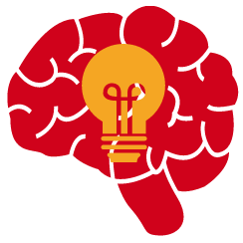
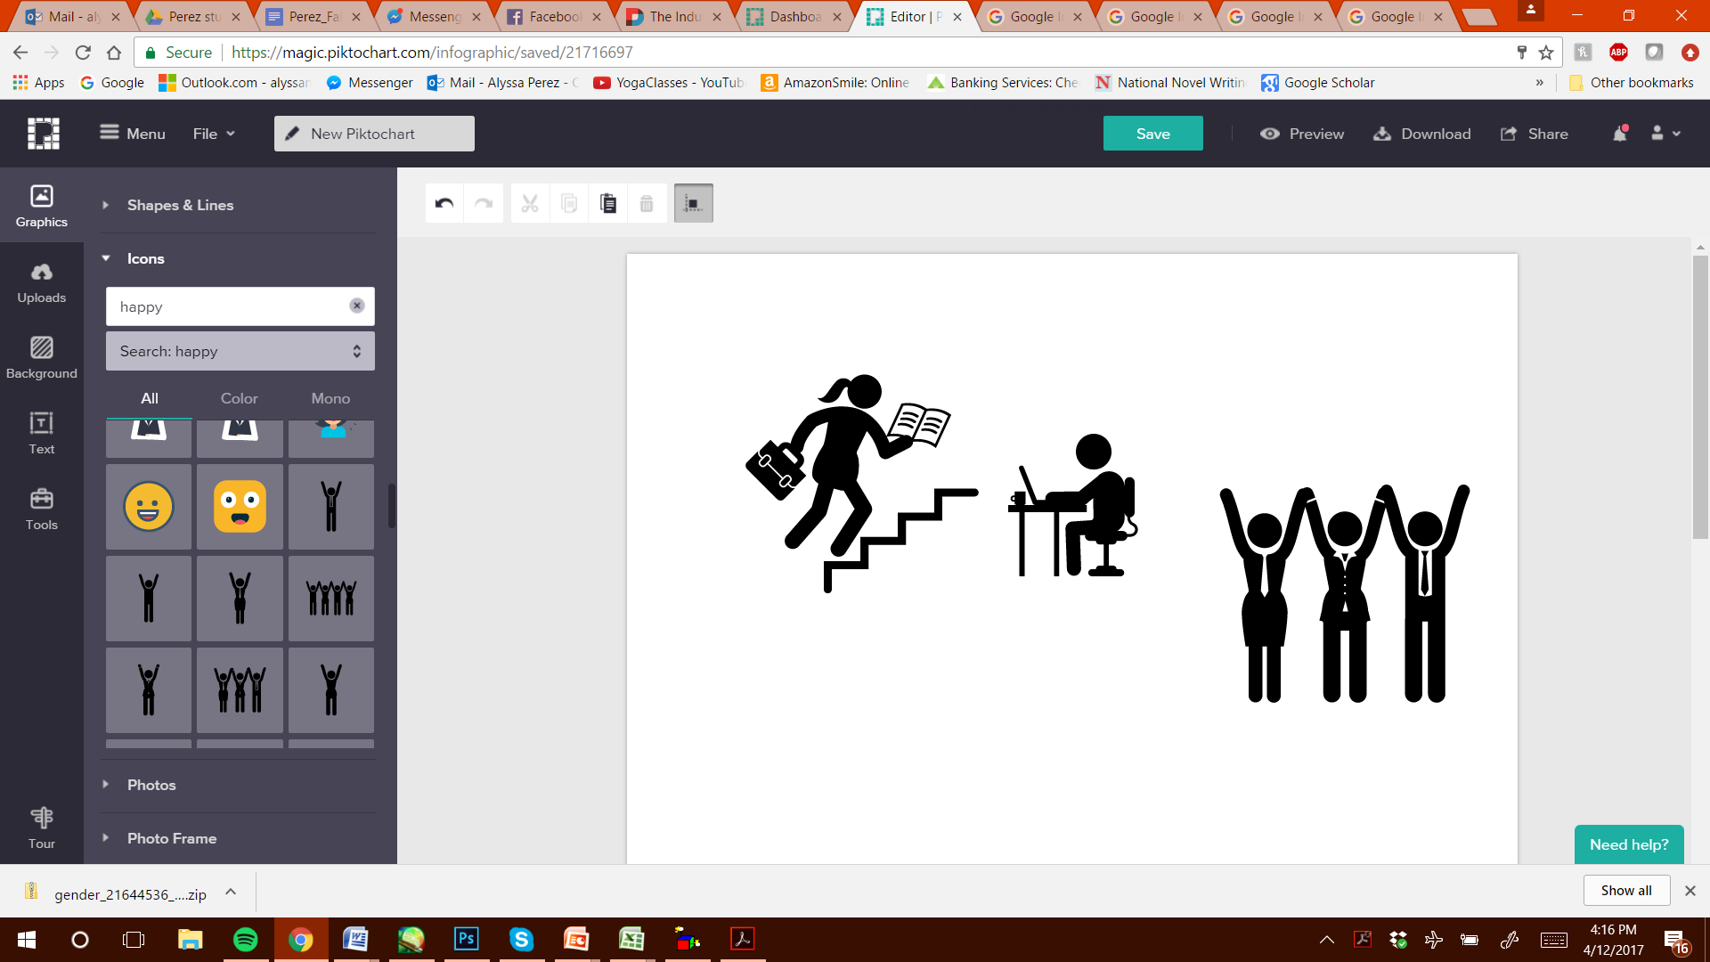
Engagement
DEDICATION: intense involvement, enthusiasm
VIGOR: high energy, resilience
ABSORPTION: concentration, engrossment
Notes:
They defined work engagement as a state of mind characterized by vigor, dedication and absorption
Vigor refers to high energy and mental resilience while working,
Dedication to being intensely involved in work tasks and experiencing an associated sense of significance, enthusiasm, and challenge, and
Absorption to a state of full concentration on work and positive engrossment in it.
Then, there is a measure of overall work engagement. These things are the important outcomes that organizations seek from promoting engagement.

Slide 45



Study Findings
Segmenting employees and matching programs based on the needs of each segment work better than unit-wide programs
Work Engagement
Dedication
Baseline
Vigor
Absorption
Time 1
Pre -Intervention
Time 2
Post -Intervention
Time 3
Follow-Up
Notes:
The meta-analysis revealed a small, positive, but reliable effect on work engagement. The engagement interventions work overall.
One important finding is that engagement programs should be designed based on needs and not as unit-wide programs.
Further, the study examined time’s effect on these interventions. [overall] work engagement and vigor demonstrated larger effects immediately post-intervention than at follow-up, and dedication and absorption demonstrating the opposite.
In other words, people are more engaged and energetic immediately after the interventions; however, at later times, the intervention increased employee involvement and concentration in their work.
[[Intervention type didn’t matter; but group interventions were better?]
Shreya, what does this tell our organizations as we invest in employee engagement?

Slide 46
Practical Implications
Support
Design programs to promote specific types of engagement
Allow employees to self-manage their engagement by selecting program that meets their needs.
MANAGE THE EMPLOYEE LIFE CYCLE
Hire
Manage
Develop
Notes:
Based on EE survey data, team decided no meetings Friday afternoons to allow for focused work.
[Alyssa] Thank you so much, Shreya. Before we reach the end of this Webinar, would you mind giving us an overview of the key takeaways form these important studies

Slide 47
Key Takeaways
1
2
3
4
5
Audit
Educate
Redesign
Measure and Analyze
Improve
How long has your organization been investing in work-life balance programs? How has this changed the gender distribution of your organization?
If you are using social media to screen candidates, evaluate the quality of candidates you’re not selecting.
Assess your organization’s norms around mWork. Determine the extent to which it is culturally acceptable to disconnect after work hours.
Review your successful and not so successful projects. Is there an observable difference in the types of leaders heading these projects?
What types of programs does your organization use to promote engagement? To what extent are the programs matched with the needs of each employee?

Slide 48
Suggested Reading
Perez, A., Grantham, C., Widlak, I, Sarkar-Barney, S. (Spring 2017). The Industrial-Organizational Psychologist. Closing the Scientist–Practitioner Gap:
Studies From 2016 With Significant Practical Utility. http://www.siop.org/tip/april17/gap.aspx#sthash.JQ2ikNgR.dpuf

Slide 49
Next HCG Webinar
Digitization of the Learning and Development Function
Thursday, June 15th, 2017
8am PT
Notes:
We have few minutes left to take Questions
All lines are unmuted now,
Feel free to speak your question or type in the chat box

Slide 50
For a free one hour consultation email us at info@humancapitalgrowth.com
Talent Management Excellence
Leadership Excellence
STRATEGY
AUDIT
DESIGN
ANALYTICS
EDUCATION
DEVELOP
ALIGN
ASSESS
Notes:
If you enjoyed this session you may be interested in some of our other services. If your company is interested in a free hour consultation about any of the topics discussed in today’s webinar, please email us at info@humancapitalgrowth.com.

Slide 51
Thank you!
Shreya Sarkar-Barney, Ph.D.
shreya@humancapitalgrowth.com
Alyssa Perez
alyssa_perez@humancapitalgrowth.com
Corey Grantham
corey_grantham@humancapitalgrowth.com
Notes:
We’re also available by email if you have any questions about any of the topics discussed today. Thank you again for joining, everyone. Enjoy the rest of your day.

