Slide 1


Deep Dive on the Talent Practices that Advance Inclusion
HCG WEBINAR
Wednesday, April 15th 2020
With Guest Panelists
Chinwe Abara, NetApp
David Ortiz, Oracle

Slide 2


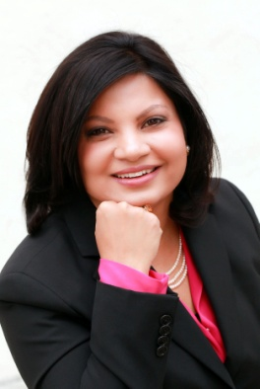

About the Speakers
Alyssa Perez
Dr. Shreya Sarkar-Barney
Research Analyst and Consultant
Founder and CEO

Slide 3


















We help organizations achieve better outcomes through talent using
science, analytics, and empathy.
Talent Management Excellence
Leadership Excellence
Drive business impact through timely talent actions
Deliver measurable and sustained improvements in leadership

Slide 4
Evidence-based Analyses
Webinars, Podcasts, Blogs, eBooks
Trending Practices
Systematic Reviews
Skills for the new world of HR
Design Thinking in HR
Digital Learning
Digital Leadership
Certifications for skill development
Leadership Development
Talent Analytics
Employee Selection
Performance Management
Employee Engagement
Talent Development
Executive Coaching

Slide 5
Certification Tracks in Strategic HR
Expertise for those who need to deliver speed to value
Comprehensive certification for strategic HR Professionals in client partnering roles
New!
Earn a Certification in Data Science for HR I (CDS-HRi)
Certified Talent Management Practitioner (CTMP)
Certified Talent Management Specialist
(CTMS)
Specializations for designers and implementer of talent management systems
Certified in Data Science for HR i
(CDS-HRi)
Certified in Workforce
Staffing
(CWS)
Certified in Workforce
Development
(CWD)
Certified in Workforce
Management
(CWM)
Certified in Organizational Effectiveness
(COE)
Focused certifications on specific talent management practices
Certified in
Talent Acquisition
(CTA)
Certified in Leadership
Development
(CLD)
Certified in Workforce
Analytics
(CWA)
Certified in Workforce
Planning
(CWP)
Certified in Change Management
(CCM)
Certified in Employee Engagement
(CEE)
Curriculum design and certification informed by our expert panel

Slide 6




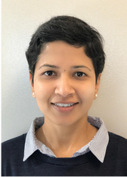
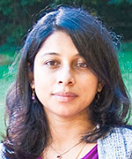




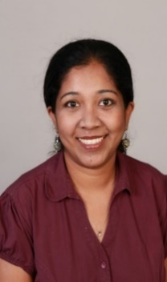
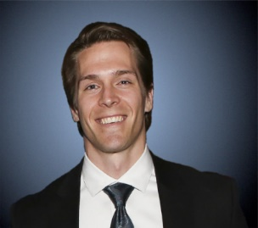


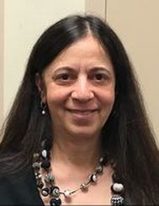
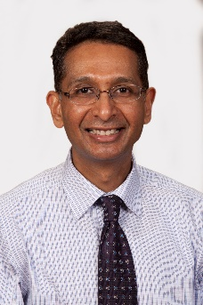






HCG Expert Panelists
Insights on needs and trending practices
Ramzi Baydoun, Ph.D.
​
Victoria A. Davis, Ph.D.
Fm
Liberty Munson, Ph.D.
Eric O’Rourke, Ph.D.
Neha Singla Ph.D.
Anu Ramesh, Ph.D.
Aarti Shyamsunder, Ph.D.
​
Psymantics Consulting &
Michael Tocci, Ph.D.
Frank Bosco, Ph.D.
metaBUS
Krista Uggerslev, Ph.D.
metaBUS
Comila Shahani-Denning, Ph.D.
Mahesh Subramony, Ph.D.

Slide 7




About the Guest Panelists
Chinwe Abara
David Ortiz
Global Diversity, Inclusion and Belonging Program Manager
D&I Strategist, Disability Inclusion Program Manager

Slide 8
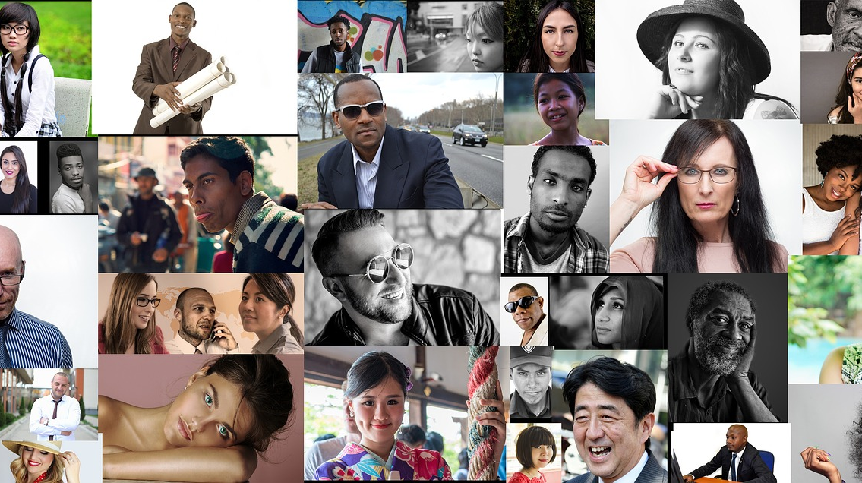
Integrated Talent Management
Practices that Move the Needle on Inclusion

Slide 9
Which of the following practices does your organization currently use to advance diversity and inclusion?
Number of respondents = 106
Source: Human Capital Growth 2020 Diversity and Inclusion survey
Notes:
https://www.thecut.com/2017/01/how-microaggression-training-could-harm-minority-students.html
https://journals.sagepub.com/doi/full/10.1177/1745691616659391
What to do incase of microagression
https://www.apa.org/monitor/2017/01/microaggressions
https://blogs.scientificamerican.com/observations/the-science-of-microaggressions-its-complicated/

Slide 10


Men and Women Rank Obstacles to Gender Diversity Differently
% of respondents who see obstacles in each category
x 1.7
x 1.8
x 1.8
x 2.1
27%
26%
18%
30%
18%
33%
20%
36%
21%
45%
RECRUITMENT
CULTURE
LEADERSHIP
RETENTION
ADVANCEMENT
Source: BCG Global Gender Diversity Survey 2017

Slide 11
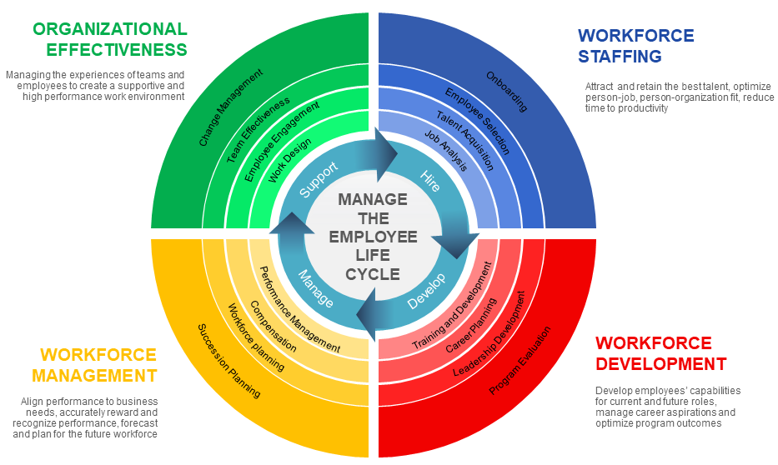
Model of Integrated Talent Management
Notes:
Too often, organizations take a siloed, disconnected approach, so taking an integrated view makes sense.
Organizations need to take a wholistic view of an employee’ experience and address the entire employee life cycle.
Generally piece meal – integration requires working across silos – connect to power and authority
Questions
How integrated are your TM system?
What and where are the bottlenecks?
Who are you hiring today?
How diverse is the candidate and hiring pool?

Slide 12
Inclusion Initiatives – What Works
Single initiatives are less effective than a comprehensive set of talent management initiatives targeting various touch points in the employee life cycle.
LOW IMPACT
HIGH IMPACT
One time training programs
Incentivizing senior leaders
Hiring highly visible role models
Grievance systems
Minority mentoring programs
Disconnected initiatives
Work-life programs (e.g. flex time, part-time, home, coaching)
Sponsorships (e.g. women, underrepresented groups)
Holistic employee development through talent management (e.g. experiences, coaching)
Making public commitments
Establishing anti-discrimination policies
Tracking progress through KPIs

Slide 13

Workforce Staffing
DIVERSITY CHALLENGE
How might we create a workforce that look less like the people who are doing the hiring and more like the people graduating or available in the workforce with the skills to join it?

Slide 14

Inclusive Hiring Practices
Job Design
Talent Acquisition
Design Jobs that appeal to both genders
Gender neutral job descriptions
Diverse candidate pools
Blind resume review
HIRE
Candidate Screening
Hiring Decision
Structured interviews
Skills and capabilities testing
Hiring decisions guided by data
Gender balanced hiring panel
Notes:
Select programs that reduce unconscious bias in evaluating candidates and employees
Alyssa:
Skills and capabilities testing
an informal process (streamlined) and three formalized processes (written-based, testing and professionalized). The use of a type of screening process depends on the constraints and resources of the firm and on the expected type of match. Finally, logit regressions show that personal and professional networks tend to penalize women and formal testing screening processes seem to
favour unemployed or inactive people, whereas the formalized screening processes are likely to penalize individuals without diplomas.

Slide 15

Workforce Development
DIVERSITY CHALLENGE
How might we overcome inherent human tendencies to be biased?
How might we create equitable opportunities for all employees to develop to their highest potential?

Slide 16
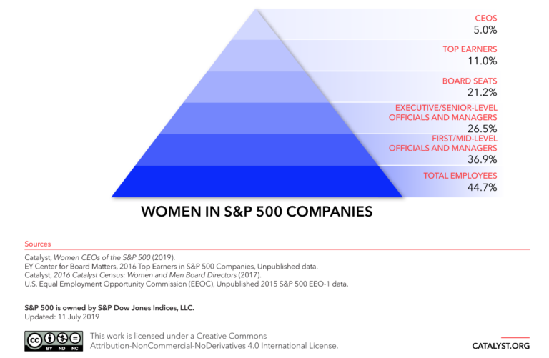
Retention and Advancement, the Biggest Challenge

Slide 17

Inclusive Learning and Development Practices
Job Training
Career Management
Habit breaking interventions
Perspective taking
Implicit bias training
Diversity training
Buddy System
Special projects
DEVELOP
Human Capital Development
Leadership Development
Special projects (opportunities)
Coaching
Mentoring
Reverse mentoring
Notes:
SSB:
Diversity training
(Bezrukova, 2016) The results revealed an overall effect size (Hedges g) of .38 with the largest effect being for reactions to training and cognitive learning; smaller effects were found for behavioral and attitudinal/affective learning. In a study covering 30K people (260 studies), The positive effects of diversity training were greater when training was complemented by other diversity initiatives, targeted to both awareness and skills development, and conducted over a significant period of time.
Habit breaking interventions
((Forcher, 2016) The habit-breaking intervention is based on the prejudice habit model (Devine, 1989), which proposes that enduring change in unintentional bias can be achieved by treating unintentional bias as an unwanted habit that can be broken through a combination of motivation, awareness, and effort.
every two days, we collected measures of: (1) implicit bias, (2) concern about discrimination, (3) discrepancies between participants’ standards for and beliefs about their interracial behavior, and (4) several potential mechanisms for the intervention’s effects: the quantity and content of race-related thoughts, race-related conversations, and cross-race interactions with Black people. Participants in the intervention condition were also asked whether and how they used the bias-reduction strategies learned during the intervention.
In the training section of the intervention, the participants were introduced to the idea that implicit bias can be overcome through a combination of motivation, awareness, and the use of bias-reduction strategies, and they are taught five such strategies. These strategies were identical to the strategies used by Devine and colleagues (2012), which included stereotype replacement (Monteith, 1993), counter-stereotypic imaging (Blair, Ma, & Lenton, 2001), individuating (Brewer, 1988; Fiske & Neuberg, 1990), perspective taking (Galinsky & Moskowitz, 2000), and increasing opportunities for contact (Pettigrew, 1998; Pettigrew & Tropp, 2006).

Slide 18

Business and Employee Resources Groups
Voluntary employee led groups that share common interests that are aligned with business objectives and advance key diversity business drivers
  Executive Sponsor
  Operates via a Charter
Top Types of ERG/BRGs
  Women
  People of African Descent
  Hispanics
  Veterans
  LGBTQ
  People with Disabilities
  Young Professionals

Slide 19
Business and Employee Resources Groups
Strengthens Recruitment, Retention,& Advancement
Marketing &
Branding
Expands and enriches business customer base
Increases Employee Engagement & Training
Increases Drives Individual and Organization Performance
2018 I4cP Research
Impact: BRGs/ERGs in high performing organizations
  3X likelier to be reviewed or assessed for their effectiveness as a leadership development platform
  5X likelier to provide specialized training for their leadership to enable them to strategically impact business results
  Development opportunity for executive sponsors
  Builds external reputation
  Inclusion on interesting and challenging projects
  Positive impact on succession decision
BUSINESS IMPACT

Slide 20

Workforce Management
DIVERSITY CHALLENGE
How might we model, inspire, and reward the right behaviours that promote inclusion?
How might we create succession plans to build a diverse pipeline?

Slide 21

Inclusive Employee Management Practices
Performance Management
Compensation & Benefits
Men and women use the rating scale differently in self evaluations
Pay policies
Egg freezing
Self-care programs
After-school programs
MANAGE
Succession Planning
Workforce planning
Talent reviews
Sponsorship
Integrated development and talent planning
Notes:
AP:
Performance Management
For example, Pazy and Oron (2001) studied a male- dominated
military organization and found that female officers' performance evaluations were affected by the gender proportions
within their units. Women's evaluations were lower than men's in units with few female officers; women's evaluations were higher
than men's in units where female officers constituted a higher proportion.
Same with Race

Slide 22

Organizational Effectiveness
DIVERSITY CHALLENGE
How might we create the right organizational environment where diverse talent can thrive?

Slide 23

Inclusive Employee Management Practices
Culture & Change
Engagement
Culture fostering cooperation vs. competition
Engaging allies including men, in diversity programs
SUPPORT
Work Design
Team Effectiveness
Work-life programs
Flexible work schedules
Demographic vs. cognitive diversity
Notes:
SSB:
Culture & Work-life programs
Culture
Across 654 store units of a large U.S. retail organization, we observed
main effects of subordinate and managerial diversity climates on unit
sales percentage change and a significant subordinate × manager diversity
climate perspective interaction. The greatest sales growth was found
in stores wherein subordinates and management perceived highly prodiversity
climates (positive consistency). In contrast, the lowest sales
growth was evident for stores in which both subordinates and managers
reported less hospitable diversity climates (negative consistency).
Our findings underscore the positive financial ramifications of highly
consistent perceptions that diversity is valued in a work context.

Slide 24
Work-Life Programs
Work–life practices had a positive effect on the proportion of women in management, but only after an eight-year lag.
Positive effect not observed only in organizations that were highly male-dominated.
Leave arrangements and access to services (e.g., childcare or eldercare) had the strongest associations with women in management.
Source: Kalysh, K., Kulik, C. T., & Perera, S. (2016). Help or hindrance? Work–life practices and women in management. The Leadership Quarterly, 27(3), 504-518. http://dx.doi.org/10.1016/j.leaqua.2015.12.009
Notes:
Work–life practices are frequently suggested as a strategy for improving women's representation
in management.We predicted that work–life practices would increase the proportion of women
inmanagement, but their impactwould bemost evidentwhen theworkforce gender composition
makes gender stereotypes less salient. Hierarchical multiple regression was used to analyze the
relationship betweenwork–life practices in 2002–2006 and the proportion ofwomen inmanagement
in 2010, 2012, and 2014. Overall, work–life practices had a positive effect on the proportion
of women inmanagement, but only after an eight-year lag. However, this positive effect was not
observed in organizations that were highly male-dominated. Leave arrangements and direct
provision of services (e.g., childcare or eldercare) had the strongest associations with women in
management. Our findings demonstrate the value of work–life practices in improving women's
representation in management, but the effect is not immediate and does not operate across all organizational
contexts.

Slide 25
Summary
Experiences
Opportunities
Notes:
Are we creating the right experiences were talent from all backgrounds feel accepted, included, and valued?
Are we providing opportunities that allows each person to rise to their highest potential?

Slide 26
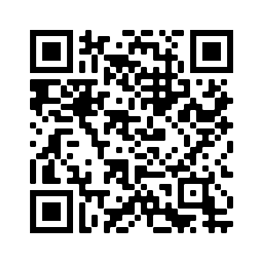
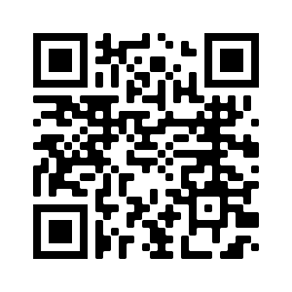
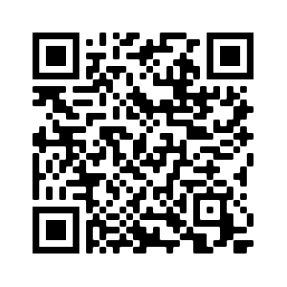
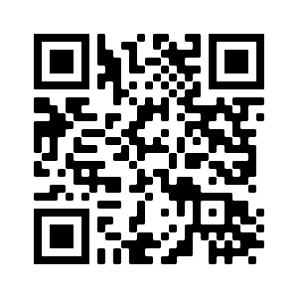
Our Thought Leadership on Evidence-based HR
WEBINARS
BLOGS
PODCASTS
eBOOKS
Exponential Talent

Slide 27
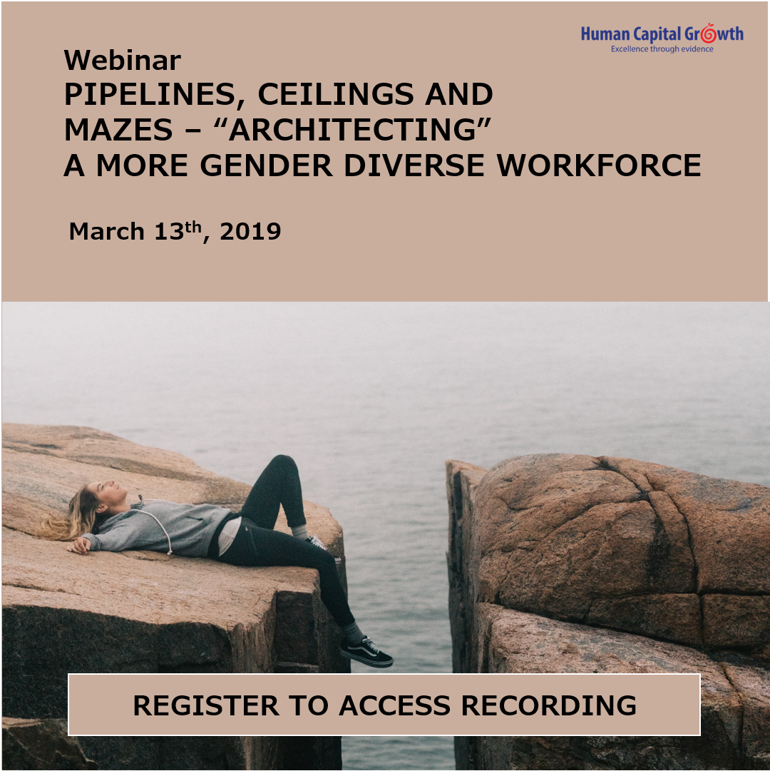
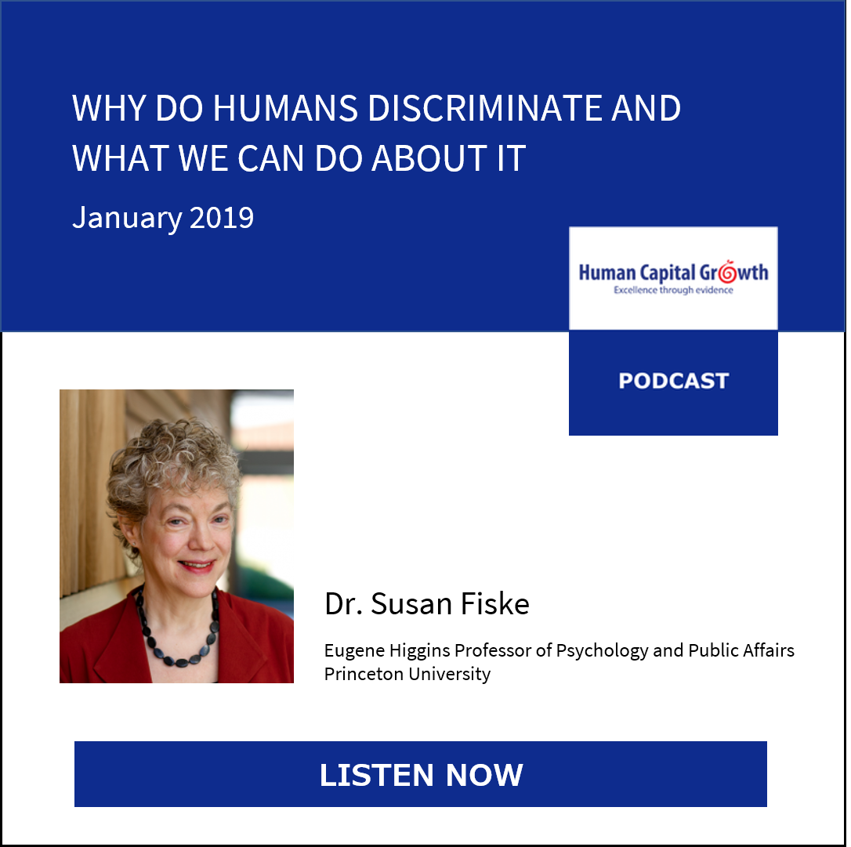
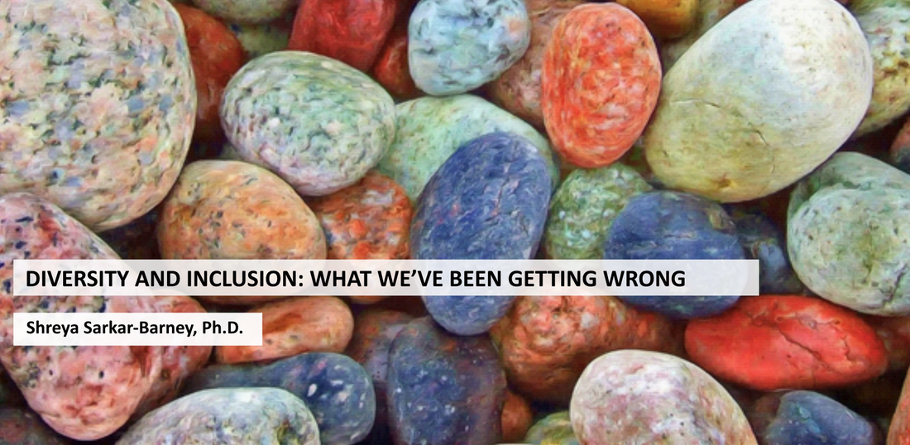
You May Also Be interested in These Resources
With Dr. Aarti Shyamsunder
Webinar
Podcast
Blog

Slide 28

Stay Connected
HCG Talent Updates
SIGN-UP
THANK YOU!
Evidence-based insights on trending topics in talent management
WEBINARS, PODCASTS, BLOGS, EBOOKS
FOLLOW US
www.linkedin.com/company/human-capital-growth
@hcgtm
insights@humancapitalgrowth.com

