Slide 1
HCG WEBINAR
Build an Internal Gig Economy to Energize and Retain Talent
With Edie Goldberg, Ph.D. and Kelley Steven-Waiss

Slide 2
We help organizations achieve better outcomes through talent using
science, analytics, and empathy.
Talent Management Excellence
Leadership Excellence
Drive business impact through timely talent actions
Deliver measurable and sustained improvements in leadership

Slide 3
Evidence-based Analyses Webinars, Podcasts, Blogs, eBooks
Systematic reviews
Trending Practices
Performance Management
Employee Engagement
Talent Development
Executive Coaching
Skills for the new world of HR
Design Thinking in HR
Digital Learning
Digital Leadership
Certifications for skill development
Leadership Development
Talent Analytics
Employee Selection

Slide 4
ANNOUNCEMENT
HCG Webinar
Resilience, the Key to an Engaged Workforce
Presenter
LINDA HOOPES
Organizational Psychologist and Expert on Resilience
January 29th, 2020 | 9AM PT

Slide 5
ANNOUNCEMENT
HCG Workshop
Data Science in HR Series: Thinking in Numbers
Expert Faculty: Alyssa Perez, and Shreya Sarkar-Barney, Ph.D.
Data introduction: The Language of Numbers
Data distributions: Speaking numbers
Data relationships: Numbers in action
Data visualization: Seeing numbers
February 2020
12th, 14th, 19th, 21st
9AM -11am PT

Slide 6
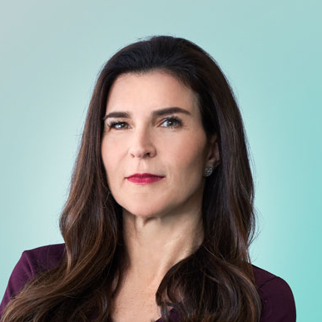
About the speakers
EDIE GOLDBERG, PH.D.
Edie Goldberg, Ph.D. is the President of E.L. Goldberg & Associates in Menlo Park, California. She has specialized in talent management and organizational effectiveness for more than 30 years. Her practice is focused on HR strategy and designing HR processes and programs to attract, engage, develop and retain employees.
KELLEY STEVEN-WAISS
Kelley Steven-Waiss is Chief Human Resources Officer at HERE Technologies, and founder of Hitch overseeing the company’s human resource management and talent strategy. Kelley has more than 25 years of executive management experience in human resources, change management, and corporate communications.

Slide 7
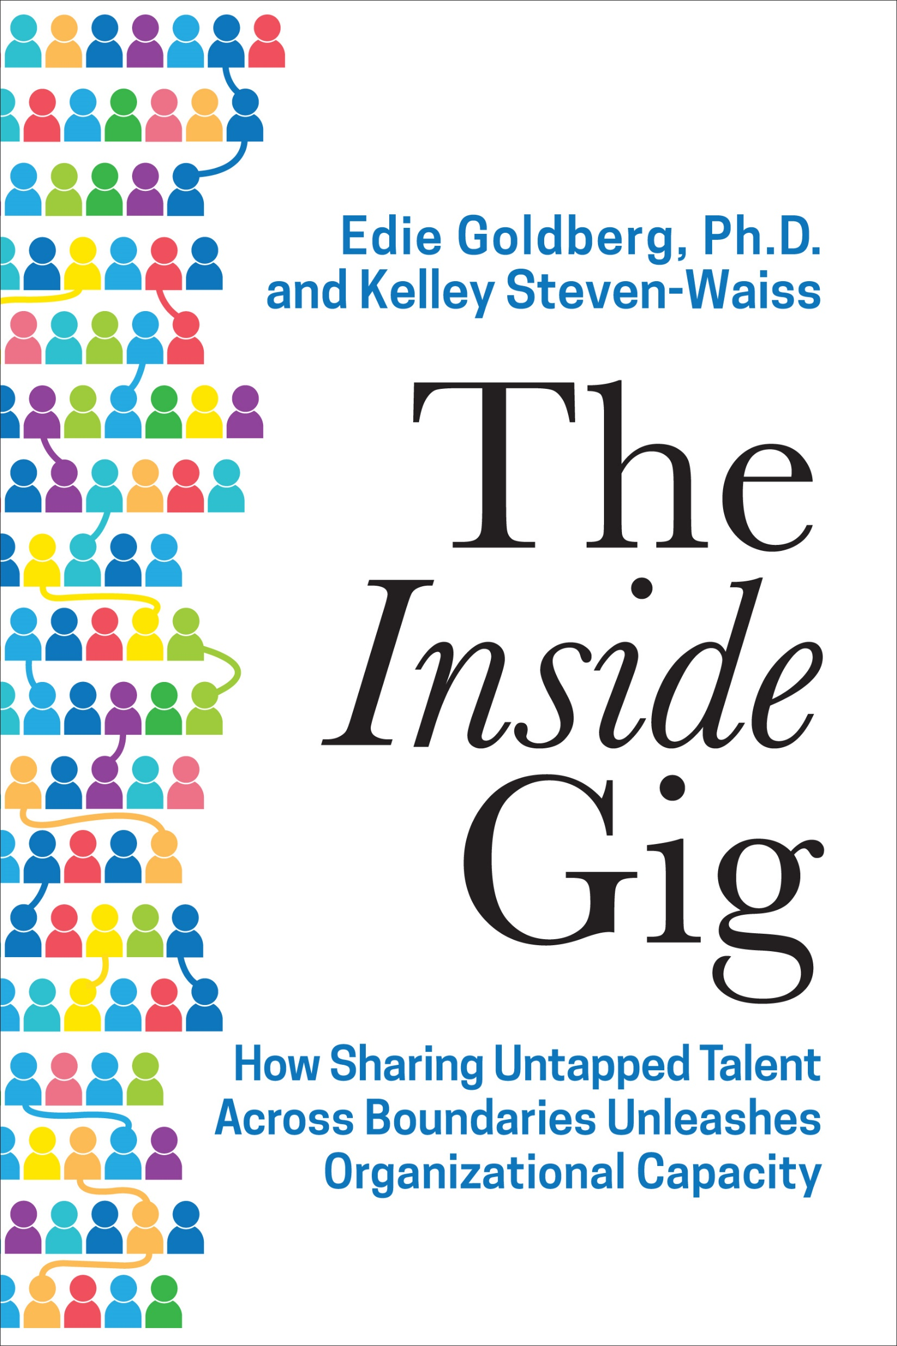
The Inside Gig
The
Inside
Gig
Edie L. Goldberg & Kelley Steven-Waiss
Human Capital Growth Webinar
12/04/2019

Slide 8
The world of work is changing

Slide 9
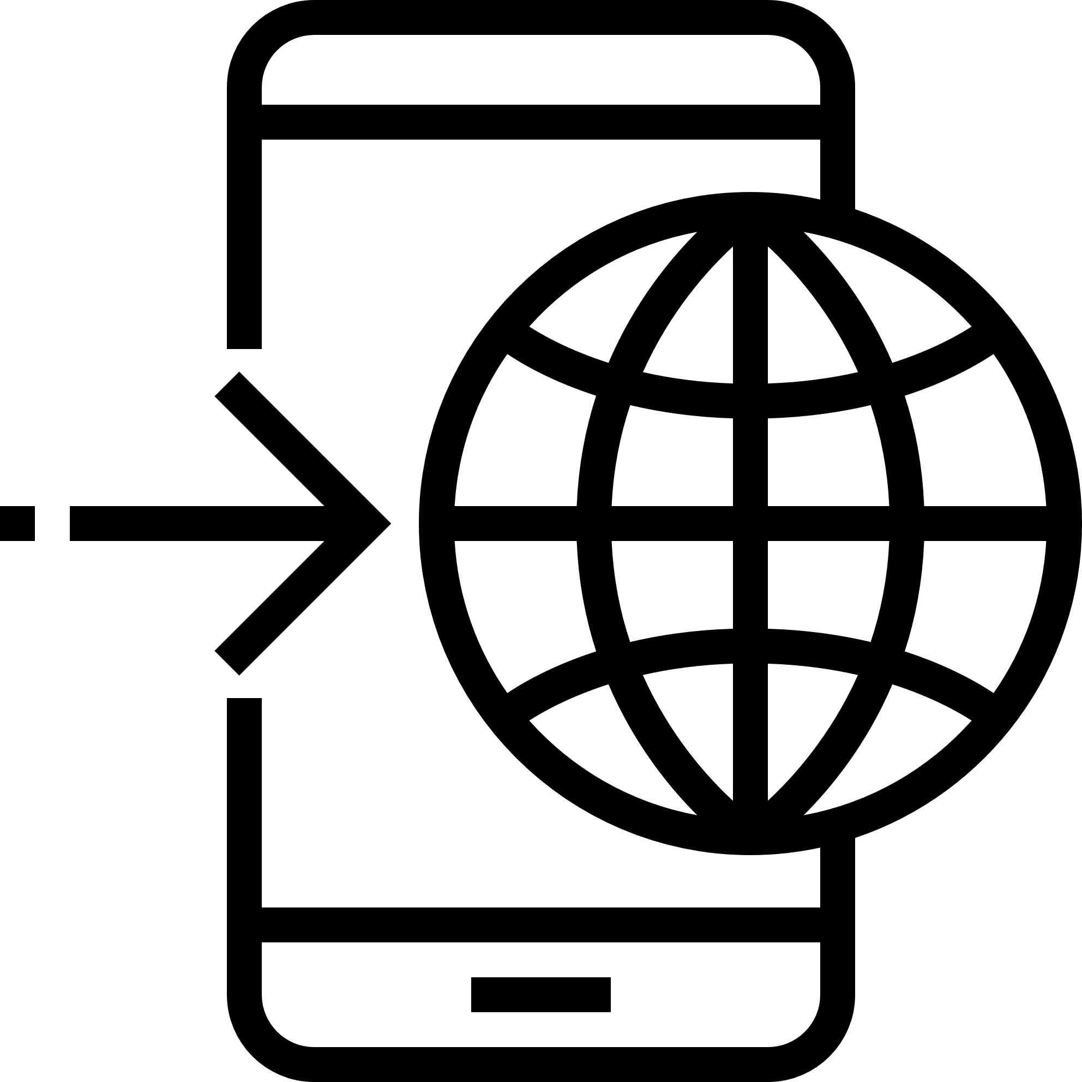
The world of work is changing
Economic Game Changers
Population
New Work Ecosystem
Cloud Technology
A TRULY CONNECTED WORLD
Democratization of work
Work force
EXPONENTIAL PATTERNS OF TECHNOLOGY CHANGE
Artificial Intelligence
Baby Boomers
Technological empowerment
Generations
Millennials
High Speed Mobile Internet
Gen X
Fertility
All inclusive global talent market
Big Data Analytics
Notes:
Yes, the world of work is changing, but that is because the world is constantly changing.
Our global population is more diverse than it has ever been. This shift in demographics is seen in our workforces. Previous minority segments of our populations will soon become a majority – particularly here in California.
Most notably we see a shift in a workforce that is simultaneously growing older (because Baby Boomers are not retiring), and younger, with the rise of the Millennial generation. Millennials currently make up over half of the workforce and they bring high expectations for a rewarding, purposeful work experience. They demand constant learning and development opportunities, and rapid career progression.
Would it surprise you to know, our workforce population is headed for a crisis as global fertility trends show a significant decrease in the world’s population?
[pause, click] New technologies are creating economic game changers as we engage in new economies and have tools to help us work in ways that were never before possible. High Speed Mobile Internet, Big Data Analytics, Artificial Intelligence, and cloud computing all enable significant changes to the way we work.
And we have this new work ecosystem that democratizes work and puts more control in the hands of the individual because they have the technology that let’s them work on their own terms. Finally while being a global business used to mean you were selling your products globally, now being global may mean you source components from global providers, or you have talent distributed globally. Today, most large companies are global in some manner.

Slide 10
Productivity, Engagement & Unemployment
Productivity growth is slowing
Employee engagement has never been lower
Unemployment is at a 50-year low
13%
5.0
of empolyees are engaged
12%
10.0%
4.0
10%
3.0
8%
Percente per year
6%
4.6%
2.0
4%
1.0
2%
4.5%
0.0
are not engaged
0.0
1991
2001
2011
63%
2007
2010
2013
2016
Non-Farm Labor Productivity Growth
(8-quarter average)
Employee Engagement is at an All-Time Low
(8-quarter average)
U.S. Umemployment Rate Decreases Further
(The U.S. unemployment rates in the period 2007 to 2017)

Slide 11
History of the Workplace
1920
1960
1990
Today

Slide 12
History of the Workplace
1920
1960
1990
Today

Slide 13
The rules around work are changing
Purpose driven
Profit driven
Hierarchical
Diverse workforces
siloed
Process based
People as workers
Significant contingent workforce
Homogenous Workforce
Human-machine co-work
Networks of collaborative teams
Significant permanent workforce
Frictionless, smart workspaces
Traditional office
Command & control
agile
Innovation department
People drive technology
Innovation by everyone
Slow to adapt
Knowledge
Project based
Inclusive digital leadership
Technology drives people

Slide 14
The rules around work are changing
Purpose driven
Profit driven
Hierarchical
Diverse workforces
siloed
Process based
People as workers
Significant contingent workforce
Homogenous Workforce
Human-machine co-work
Networks of collaborative teams
Significant permanent workforce
Frictionless, smart workspaces
Traditional office
Command & control
agile
Innovation department
People drive technology
Innovation by everyone
Slow to adapt
Knowledge
Project based
Inclusive digital leadership
Technology drives people

Slide 15
The Desire to continuously Learn and Grow
5 years
8 of 10
93%
1 of 3
42%
Half-Life of Skills
Managers View Learning as Important
Would Stay Longer
Agree Using Skills Well
Likely to Leave if Not Learning
Notes:
Before we discuss the employee’s desire to learn and grow, let’s consider this need to be always developing from your company’s perspective:
Have you heard that they ½ life of skills is now only 5 years?
What this means is that in 5 years, ½ of everything a new college graduate learned in school will be obsolete. It is now a business imperative that employees continuously learn because their skills quickly become out-of-date and they need new skills.
According to a Deloitte Study More than eight out of ten global managers view learning as important or a very important issue for organizations. However, companies are realizing that they cannot keep up with the demand for personalized, dynamic, continuous learning opportunities. As a result they are shifting to self-directed practices that enable people to develop themselves (e.g., on-the-job learning opportunities, access to MOOCs or other on-line content that has been curated for their experience, etc.)
LinkedIn’s 2018 Workforce Learning Report indicated 93% of employees would stay at a company longer if it invested in their career.
Glassdoor data reveal that only 1/3 of Millennials believe their organization is using their skills well, and 42% say they are likely to leave because they are not learning enough.

Slide 16
A new Leadership Model
The Industrial Corporation
Hierarchical
Leadership
Collaborative
Management
A Network of Teams
The Trusted Enterprise
Operational Efficiency
Profit, Growth, Financial Engineering
Customer Service,
Employees as Leaders
Mission, Purpose, Sustainability
Citizenship, Trust, Growth, Learning
Industrial Age
People as Workers
Management by Objective
Servant Leadership
Work Together
Empower the Team
Productivity, Wellness, Responsibility
Andrew Carnegie
Henry Ford
Jack Welch
Peter Drucker
Howard Shultz
Steve Jobs
Netflix, Google, Facebook, Amazon
Unilever, Allbirds, Levi’s,
Patagonia, Whole Foods
The Corporation is King
The Executives are King
The People are King
The Teams and Team Leaders are King
The Individual, Community, and Team
<1950s
1960s-80s
1990s
Today
2020
Source: Josh Bersin, Bersin Academy Webinar 2019

Slide 17
Being agile is a shift in the mental model of what an organization is and how it operates
Leadership shows direction and enables action
Top-down hierarchy
Bureaucracy
Boxes and lines less important, with more focus on action
Detailed instruction
Quick changes, flexible resources
Teams built around end-to-end accountability
Silos
Notes:
Transition from previous slide: Building and preparing today for the future tomorrow, and ways of working in the HR operating model. That helps make some link to Talent Platform (as an example of this) and the Jolie session
Talent does not go top down and does not sit linear in verticals
Talent is all over the organization
We need to bring the right talent to the right jobs
Solution oriented teams
Think scrum-teams – HERE alone could create 1000 problem solving scrum teams (team of 6 x 1000)
As part of operating model and being fit for growth, one way to get there is to work in agile teams. We are hearing and seeing this more and more in the external market. This is an opportunity for the HR team to be thought leaders.

Slide 18
The value of Employee Experience
Cultural
Transparency Responsiveness
Emotional
Flexible Purpose-Driven
Make the
workplace an Experience
Technological
Smart Technology
Collaborative Tools
Intellectual
Learning Career Development
Physical
Space Community

Slide 19
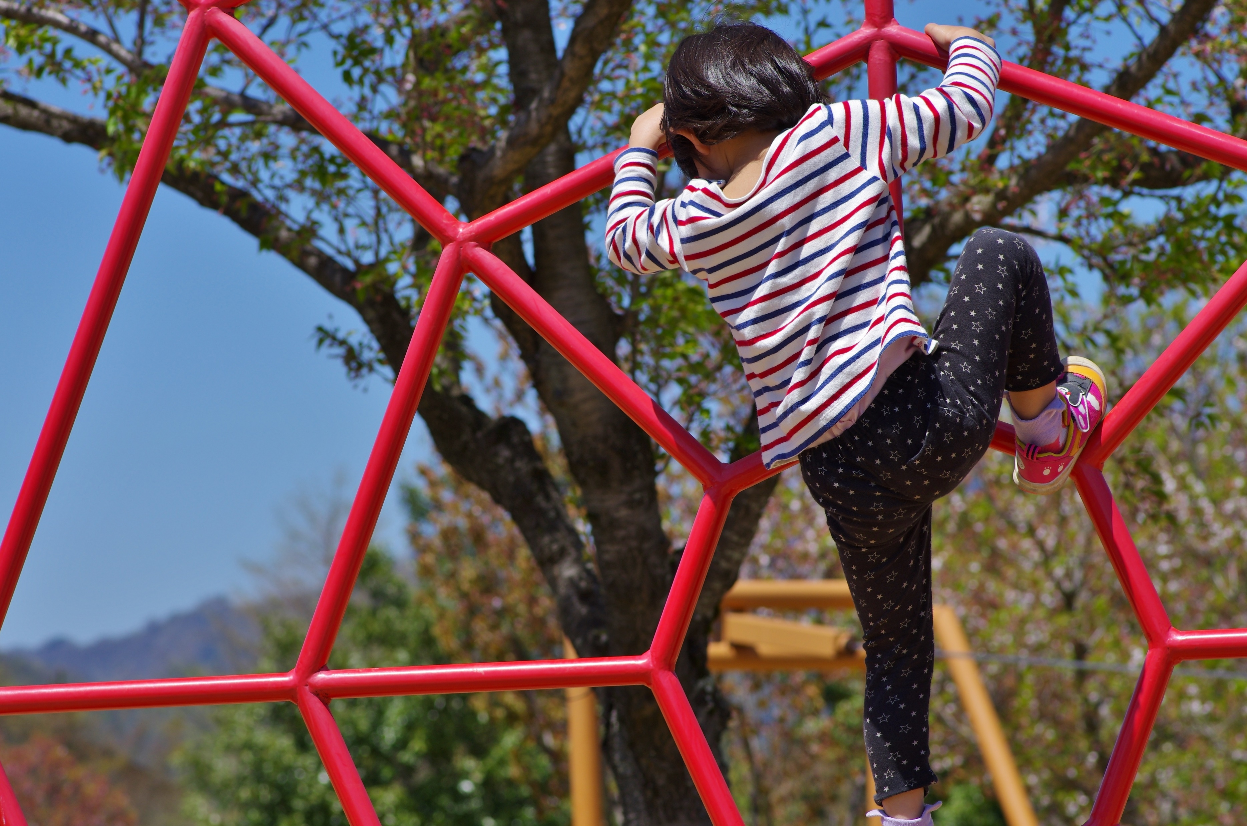
Careers are changing

Slide 20
Great Companies
“
…
…don’t have skilled people and motivate them; they have motivated people and inspire them.
- Simon Sinek

Slide 21
The Rise of the new Talent Operating Model

Slide 22
Breaking down the traditional operating model
STRATEGY & VALUES
OPERATING MODEL
EXECUTION
Structure
Accountabilities
Governance
Ways of Working
People
Processes
Technology
HR leads these workstreams for the company
Capabilities

Slide 23
Breaking down the traditional operating model
STRATEGY & VALUES
OPERATING MODEL
EXECUTION
Structure
Accountabilities
Governance
Ways of Working
People
Processes
Technology
HR leads these workstreams for the company
Capabilities

Slide 24
The New Talent Operating Model
Growth mindset culture
Team-based rewards
Gamified recognition
Skills-based pay
Project-based work
Talent-sharing
Self-directed, micro-learning
Skill Communities
Targeted Mentorship
Portfolio Careers

Slide 25
The Six Principles of The Inside Gig

Slide 26
You Get What You Give
01

Slide 27
Know What You Have
02

Slide 28
Create a Learning Organization
03

Slide 29
Democratize the Work
04

Slide 30
Create an Agile Organization
05

Slide 31
Bust the Functional Silos
06

Slide 32
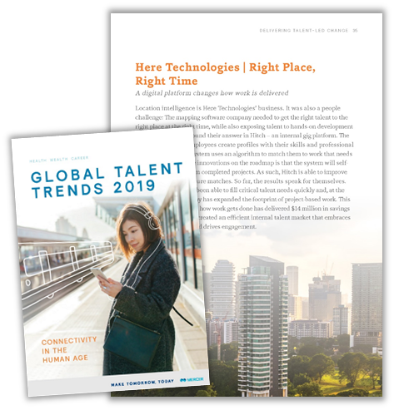
Inside Gig in practice
Case Study: HERE Technologies
Creating an Inside Gig to Optimize Your Talent Supply Chain

Slide 33
Technology to Enable Talent Mobility
33

Slide 34
HOW HITCH WORKS
34

Slide 35
Proven Business Impact – Over the first year
Productivity / Savings
FTE worth of capacity
111 FTE
The Business Problem
HERE was looking match project needs with the right talent to do the work at the right time. Agility, speed, and managing costs limited outsourcing, contracting, and hiring options.
Completed
The Solution
Develop an “internal gig” platform. Employees would create profiles providing skills, experience, and interests. Managers would post projects and requirements. Using AI, the platform quickly recommends the right talent for a posted project, reducing time and uncertainty in securing resources.
Engagement
HERE Promoter Score Increased
9%
About HERE:
Tech Company with +$1Bn Revenue
Global Market Leader in Location
Data and Technology with over 30
years of experience
9,300 employees in 56 countries

Slide 36
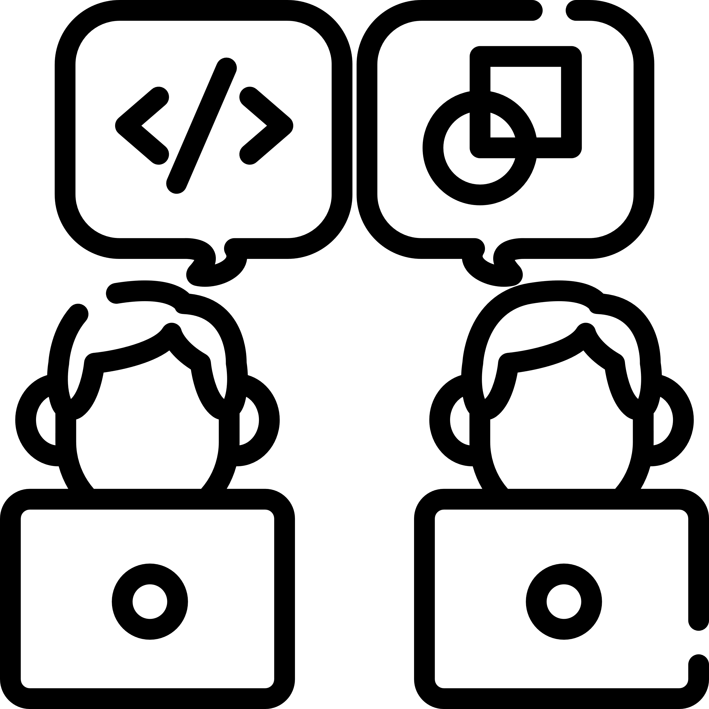
How to get started
01
Build your Business Case
02
03
04
05
Assess Org Readiness
Create a Change Mgt Plan
Enable the Process
Define Ways of Working
09
08
07
06
Deploy to the Enterprise and Evolve
Collect Feedback & Adjust Change Plan
Pilot
Align HR Systems

Slide 37
Big Journeys begin with Small Steps
What steps will you take to unleash the capacity of your organization?
EDIE GOLDBERG, PH.D.
edie@elgoldberg.com
www.elgoldberg.com
650-854-0854
Kelley Steven-Waiss
kelley@hitch.works
www.hitch.works
415-596-5553
Notes:
The world of work is changing, and the way work gets done has changed as well. Employees want diversity and choice in work. They want to continuously learn and grow as a professional.
“What small steps can you take now to create an internal gig platform to share talent across organizational boundaries and unleash the capacity of your organization?”
Extra: The time for action is now. How will you build a work environment that is more agile, and increases employee engagement by creating opportunities for continuous learning while doing high-value work?

Slide 38
Thank You! Upcoming Events JANUARY: Webinar on Resilience FEBRUARY: Workshop series on Data Science for HR
HCG Talent Updates
SIGN-UP
Evidence-based insights on trending topics in talent management
WEBINARS, PODCASTS, BLOGS, EBOOKS
insights@humancapitalgrowth.com
Follow us
www.linkedin.com/company/human-capital-growth
@hcgtm

