Slide 1



Better performance, less management
The Gap Inc. Story
Webinar
September 27th, 2017

Slide 2
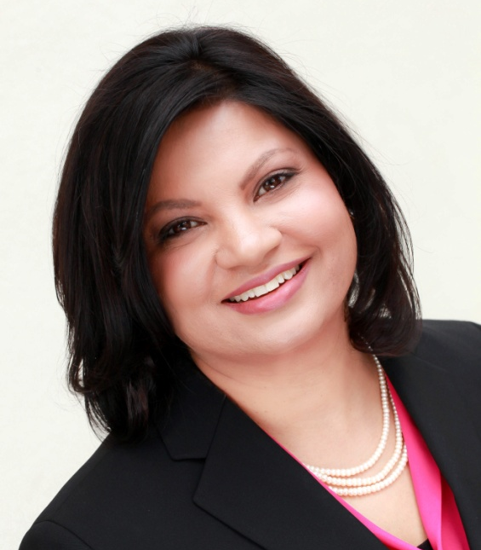
Host
Dr. Shreya Sarkar-Barney
CEO & Founder
Human Capital Growth

Slide 3


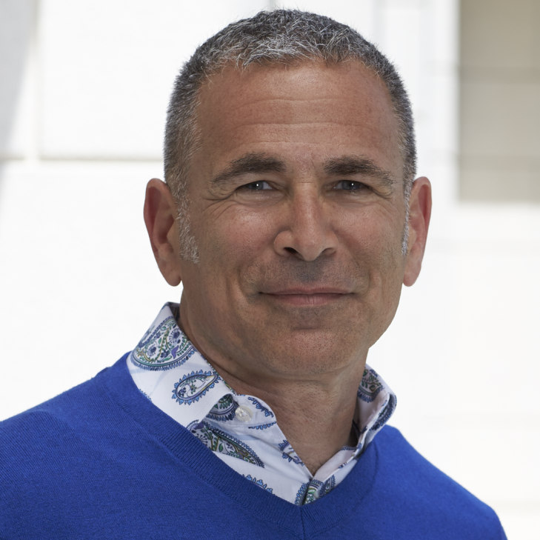

Presenters
Anika Briner
Rob Ollander-Krane
Talent Planning and Performance

Slide 4













We help organizations achieve better outcomes through talent using
science, analytics, and empathy.
Leadership
Excellence
Talent Management
Excellence
US
India
Evidence-based solutions for measurable and sustained improvements in leadership
Drive business impact through timely talent actions
Notes:
For those of you who are new to our webinars, HCG provides services in two key areas (a) Leadership assessment and development and (b) Talent management. Our work is grounded in science, made relevant using empathy, and results driven through the use of analytics. You can see some of the clients we have worked with.

Slide 5
Which of the Following Best Describes your Company’s Performance Management Process?

Slide 6
Which of The Following is True About Your Company’s Performance Management Process?

Slide 7
Common Concerns

Slide 8
Topics of Greatest Interest

Slide 9

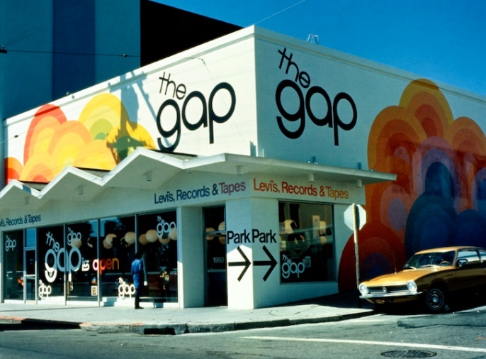










Slide 10

The big headlines
Review
Ratings

Slide 11
Why we did it
  Business performance was erratic
  Process was complex, time consuming and expensive
  Employees disliked the process
  Company going global
  Thought leaders were saying… change

Slide 12
How we did it?
Analysis
Conducted research
Benchmarked
Asked leaders
Design
Assembled a team
Developed a process and brand
Created a flexible change plan
Implement
Communicated
Launched
Built Capability
Continuous Improvement
Measured
Refined

Slide 13
  What the research told us
  There is a gap between what science knows and what business does
Daniel Pink — Drive
Traditional performance management drives productivity but squelches creativity and innovation
Samuel Culbert — Get Rid of the Performance Review
Reviews, ratings and forced distribution curves are demotivating
Frequent informal performance conversations are key to driving performance
Dr. David Rock — Coaching with the Brain in Mind
Neuroscience points to the need to rethink how we give feedback to minimize threat and unlock creativity
Dr. Carol Dweck — Mindset
A Growth Mindset drives performance – intelligence can be developed
Embrace challenges, persist in the face of setbacks, see effort as the path to mastery, learn from feedback, find inspiration in others’ success

Slide 14
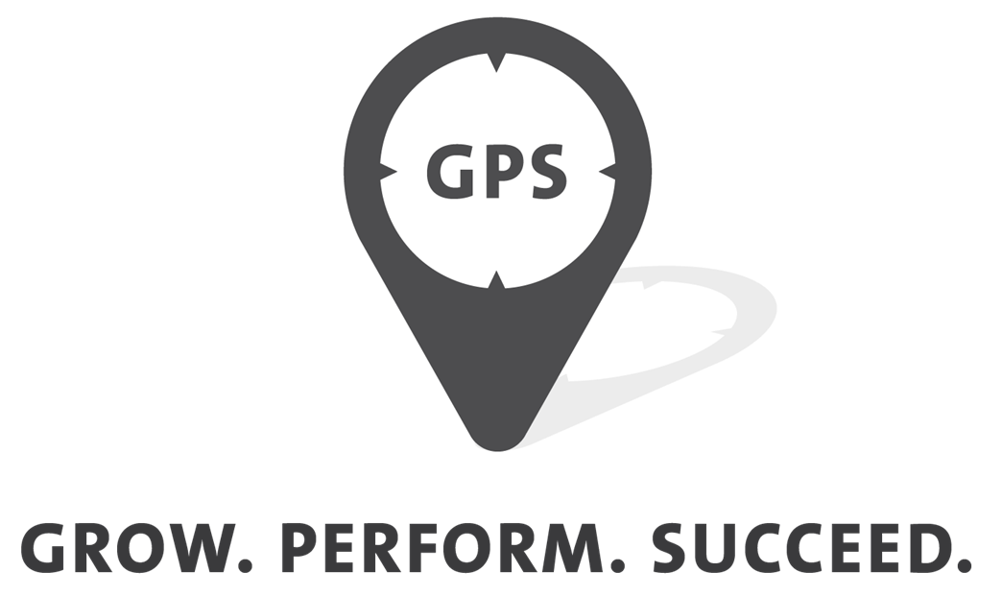
Gap Inc.’s approach to performance management…
More of the performance, less of the management

Slide 15
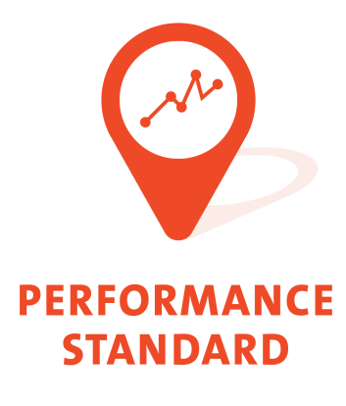

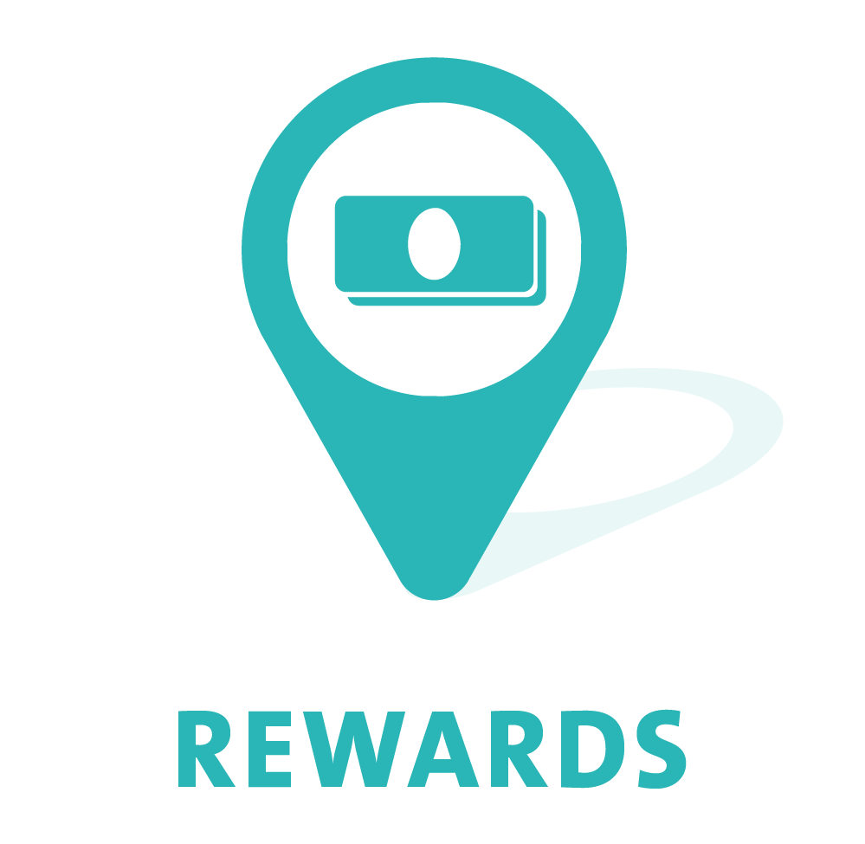
Growth Mindset
(Intelligence can be developed)

Slide 16
Ratings

Slide 17


We set tough objectives and work hard to exceed our goals. We do what it takes to win in the marketplace with integrity. We live the values of our company. If we fall short of hitting our goals, we quickly learn from our experience and strive to win. Managers inspire and drive performance of their teams through regular coaching and feedback.

Slide 18


No more than 8 goals
Use SMART
Create outcomes… not lists of tasks
Have a stretch component
Determine appropriate timeframe
Documented
Dynamic

Slide 19
Review

Slide 20


Regular cadence of discussion
Includes goals, performance against the standard, key relationship effectiveness, development plans
Doesn’t wait until the end of the journey

Slide 21


Separate process from performance
Based on goal achievement and performance against the standard
Not tied to ratings
New concept: pre-calibration

Slide 22


Grounded in Growth Mindset
Built Goal Setting and Feedback Skills
Increased Rewards Understanding

Slide 23
Frequency:
90% of surveyed employees are having monthly TBs
Quality
Want more feedback 4.1
See better performance 4.2
Are learning 4.2

Slide 24
More of the performance, less of the management

Slide 25
Questions?
Next HCG Webinar
Leadership Development
Wednesday, November 15th, 2017
8am PT

Slide 26
Talent Development Benchmark Study
Existing benchmarks are indicative of trending practices but fail to answer “what works?”. Study explore the use of practices that are informed by science.
This survey explores
Learning and development practices
Career management practices
Leadership development practices
REGISTER
If the link is inactive visit this URL https://www.humancapitalgrowth.com/benchmark.html
Notes:
https://www.humancapitalgrowth.com/benchmark.html

Slide 27

Additional Resources
HCG Webinars
  Take Your Performance Management from Hate to Love
  Boost your HR Practices with Design Thinking
  New approach to People Analytics
  Click on the icons to access the webinars.

Slide 28
What We Do
Talent Management Excellence
Leadership Excellence
STRATEGY
AUDIT
DESIGN
ANALYTICS
EDUCATION
DEVELOP
ALIGN
ASSESS
Notes:
Human Capital Growth is excited to share that we now offer a full portfolio of solutions for optimizing your Talent Management function. If you’d like more information, Please reach out to us. We will share our contact information at the end of this session.

Slide 29





Thank You!
For more information contact
Shreya Sarkar-Barney, Ph.D.
https://www.linkedin.com/in/sarkarbarney/
Follow us
@sarkarbarney
www.linkedin.com/company/human-capital-growth
@hcgtm
info@humancapitalgrowth.com
707.317. 7644
www.Humancapitalgrowth.com
shreya@humanpitalgrowth.com

